Slide 1


Smokefree Hospitals – Challenges and Solutions
27th June, 2013

Slide 2

Smokefree South West
Collaboratively funded Tobacco Control Office for South West England
Also provides expertise, consultancy & resources in other areas
Evidence based interventions & innovative programmes
Social marketing & behaviour change campaigns

Slide 3


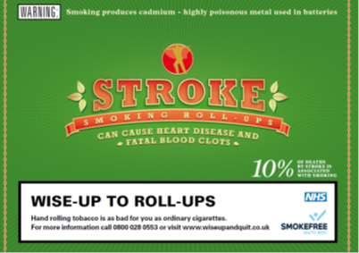
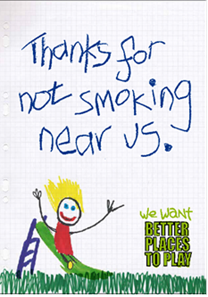




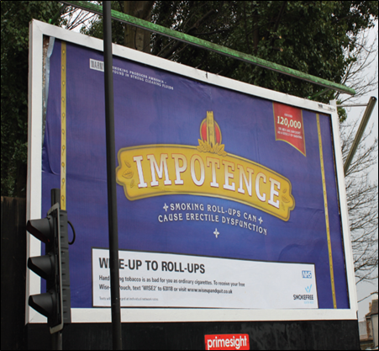

Hand Rolled Tobacco
Smoke Outside
Plain Packs
Smokefree Play Parks
COPD
Illegal Tobacco

Slide 4
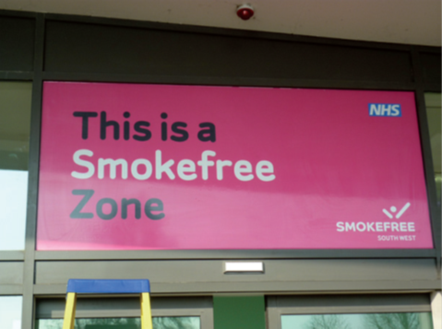
Smokefree Hospitals
Working with local partners to support 20 hospital in the South West
Ambition:
  Completely Smokefree Hospitals including the grounds
  Support for smokers at every level
  Referral processes embedded

Slide 5
Getting the Smokefree Policy Adopted

Slide 6

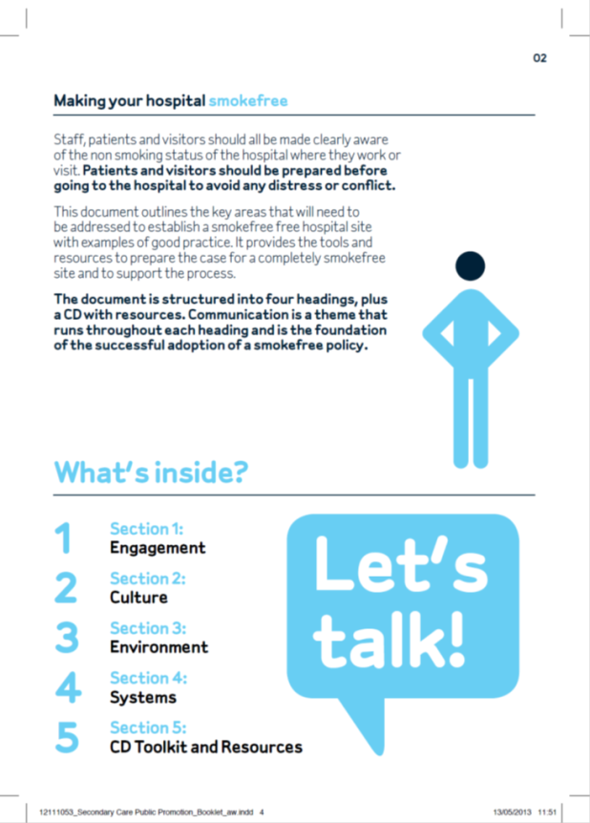
5 Strands to Achieve a Smokefree Hospital
Environment
Support
Training
Awareness
Enforcement

Slide 7
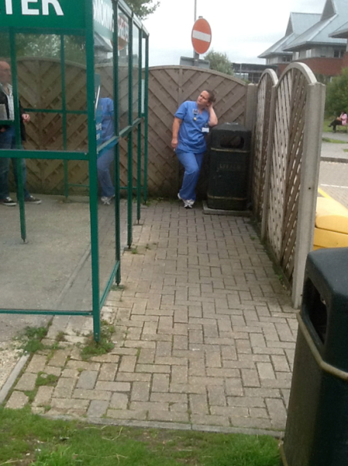
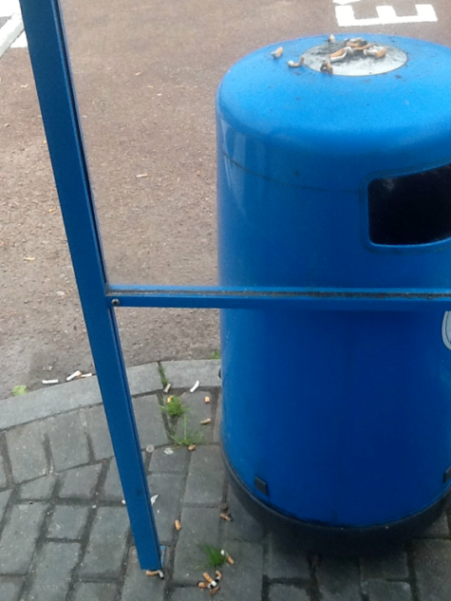
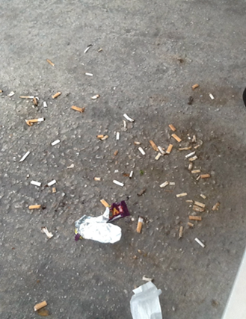
Environment
Smokers look for cues
  Health Professionals smoking
  Tobacco litter
  Other people smoking
  Smoking shelters

Slide 8
Environment
Smokers look for cues
  Health Professionals smoking
  Tobacco litter
  Other people smoking
  Smoking shelters
Need to remove all smoking cues

Slide 9
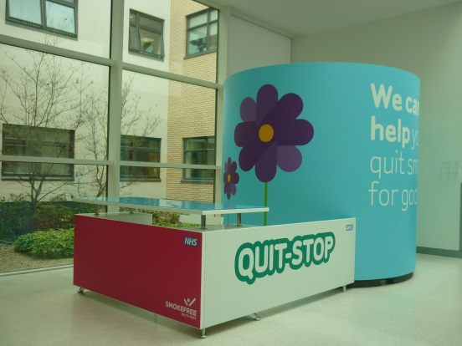
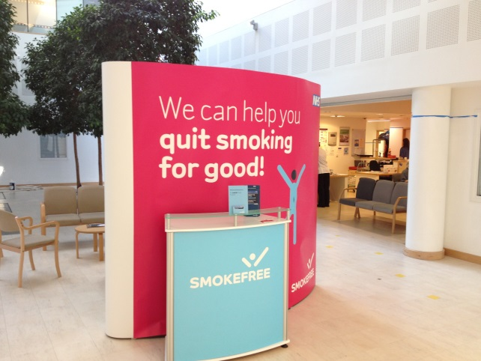
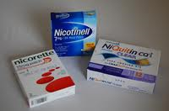
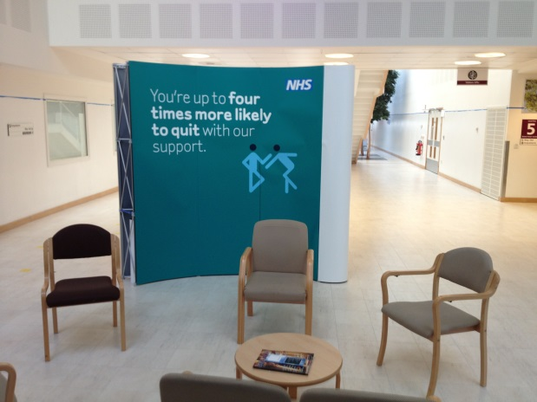
Support
Stop smoking support
Effective medication
  Quitting
  Temporary abstinence
Quick, simple referral process
Notes:
.

Slide 10
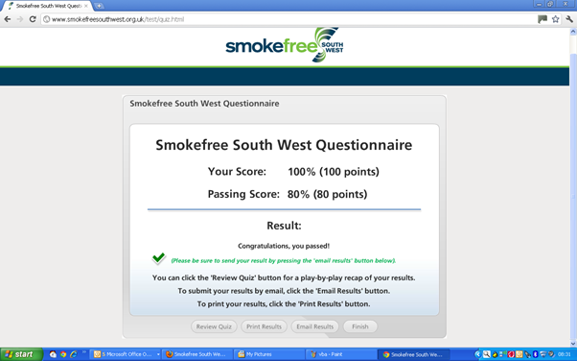
Training for All Staff
Should be
  Easy to access
  Ideally e-learning
  No longer than 25 minutes
Covers:
  Brief Advice
  Conflict resolution
  Rationale for Smokefree Hospital
Notes:
.

Slide 11
Awareness
Smokefree policy communicated clearly
Staff made aware of rationale
Planned admissions notified in advance
Primary care aware of policy
Clear signage
Notes:
Initial meeting takes some time to co-ordinate – Facilities managers, comms, clinical directors,
First site walk takes place on the same day
MOU goes to Board of Directors to sign off
Planning permission - Devon has waited for 4 months so far. Weston for 3 months, now agreed for 1st August.

Slide 12
Gloucestershire Hospitals Foundation NHS Trust

Slide 13
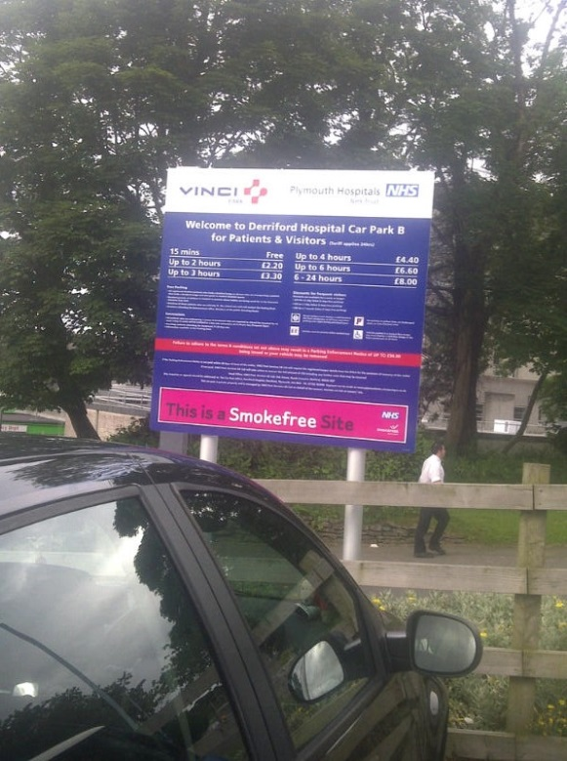
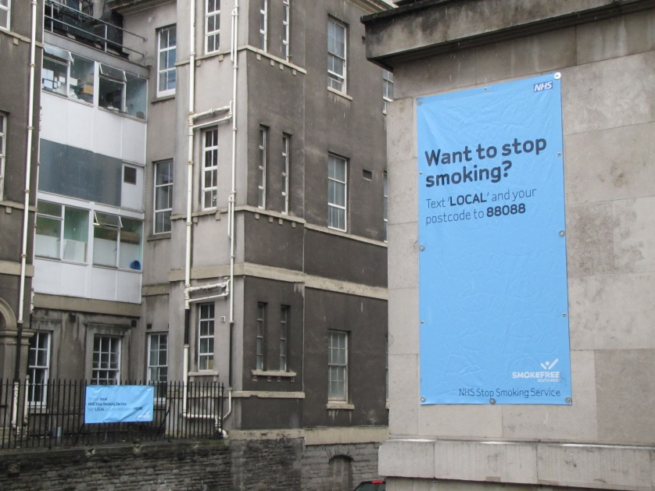
South West Secondary Care Branding

Slide 14
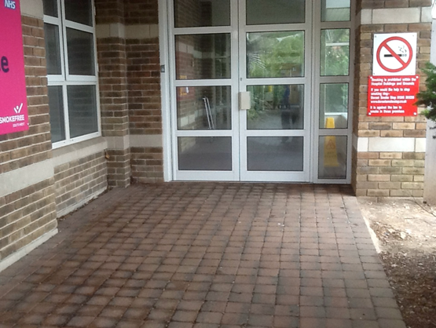
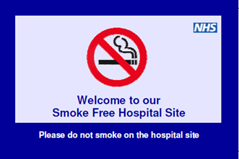
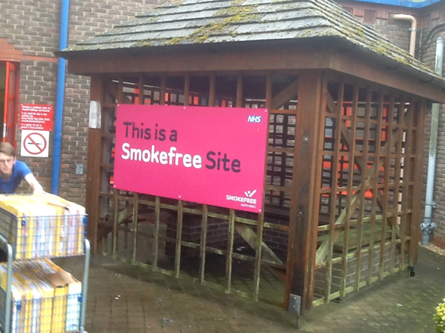
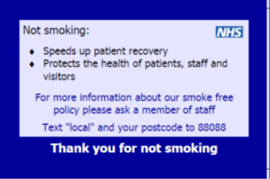
Enforcement
Clear, effective Smokefree policy
  Consistently enforced
Staff, patients, visitors and public aware of policy
Smoking litter regularly cleared
  Don’t provide smoking bins
Pocket Prompt Card for staff

Slide 15



Slide 16
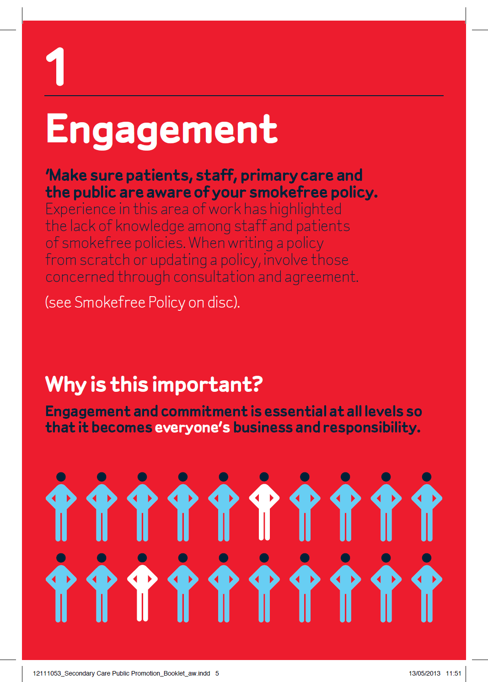

Slide 18
Smokefree South West
Toolkit and resource disc
  4 years work
  16 acute trusts
  20 hospitals
Smokefree Policies in place
Hospitals branded Smokefree
Work continues
Next step…mental health units

Slide 19
1. Engagement
Cost Calculator
Hospital Smokefree Policy
Why Go Smokefree (Sell-in)
Patient Questionnaire Presentation
Stakeholder Smokefree Briefing Letter
Systems in Secondary Care Presentation
2. Culture
Q&A Leaflets for Staff, Patients and Visitors
Credit Card Patient Info
Get Well Sooner Leaflet for Primary Care Get Well Sooner Leaflet Secondary Care How to Approach a Smoker Very Brief Advice Training Presentation
3. Environment
Example Smokefree Hospital Policy
Condition Specific Poster
Response to Complaint About Smokefree Hospital Policy
Response to Opposition to a Smokefree Hospital
Smoking on NHS Estates Smokefree South West
Smoking Shelter Research
Smokefree Signage
4. Systems
Nicotine Replacement Therapy Prescribing Guidelines
NRT Decision Aid for Wards
Protocol for Supply of Nicotine Replacement Therapy
Very Brief Advice Prompt Sheet
5. Further References and Reading

Slide 20
Thank you
Andrea.dickens@smokefreesouthwest.org.com

