Slide 1
Staff and client attitudes towards smoking in addiction services
Camilla Cookson
King’s College London

Slide 2
Acknowledgements
Professor Ann McNeill
Professor John Strang
Ms Gay Sutherland
Dr Elena Ratschen
Karolina Bogdanowicz
All the staff and clients at the services involved
This study was part funded by the National Institute for Health Research (NIHR) Mental Health Biomedical Research Centre. The views expressed are those of the authors and not necessarily those of the NHS, the NIHR or the Department of Health

Slide 3
Background
Smoking prevalence in substance misusers has been shown to be considerably higher than the general population (Harris et al., 2000; Tacke et al., 2001)
Since then, the UK has implemented a number of tobacco control measures, such as the ban on tobacco advertising, the development of a network of NHS Stop Smoking Services and the implementation of the national smoke-free policy (DOH, 1998, 2011)

Slide 4
Background (2)
Health related consequences are a huge concern, e.g.
Alcoholics are more likely to die from a tobacco-related disease, compared to alcohol-related causes (Hurt et al., 1996)
There is a synergistic interaction between alcohol and smoking for cancer risk (Pelucchi et al., 2007)
Smoking in this population needs to be addressed!

Slide 5
Background (3)
Staff concerns:
Substance misusers do not want to quit smoking
Substance misusers are unable to quit smoking
Quit attempts will have a negative impact on treatment of other substance use
Lack of knowledge and training
(Campbell et al., 1995; Walsh et al., 2005; Guydish et al., 2007)

Slide 6
Background (4)
Stopping smoking does not appear to impact negatively on other substance treatment
Some evidence suggests that continued nicotine dependence may be a risk factor for relapse (Weinberger & Sofuoglu, 2009; Baca & Yahne, 2009; Tsoh et al., 2011)
Staff who smoke are less likely to intervene in patients’ smoking (Guydish et al., 2007) and staff smoking has the potential to normalise the behaviour (Ziedonis et al., 2007)

Slide 7
Smoking Audit: Method
Questionnaire survey conducted across Addiction and Mental Health (MH) services within or with links to a large London Mental Health Trust
Questionnaires were designed to measure:
smoking behaviour
motivation to quit
treatment provision and
attitudes towards nicotine dependence treatment
Community services and inpatient wards were visited over 1 or 2 days: questionnaires completed by all consenting staff and clients present

Slide 8
Response Rates
A good capture was obtained.
97% (n= 145) and 85% (n=163) response rates for staff and clients respectively in addiction services
85% (n=135) and 70% (n=106) response rates for staff and clients respectively in MH services

Slide 9
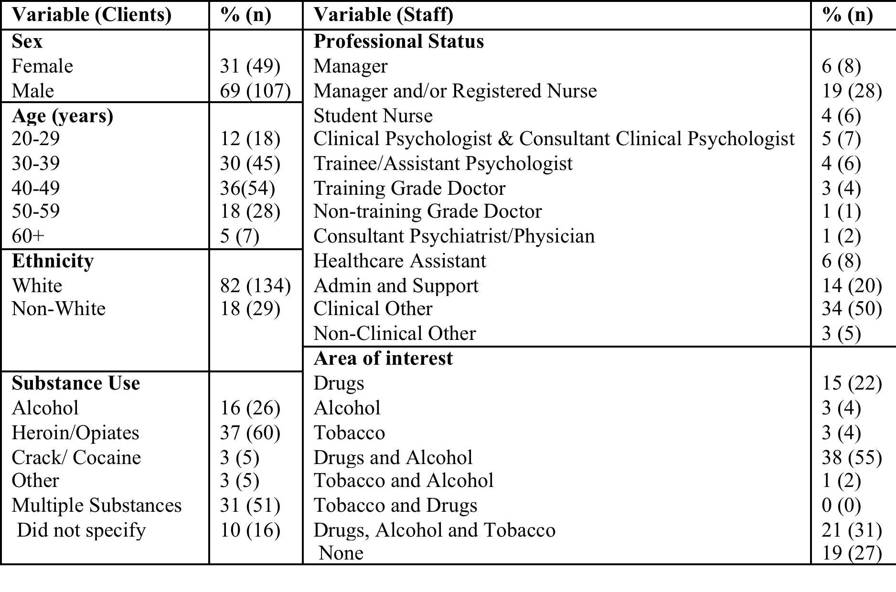
Demographic and Clinical Characteristics

Slide 10
Key Findings: 1. High smoking prevalence
 | ADDICTION |  | MENTAL HEALTH
 | Staff | Clients | Staff | Clients
Ever smoked | 70% (n= 102) | 94% (n= 154) | 46% (n= 61) | 71% (n= 75)
Currently smoking | 45% (n= 65) | 88% (n= 144) | 24% (n= 32) | 55% (n= 58)
General population prevalence: 20%

Slide 11
2. Smoking behaviour
Clients: All but 2 were daily smokers
Staff: 58% smoked daily and 42% occasionally
Is the high prevalence of occasional smoking an attempt to cut down/quit or characteristic of the professional group?
Heaviness of Smoking Index (CPD and TTF)
HSI | Staff | Clients
0-2 (low addiction) | 66 (21) | 25 (33)
3-4 (moderate addiction) | 31 (10) | 64 (83)
5-6 (high addiction) | 3 (1) | 11 (14)

Slide 12
3. A motivated client group
81% (n=111) of substance misusers who smoked wanted to give up (12% wanted to in the next month). (Measured using the Motivation To Stop Scale)
Attitude | % Smokers from the Smoking Toolkit study (Kotz et al., 2013) | % of smoking clients | % of smoking staff
I REALLY want to stop smoking and intend to in the next month. | 9 | 12 (16) | 7 (4)
I REALLY want to stop smoking and intend to in the next 3 months. | 9 | 11 (15) | 5 (3)
I want to stop smoking and hope to soon. | 11 | 18 (25) | 38 (21)
I REALLY want to stop smoking but I don’t know when I will. | 24 | 23 (32) | 15 (8)
I want to stop smoking but haven’t thought about when. | 9 | 17 (23) | 7 (4)
I think I should stop smoking but don’t really want to. | 17 | 9 (12) | 11 (6)
I don’t want to stop smoking. | 21 | 11 (15) | 16 (9)

Slide 13
4. A lack of treatment provision
Only 15% (n=19) smokers in addiction services had been offered support to stop smoking during their current treatment episode
56% (n= 78) had never been offered support
Similar picture in mental health services
AN UNMET CLINICAL NEED

Slide 14
5. Interest in support and advice
46% (n =66) wanted to talk to someone about trying to reduce the harmfulness of their smoking behaviour; a further 21% did not know
Motivation also apparent in Mental Health Services (64% wanted to quit and 36% were interested in talking to someone)

Slide 15
6. Interest in different kinds of advice
Preferences for advice on different treatment options were mixed:
Advice on gradually reducing the number of cigarettes smoked ( 77%) and using other nicotine products to replace some cigarettes (87%) was more popular than stopping smoking abruptly (53%)
Over 2/3rd of clients did not know enough about varenicline or bupropion to express any interest

Slide 16
7. Staff attitudes
Nicotine dependence treatment was rated significantly less important than other substances a client may be using (by both MH and Addiction staff).
Clients rated the appropriateness of treating smoking as an ‘addiction requiring treatment’ an average of 8.1 on a 10 point scale (1 – not at all appropriate, 10 – definitely appropriate)
Staff: If a client was primarily in treatment for x*, on a scale from 1 to 10, how important would you rate treatment of the following substances that they may also be using:
 | Primary substance: *Alcohol |  | Primary substance: *Heroin |  | Primary substance: *Cannabis
 | Average | Range | Average | Range | Average | Range
Alcohol |  |  | 9.2 | 8 | 8.5 | 9
Heroin | 9.2 | 9 |  |  | 9.0 | 9
Cannabis | 6.7 | 9 | 6.8 | 9
Benzos | 8.8 | 9 | 8.7 | 7 | 8.3 | 9
Smoking | 5.6 | 9 | 5.4 | 9 | 6.6 | 9

Slide 17
7. Staff Attitudes cont…
63% (n= 88) of addiction staff believed that smoking should be addressed late or after a client’s primary addiction treatment (29% thought early in their treatment and 7% ticked multiple time points)
In contrast: 48% of clients believed smoking should be addressed early in their primary addiction treatment, and 50% thought later or after treatment
Average rating of staff confidence (on a 10 point scale) was 7.0 (range 9)

Slide 18
7. Staff attitudes cont… (MH)
36% (n= 37) MH staff agreed with the statement “smoking is an important coping mechanism for many patients, helping them to deal with their mental health illness”
Despite the lack of treatment provision reported by clients: 38% (n=39) of MH staff agreed with the statement “nicotine replacement products and behavioural support (for smoking cessation/harm reduction/ nicotine withdrawal) are readily available for patients on my ward/at my service”

Slide 19
Conclusions
An unmet clinical need is evident: smoking cessation support is not being delivered to this high prevalence population
Client motivation is apparent but unaddressed
Some staff attitudes regarding the importance of nicotine dependence treatment may be inadvertently affecting treatment accessibility in MH and addiction services
Given previous research showing that staff who smoke are more likely to question the importance of nicotine dependence treatment, the number of staff smoking is a concern for their own and their patients’ health

Slide 20
What’s needed?
Clinical pathway to address the unmet clinical need:
Mandatory recording of smoking status and motivation to quit
Development/facilitation of routinely provided support which should also be documented in patient notes
Staff training
Support for staff smokers
Future research: Do interventions delivered to this group produce standard observed benefits, or are special more tailored interventions required?

Slide 21
References
London Health Observatory, Smoking in England, 2012.
http://www.lho.org.uk/LHO_Topics/National_Lead_Areas/NationalSmoking.aspx
Harris, J., Best, D., Man, L-H., Welch, S., Gossop M. & Strang, J. (2000). Changes in cigarette smoking among alcohol and drug misusers during inpatient detoxification. Addiction Biology, 5, 443-450.
Tacke, U., Wolff K., Finch, E., & Strang, J. (2001). The effect of tobacco smoking on subjective symptoms of inadequacy (“not holding”) of methadone dose among opiate addicts in methadone maintenance treatment. Addiction Biology, 6 (2), 137-145.
Department of Health, Smoking Kills: A white paper on tobacco. 1998. http://www.healthpromotionagency.org.uk/Resources/strategies/smokingkills.htm
Department of Health, Healthy Lives, Healthy People: A Tobacco Control Plan for England, 2011. https://www.gov.uk/government/uploads/system/uploads/attachment_data/file/135349/dh_124960.pdf.pdf
The NHS Information Centre, Statistics on Smoking: England, 2012.
https://catalogue.ic.nhs.uk/publications/public-health/smoking/smok-eng-2012/smok-eng-2012-rep.pdf
Hurt, R.D., Offord, J., P., Corghan, I., T., Gomez-Dahl, L., Kottke, T.R., Morse R.M., & Melton, J. (1996). Mortality Following Inpatient Addictions Treatment: Role of Tobacco Use in a Community-Based Cohort. The Journal of the American Medical Association, 275 (14), 1097-1103.
Pelucchi, C., Gallus, S., & Garavello,W. (2007). Cancer risk associated with alcohol and tobacco use: Focus on upper aero-digestive tract and liver. Alcohol Research & Health, 29, 193−198.
Campbell, B.K., Wander, N., Stark, M. & Holbert, T. (1995). Treating cigarette smoking in drug-abusing clients. Journal of Substance Abuse Treatment, 12 (2), 89-94.
Walsh, R. A., Bowman, J.A., Tzelepis, F., & Lecathelinais, C. (2009). Smoking cessation interventions in Australian drug treatment agencies: a national survey of attitudes and practises. Drug and Alcohol Review, 24 (3), 235-244.
Guydish, J., Passalacqua, E., Tajima, B., & Manser, S. T. (2007). Staff Smoking and Other Barriers to Nicotine Dependence Intervention in Addiction Treatment Settings: A review. Journal of Psychoactive Drugs, 39 (4), 423-433.
Weinberger, A.H., & Sofuoglu, M. (2009). The Impact of Cigarette Smoking on Stimulant Addiction. American Journal of Alcohol Abuse, 35 (1), 12-17.
Baca, C. T., & Yahen, C.E. (2009). Smoking cessation during substance abuse treatment: What you need to know. Journal of Substance Abuse Treatment, 36, 205-219
Tsoh, J., Chi, F., Mertens, J., Weisner, C. (2011). Stopping smoking during first year of substance use treatment predicted 9-year alcohol and drug treatment outcomes. Drug Alcohol Depend., 114 (2-3), 110-118.
Ziedonis, D.M., Guydish, J., Williams, J.M., Steinberg, M., & Foulds, J. (2007). Barriers and solutions to addressing tobacco dependence in addiction treatment programs. Psychiatry Publications and Presentations. Paper 215. http://escholarship.umassmed.edu/psych_pp/215
Kotz, D., Brown, J., & West, R. (2013). Predictive validity of the Motivation To Stop Scale (MTSS): A single-item measure of motivation to stop smoking. Drug and Alcohol Dependence, 128, 15-19.

Slide 22
Thank you!
Any questions?

