Slide 1
Representations of electronic cigarettes in UK and Scottish newspapers
Catriona Rooke & Amanda Amos

Slide 2
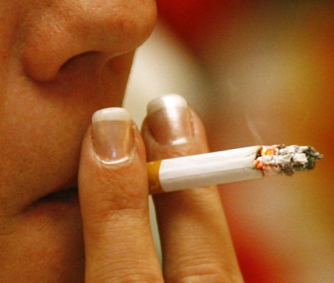
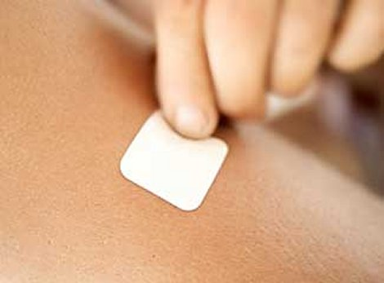
Background: tobacco harm reduction
“Nicotine inhaled from smoking tobacco is highly addictive. But it is primarily the toxins and carcinogens in tobacco smoke – not the nicotine – that cause illness and death. The best way to reduce these illnesses and deaths is to stop smoking. [...] However , there are other ways of reducing the harm from smoking, even though this may involve continued use of nicotine. (p6)
Using [licensed nicotine-containing] products can make it easier for people to cut down before stopping, reduce their smoking or abstain. (p8) (NICE, 2013)

Slide 3
Background: debates over e-cigarettes
For
Promising harm reduction tool
Evidence they help people quit smoking
No second-hand smoke
Close resemblance to cigarettes
Against
Possible use by non-smokers
Lack of knowledge
Regulation & safety issues
Promotion of dual use
Maintenance of nicotine addiction
Undermine smokefree legislation
Close resemblance to cigarettes
(Social norms)
“Pure nicotine or other nicotine devices have the potential for massive public health gains”
(Prof John Britton, quoted in the Advisor, Summer 2012)
Vapestick.co.uk

Slide 4
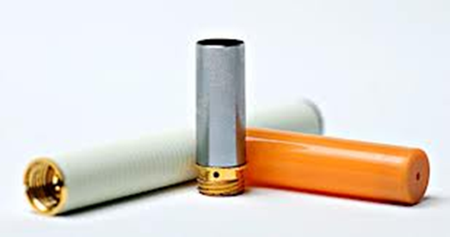
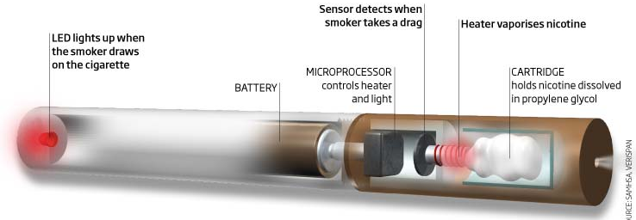
Background
What are e-cigarettes?
Battery-operated, nicotine vapour inhaler device
Usually include a nicotine cartridge, a vapouriser, electronic circuitry, sensors and a battery
Some have an LED which glows when the user inhales, resembling a real cigarette
May contain nicotine, humectants to produce the vapour & flavourings – do not contain tobacco

Slide 5
Brief history
2004: developed in China
2006: began to be exported to the UK
2007: first international patent registered
2007-8: began to gain popularity in the UK
Regulation
Has been problematic – not regulated by Tobacco Products nor Medicines regulation
General product safety legislation
Recent developments:
MHRA decision (2016) and new NICE guidance (2013)

Slide 6
Research on e-cigarettes
Not all brands deliver nicotine. Those that do, do so with differing efficacy.
(Eissenberg et al, 2010; Vansickel et al, 2010; Goniewcz et al, 2012a)
Preliminary studies found traces of selected tobacco-specific toxicants in some products; however in amounts much lower than cigarettes.
(Goniewicz, 2012b; Westenberger, 2009; Laugesen, 2008, 2009)
Some evidence they are effective for smoking cessation.
(Bullen et al, 2010; Etter et al, 2011; Goniewicz et al, 2012c; Polosa et al, 2011)
Evidence of increasing awareness and use of e-cigarettes amongst UK smokers.
(Morrison et al, 2013)

Slide 7
Why is media coverage important?
Diffusion of innovations theory & media channels:
Relative advantage; compatability; complexity; triability; observability
The news media are a central forum for debates on health and lifestyle, and a key means by which information is diffused in society.
News media can be seen as constructing interpretative frameworks, which shape how an issue is understood.
How are the meanings, uses and users of e-cigarettes presented in newspaper coverage, and how has this changed over time.

Slide 8
Methods
12 national UK and Scottish newspapers (& their Sunday editions) were searched in Lexis Library for the six year period – 1st July 2007 to 30th June 2012
Search terms: “electronic cigarette”, “E-cigarette”, “e cigarette”
The newspapers selected were those with high circulation figures & included a range of readership profiles (serious, middle-market tabloid & tabloid).
3 of the most popular online news sources were also searched: MailOnline, BBC News. guardian.co.uk.

Slide 9
Findings
119 articles analysed:
27 from broadsheet newspapers, 26 mid-market tabloid, 29 tabloid, 37 from online sources.
The earliest reportage of e-cigarettes occurred in July 2007
This coincides with the implementation of legislation prohibiting smoking in all enclosed public places in England.
Five key themes were identified

Slide 10
Findings: key themes
Getting around smokefree legislation
Risk and uncertainty
Healthier choice
Celebrity use
Price

Slide 11
Table 1: Prevalence of themes – as a proportion of the total number of stories each year (2007-12)
Theme | Get around smokefree | Risk and uncertainty | Healthier choice | Celebrity use | Price | Total no of stories
Year | Count (percentage of total no of stories)
Year 1 (07/08) | 8 (100%) | 0 | 6 (75%) | 0 | 8 (100%) | 8
Year 2 (08/09) | 10 (48%) | 9 (43%) | 12 (57%) | 2 (10%) | 9 (43%) | 21
Year 3 (09/10) | 10 (67%) | 3 (20%) | 7 (47%) | 4 (27%) | 5 (33%) | 15
Year 4 (10/11) | 9 (33%) | 7 (26%) | 18 (67%) | 21 (78%) | 7 (26%) | 27
Year 5 (11/12) | 7 (15%) | 12 (25%) | 28 (58%) | 14 (29%) | 12 (25%) | 48
Total (07-12) | 44 (37%) | 31 (26%) | 71 (59%) | 41 (34%) | 41 (34%) | 119

Slide 12
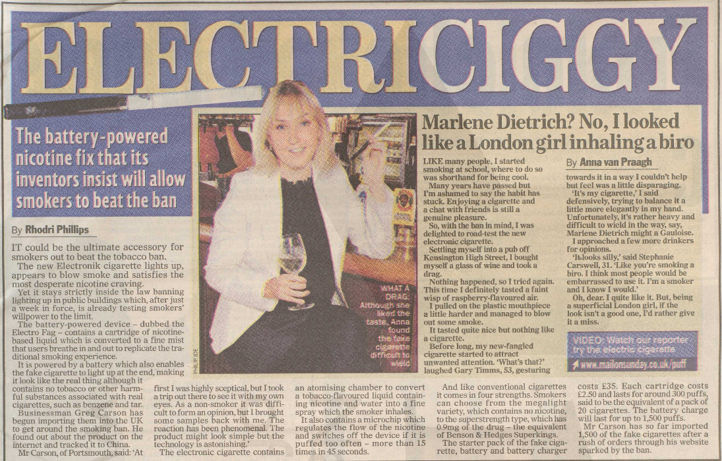
Getting around smokefree
The ‘Electronik cigarette’: “Stays strictly inside the law banning lighting up in public buildings which, after just a week in force, is already testing smokers’ willpower to the limit.”
(ELECTRICIGGY: THE BATTERY-POWERED NICOTINE FIX THAT ITS INVENTORS INSIST WILL ALLOW SMOKERS TO BEAT THE BAN, Mail on Sunday, 8 July 2007: 43)
“Oh, dear. I quite like it. But, being a superficial London girl, if the look isn’t a good one, I’d rather give it a miss”.
(MARLENE DIETRICH? NO, I LOOKED LIKE A LONDON GIRL INHALING A BIRO, Mail on Sunday, 8 July 2007: 43)

Slide 13
Price
It costs £35 pounds to buy a starter park and £4 for refills after that.
(BBC News, 8/10/08)
The value of the e-cigarette is apparent enough. For a start it is far cheaper. The calculation is that one recharged "e" is the equivalent of 15 cigarettes - and mine comes at £2 a time: a saving of more than £3 a packet.
(I’M MARLBORO MAN NO LONGER… AND SAVING CASH; Comment, The Independent, 31/12/11)

Slide 14
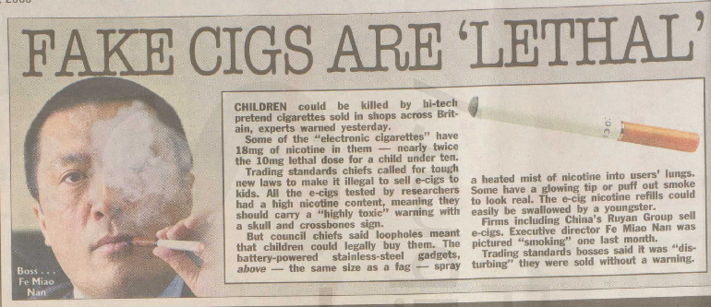
Risk and uncertainty
“…trading standards officers say they contain up to 18mg of liquid nicotine in refill cartridges which could prove fatal to young children if swallowed. A dose of just 10mg is understood to be lethal for children under 10.”
(FAKE CIGARETTES ‘ARE POTENTIALLY LETHAL TO CHILDREN, MailOnline, 13/03/09)
“…Carcinogens and toxic chemicals such as diethylene glycol, which is found in anti-freeze.”
(ELECTRONIC CIGARETTE SMOKERS WARNED OF CHEMICAL DANGERS, The Independent on Sunday,26/07/09: 16).

Slide 15
Celebrity use
“Sarah Harding has been spotted puffing away on one and Kate Moss is said to be on the waiting list for the most unlikely must-have accessory of London Fashion Week: an electronic cigarette. Perhaps even more surprising is the woman who is touting these little white sticks around town: Lady Victoria Hervey.”
(LADY VICTORIA'S PUFFING THEM BUT IS THE 'NO-CANCER' FAG REALLY A HEALTHY OPTION? Mail on Sunday, 27 Sept 2009)

Slide 16
“Ever since adopting her daughter Naleigh last September, Katherine Heigl has been trying to kick her heavy smoking habit. But it appeared as if she had lit up a cigarette on the set of her latest film…. Or did she? It turns out that the Knocked Up star was in fact smoking an electronic cigarette”
Descriptions of her “struggle”
to quit:
“‘I've tried everything. I've tried
the patch, I've tried the gum,
I've done Chantix, twice, which
made me bananas...”
(ISN’T IT TIME YOU WEANED YOURSELF OFF
THEM?, MailOnline, 15/03/11)

Slide 17
Healthier choice:
“‘It's a healthier way of smoking. You don't get any of the stuff that's in regular tobacco. It's better if people aren't using nicotine in any form, but they're an alternative to using a tobacco-based product and my opinion is they're massively less harmful. I bet my life they're a hundred times healthier than using a tobacco-based cigarette.’”
(ELECTRONIC CIGARETTES SPARK HEALTH ROW, Guardian, 9 October 2008: 13)
“The electronic cigarette looks very similar to a normal cigarette and acts as an alternative to smoked tobacco products. The battery-operated device provides small doses of nicotine when the smoker inhales but without the tar, tobacco or carbon monoxide of a traditional cigarette.”
(10 MOTIVES E-CIGARETTES FOR SMOKERS GO UK-WIDE, BBC News, 1 Nov 2010)

Slide 18
Quitting aid
“…he ended up buying a strange new gizmo for himself - menthol-flavoured electronic cigarettes …He had tried everything to ditch the habit, including acupuncture, patches and gum. He reckoned the electronic fags might just work.”
(TRUE BELIEVERS LINE UP AT THE GATES OF GADGET HEAVEN, Guardian, 18/04/09: Home, 8)
“Giving up smoking is a real drag, but if you're determined to stick to your resolution, the SmokeStik electronic cigarette could help. It's a hit with the likes of Paris Hilton and Leonardo DiCaprio because it provides a nicotine hit without any tar or carcinogens. Best of all, no more being banished to the garden. The SmokeStik emits only water vapour, so you can use it anywhere.”
(BITS & PIECES: THIS WEEK’S BEST HEALTH-FIX PRODUCTS, Daily Mail, 10/01/11)

Slide 19
Concluding comments
Somewhat balanced approach; however, overall coverage tended towards positive themes.
Shift over time from uncertainty and getting around smokefree to greater familiarity and multiple themes.
Important, and selective, information about what e-cigarettes are for and their key features.
Representations communicate various characteristics of e-cigarettes that are associated with uptake

Slide 20
Questions/concerns raised
Celebrity use/promotion – glamourising a product containing an addictive substance?
Emphasis on visual similarity between e-cigarettes and cigarettes – social norms?
Promotion in ways that encourage dual use?
Making of health claims based on limited evidence?
Need to subject the claims commonly being made about e-cigarettes to appropriate scrutiny.
Pressing need for prompt implementation of appropriate controls over the marketing and promotion of these products.

