Slide 1
Using and interpreting findings from Cochrane reviews of interventions to combat tobacco addiction
Jamie Hartmann-Boyce and Monaz Mehta
Cochrane Tobacco Addiction Review Group
June 2013

Slide 2

Acknowledgements
Our funding
The National Institute for Health Research (NIHR) is the largest single funder of the Cochrane Tobacco Addiction Group.
The Group is based at the Department of Primary Care Health Sciences, University of Oxford

Slide 3
What we’ll cover
Introduction to our Group
About the Cochrane Collaboration
What defines a Cochrane review
Finding and accessing Cochrane Reviews
Scope of the Cochrane Tobacco Addiction Review Group
Methods and interpretation of our cessation reviews
On-going and future initiatives
Discussion and questions

Slide 4
The Cochrane Collaboration - mission and aims
international not-for-profit organisation
aims to help people make well-informed decisions about healthcare by preparing, maintaining and promoting the accessibility of systematic reviews of the effects of health care interventions
aiming to be:
  unbiased, reliable, up-to-date
  relevant and accessible
  collaborative

Slide 5
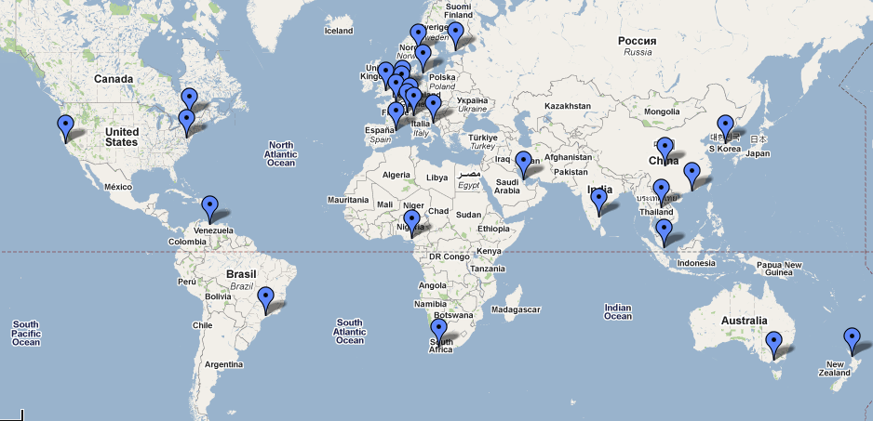
Cochrane structure
over 100 countries
decentralised structure - 52 Cochrane Review Groups
largely funded by government grants

Slide 6
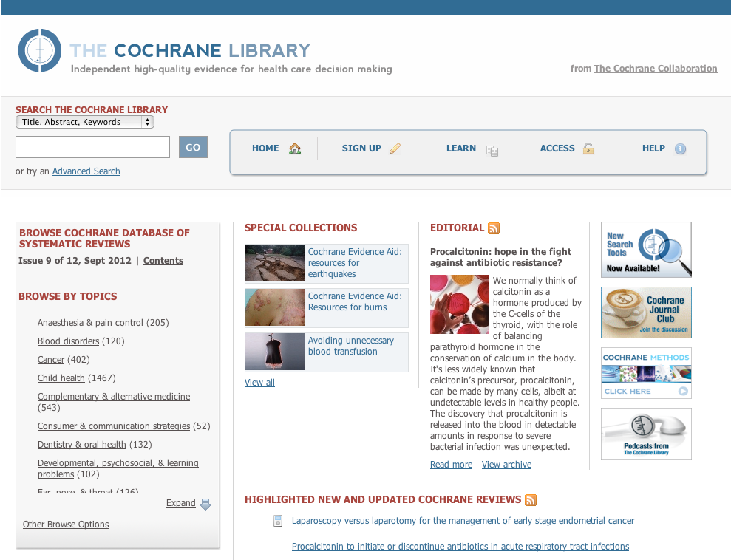
www.thecochranelibrary.com

Slide 7
Why systematic reviews?
efficient way to access the body of research
  saves time required for searching
  critical appraisal
  interpretation of results
explore differences between studies
reliable basis for decision making
  unbiased selection of relevant information
  useful for health care, policy, future research

Slide 8




What’s so special about a Cochrane review?
Cochrane reviews aim to be….
Unbiased
The methods used in Cochrane reviews are pre-defined from the outset.
At least two reviewers assess and extract data for every included study.
Methods follow those set out
in the Cochrane Handbook
(which is very detailed –
over 600 pages long!)
Every Cochrane review starts with a systematic search, which is comprehensive and exhaustive, covering all languages, all countries, and many unpublished sources
Every included study is assessed for risk of bias based on a predefined tool used in all reviews
Cochrane reviews are free to access from the UK and many other settings
Every review has a plain language summary, which summarizes the review with a minimum of jargon. These are available to everyone.
Increasingly, Cochrane reviews also have summary of findings tables.
We aim to update Cochrane reviews every two years, but prioritise those where new research may change the conclusions
Reliable
Up to date
Accessible

Slide 9
Key features of a systematic review
PROTOCOL
clearly stated objectives
pre-defined eligibility criteria
explicit, reproducible methodology
Search strategy
FULL REVIEW
systematic search
assessment of validity of included studies
systematic synthesis and presentation of findings

Slide 10

Finding and accessing Cochrane reviews

Slide 11
www.thecochranelibrary.com

Slide 12
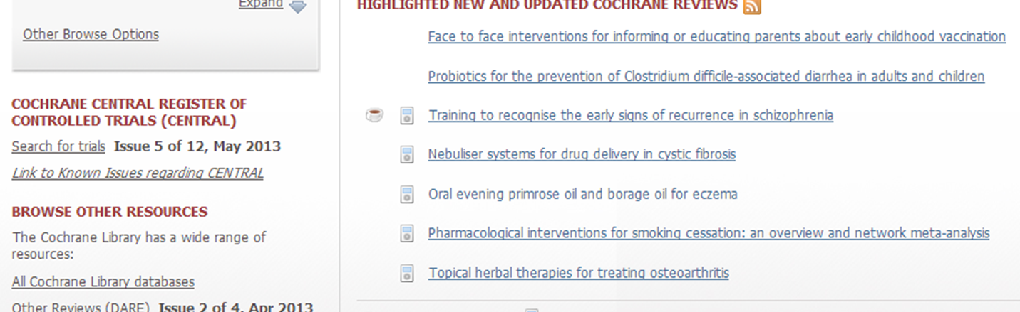
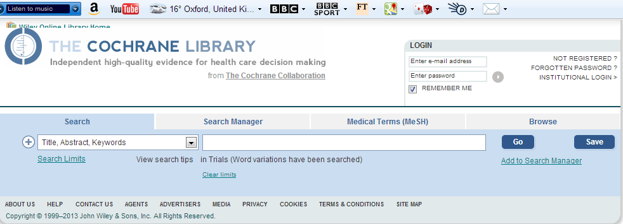

Slide 13
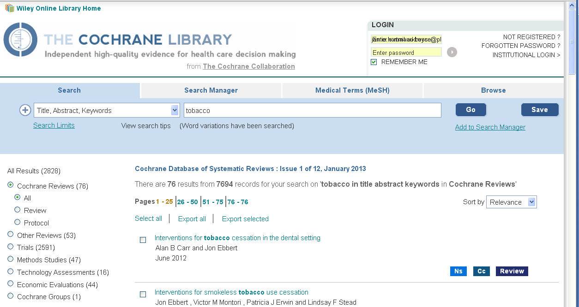
www.thecochranelibrary.com
Advanced search
Browse by topic, group, etc.
Filter results by database/article type
Search and browse using MeSH terms
Simple search

Slide 14
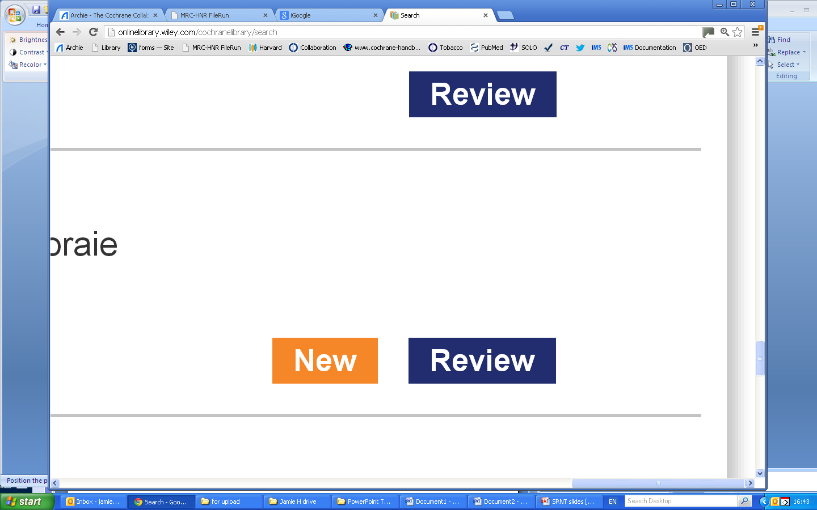
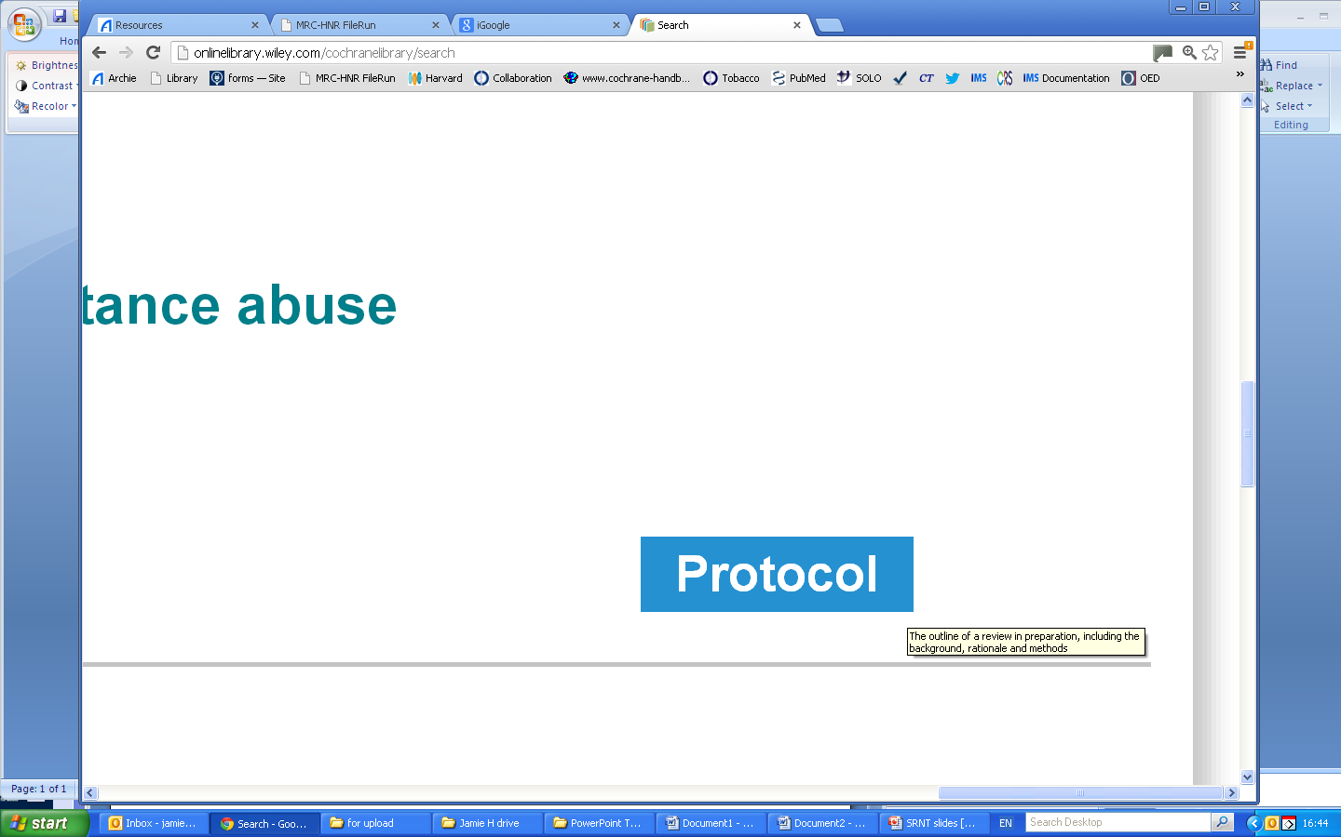
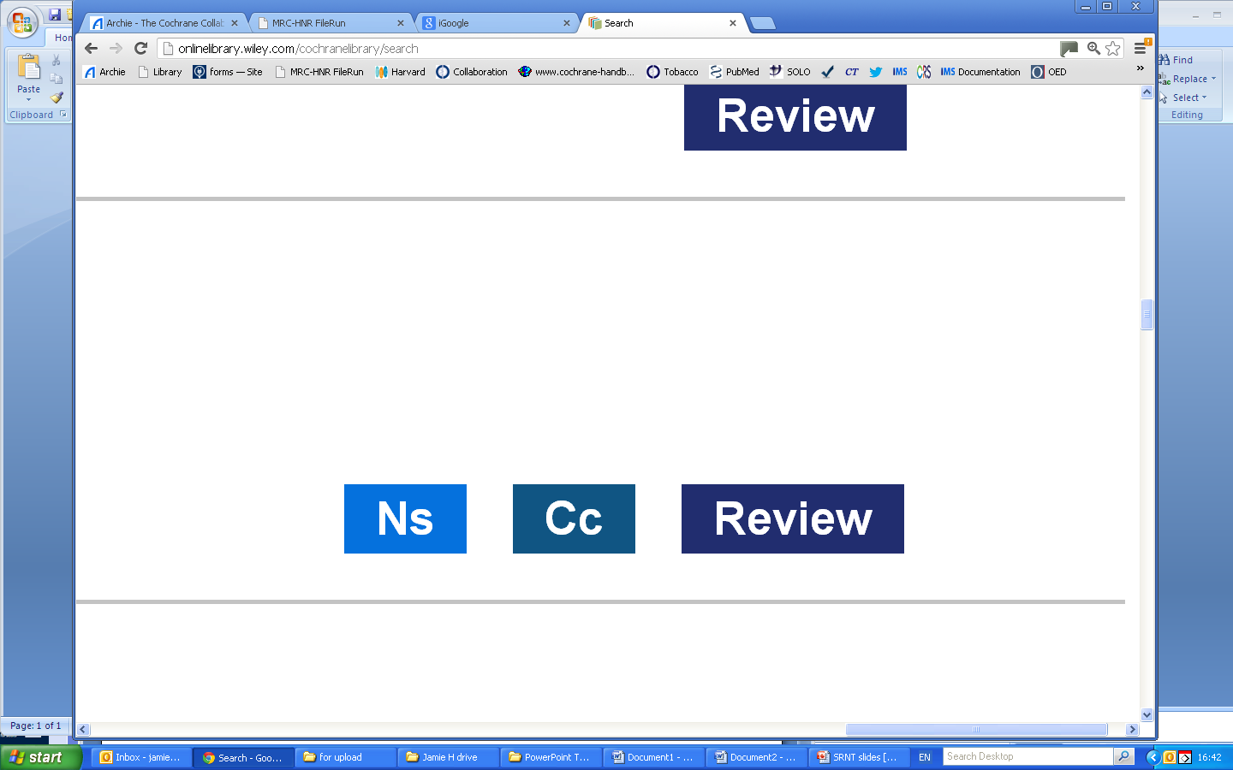
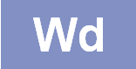
How to identify new and upcoming reviews
Identifies a review version or protocol first published this month
Identifies a published protocol; full review to come
Identifies a full review
Identifies an update of a previously published review (Ns= New search)
Identifies a previously published review or protocol which has since been withdrawn
Identifies updates where conclusions have changed since the previous version

Slide 15
Summaries of Cochrane reviews
Plain language summaries, either via Cochrane Library, or summaries.cochrane.org
Podcasts via www.cochrane.org/podcasts
Abstracts via most search engines or the Cochrane Library
Summary of Findings tables on the Cochrane Library

Slide 16
The Cochrane Tobacco Addiction Review Group

Slide 17

Cochrane Tobacco Addiction Group (CTAG)
Coordinating editor – Tim Lancaster
Editorial advisory board – Paul Aveyard, John Hughes and Robert West
Managing Editors & associated – Jamie Hartmann-Boyce, Lindsay Stead, Kate Cahill and Monaz Mehta
Statistics advisor – Rafael Perera
Trials Search Coordinator – Lindsay Stead
Appropriate reviews are also sent to a consumer reviewer
Thanks to all our authors, too!
Kate Cahill at Cochrane clinic, UKNSCC, 2008

Slide 18
What do we do?
Systematic reviews of interventions for tobacco use cessation & prevention, published in Cochrane Database of Systematic Reviews
  Cessation
    Behavioural interventions
    Pharmacotherapies
  Prevention
    School programmes
    Mass media
  Policy
    Age restrictions
    Plain packaging
  Miscellaneous
    Harm reduction
    E-cigarettes
  ‘Orphan reviews’

Slide 19
Cessation reviews
  Adult smokers
  Adolescents
  Special populations
    hospitalised patients
    pregnancy (historic Cochrane Preg. & Childbirth group)
    with schizophrenia
    with depression/history
    in treatment for substance abuse
    Indigenous populations
  Smokeless tobacco users
  Specific providers
  Specific delivery formats
Page 19

Slide 20
Output & Impact
66 reviews & 6 protocols currently
10 new reviews in 2012
14 updates
Recently published our first overview
Feed into inter/national guidelines

Slide 21

Methods
(cessation reviews)

Slide 22
Outcomes
Cessation not reduction (risk ratios)
Prefer most conservative outcomes (continuous or prolonged abstinence over point prevalence)
Use biochemically validated quits where reported (often not reported in trials that don’t involve face to face contact)
Generally exclude studies with less than six months follow-up
Treat all losses to follow-up as continuing smokers

Slide 23
Risk ratios (RR) in cessation reviews
If the result of a cessation study presented in a Cochrane review is RR 1.50, have more participants quit in the control group or in the intervention group?
events in intervention group/participants in intervention group
RR =
events in control group/participants in control group
Answer: intervention group.
For cessation, a risk ratio greater than 1 indicates that more people are quitting in the intervention condition. For example, the below data gives us an RR of 1.5.
Intervention quit | Intervention total | Control quit | Control total
15 | 100 | 10 | 100

Slide 24


What is a forest plot?
Graphical display of treatment effects from multiple randomized controlled trials. When these are combined, it’s called a meta-analysis.

Slide 25
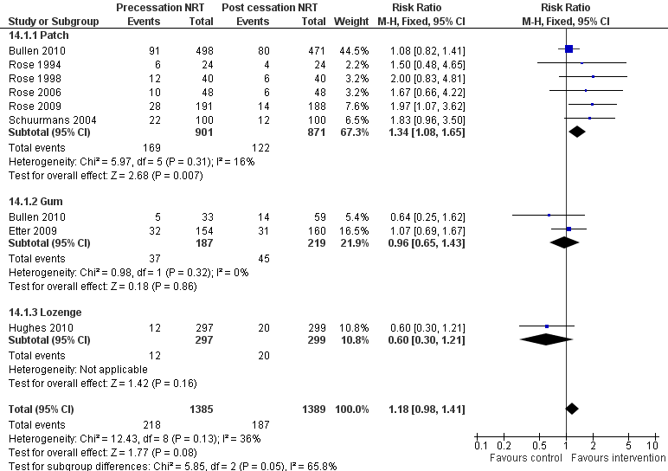
Each line represents an individual study (or intervention versus control comparison)
The vertical line is known as the line of no effect.
For our cessation reviews, if the point estimate is on the right side of the line, more people receiving the intervention quit than people in the control group. If the point estimate is on the left side of the line, more people quit in the control group than in the intervention group.
If the confidence interval crosses this central line, the effect is not statistically significant, meaning it is possible that the intervention and the control do not have different effects.
The size of the square is dependent on the size of the study. Bullen 2010 has 969 participants; Rose 2006 96.
Results based on trials - element of chance
Each point estimate displayed with a confidence interval (CI)
CIs represented by the ends of the lines for individual studies and by the horizontal edges of the diamonds for pooled estimates.
95% CIs provide an estimated range of values within which the true effect is 95% certain to lie.
In this example, studies are divided into subgroups based on the type of NRT.
Diamonds show a pooled estimate, or the combined result from all of the studies. Here, there are pooled estimates for studies in each subgroup and for studies overall. This pooled estimate represents the result of the meta-analysis.
The blue square represents the point estimate for the effect.
Stead LF, Perera R, Bullen C, Mant D, Hartmann-Boyce J, Cahill K, Lancaster T. Nicotine replacement therapy for smoking cessation. Cochrane Database of Systematic Reviews 2012, Issue 11

Slide 26
  How many of these studies have a statistically significant result?
  none
  One
  Two
  Three or more
The confidence interval for Rose 2009 doesn’t cross the line of no effect. All of the other studies have confidence intervals that cross the line, so their results aren’t statistically significant.
Stead LF, Perera R, Bullen C, Mant D, Hartmann-Boyce J, Cahill K, Lancaster T. Nicotine replacement therapy for smoking cessation. Cochrane Database of Systematic Reviews 2012, Issue 11

Slide 27
In how many studies did more people quit in the control group than in the group receiving varenicline?
None
One
Two
13 (all but one)
In Steinberg 2011, the point estimate is to the left of the line of no effect
Cahill K, Stead LF, Lancaster T. Nicotine receptor partial agonists for smoking cessation. Cochrane Database of Systematic Reviews 2012, Issue 4. Art. No.: CD006103. DOI: 10.1002/14651858.CD006103.pub6.

Slide 28
Summary of findings tables
Summary of key information from review
Most important outcomes for someone making a decision

Slide 29
Behavioural interventions as adjuncts to pharmacotherapy for smoking cessation
Patient or population: People using smoking cessation pharmacotherapy Settings: Health care and community settings Intervention: Behavioural interventions as adjuncts to pharmacotherapy
Outcomes | Illustrative comparative risks* (95% CI) |  | Relative effect (95% CI) | No of Participants (studies) | Quality of the evidence (GRADE) | Comments
 | Assumed risk | Corresponding risk
 | Control | Behavioural interventions as adjuncts to pharmacotherapy
Smoking cessation at longest follow-up Follow-up: 6 - 24 months | Study population |  | RR 1.16 (1.09 to 1.24) | 15506 (38 studies) | ⊕⊕⊕⊕ high^{1,2}
 | 183 per 1000 | 213 per 1000 (200 to 227)
 | Median quit rate
 | 210 per 1000 | 244 per 1000 (229 to 260)
*The corresponding risk (and its 95% confidence interval) is based on the assumed risk in the comparison group and the relative effect of the intervention (and its 95% CI).
GRADE Working Group grades of evidence High quality: Further research is very unlikely to change our confidence in the estimate of effect. Moderate quality: Further research is likely to have an important impact on our confidence in the estimate of effect and may change the estimate. Low quality: Further research is very likely to have an important impact on our confidence in the estimate of effect and is likely to change the estimate. Very low quality: We are very uncertain about the estimate. Footnotes ¹ All studies rated at low or unclear risk of bias ² No overall evidence of statistical heterogeneity (I² = 3%), or of differences between the subgroups defined by pharmacotherapy
The illustrative comparative risks use the RR to illustrate what this calculation might mean in terms of numbers of patients. In our reviews, the first risk displayed (183 per 1000 in this case) is based on the actual percentages of people who quit in the control arms of all of the included studies. The median quit rate is based on what we might expect to see in a broader population (for example, here it is calculated with the knowledge that the control groups are all receiving stop smoking pharmacotherapy).
Stead LF, Lancaster T. Behavioural interventions as adjuncts to pharmacotherapy for smoking cessation. Cochrane Database of Systematic Reviews 2012, Issue 12. Art. No.: CD009670. DOI: 10.1002/14651858.CD009670.pub2.

Slide 30
What is GRADE based on?
Quality of evidence in GRADE is based on 5 domains
Risk of bias
The degree to which review authors have judged each included study to be at risk of bias
A systematic under or overestimate of an effect due to selective publication of studies. This can happen when the results of a study are not reported. If, for example, studies that detect an effect are more likely to be published than those with negative results, the meta-analysis will be biased towards positive results.
Unexplained differences between the results of individual studies (heterogeneity). This can lead to uncertainty about the underlying effect.
Results can be downgraded because of indirectness if:
Head to head comparisons are not available
The population, intervention, comparator or outcome is different from the question the review is trying to address
Results are considered imprecise if:
The total number of events is small (usually less than 300)
The confidence intervals are wide
Inconsistency
Indirectness
Imprecision
Publication bias

Slide 31
Internet-based interventions for adults who want to stop smoking
Patient or population: adults who want to stop smoking Intervention: Internet-based interventions
Outcomes | Illustrative comparative risks* (95% CI) |  | Relative effect (95% CI) | No of Participants (studies) | Quality of the evidence (GRADE)
 | Assumed risk | Corresponding risk
 | Control | Internet-based interventions
Smoking cessation - Interactive and tailored, Internet only | 64 per 1000 | 91 per 1000 (72 to 179) | RR 1.41 (1.11 to 2.78) | 3631 (3 studies) | ⊕⊕⊝⊝ low^{1,2}
¹ All three included studies judged to be of high risk of bias in one domain: two at risk of attrition bias due to very high loss to follow-up which was balanced across arms (could underestimate effect), and one quasi randomized trial at risk of selection bias. ² High statistical heterogeneity (I squared = 53 %) despite perceived clinical homogeneity. All studies have point estimates favouring intervention.
Why was the evidence downgraded?
(can choose more than one answer)
Risk of bias
Inconsistency
Indirectness
Imprecision
Publication bias
The review authors judged each of the included studies to be at high risk of bias, and the size of the effect varied in each study, but the authors could not detect a reason for this variation.
Civljak M, Sheikh A, Stead L, Hartmann-Boyce J, Car J. Internet-based interventions for smoking cessation. Cochrane Database of Systematic Reviews, 2013 (in press).

Slide 32
What’s next?

Slide 33
Identifying ongoing research
Trial registries systematically searched
Relevant studies imported into CRS
Trial registration numbers included in Cochrane Reviews, ongoing trials added to ‘Ongoing studies’ list
Studies tagged with details of relevant reviews and linked to existing publications
New bespoke software for Cochrane groups to manage study registers
Will allow us to link publications with their trial registration details
Should result in more detailed and comprehensive lists of relevant ongoing studies in future reviews and updates, and be an effective way to identify relevant unpublished research

Slide 34
Reviews and protocols in the pipeline
Electronic cigarettes
Smokers with depression
Packaging
Medication adherence
School policies
System change
And numerous updates in progress…

Slide 35
Discussion
Any suggestions about how our reviews could be improved for use in clinical environments?
Any questions?

Slide 36
Sources of information
The Cochrane Library
www.thecochranelibrary.com
Cochrane Collaboration website
www.cochrane.org
Cochrane Review Group websites
www.cochrane.org/contact/review-groups
if unsure, contact your reference Centre www.cochrane.org/contact/centres
Follow us on twitter @cochraneTAG

