Slide 1


This house believes that the field should be positive about the development of e-cigarettes, even if they’re developed by subsidiaries of tobacco companies
John Britton
Notes:
Thank organisers, welcome on behalf of srnt and ukctcs,
Stress this is predominantly european union
by way of introduction to ukctcs.....

Slide 2
Declaration of financial interests:
Paid by University of Nottingham
Occasional editorial and examining fees
Nothing else

Slide 3
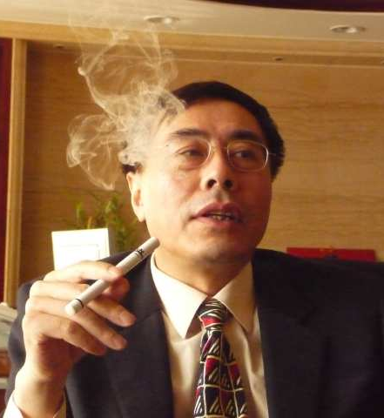
Positive about the development of e- cigarettes?
Nicotine delivery devices
Unlicensed, variable quality and efficacy
Similar to existing NRT products, hence likely to be effective
Much more like cigarettes, not ‘medical’
Notes:
Hon lik

Slide 4
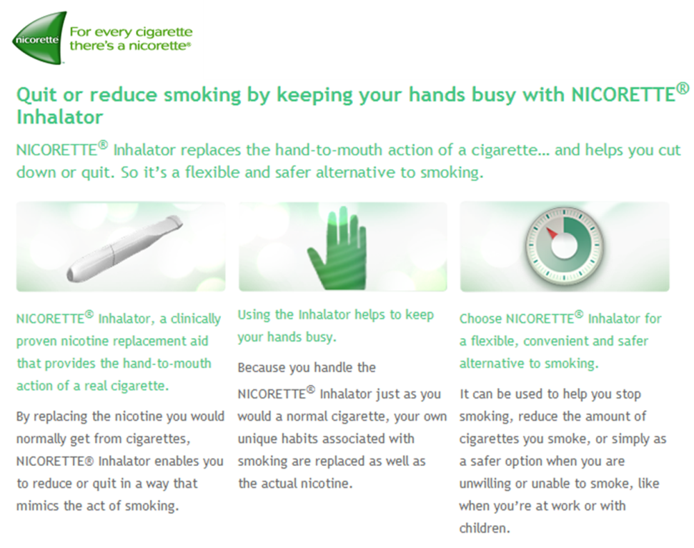


Slide 5
E-cigarettes – use for any purpose

Slide 6
E-cigarettes used in quit attempts

Slide 7
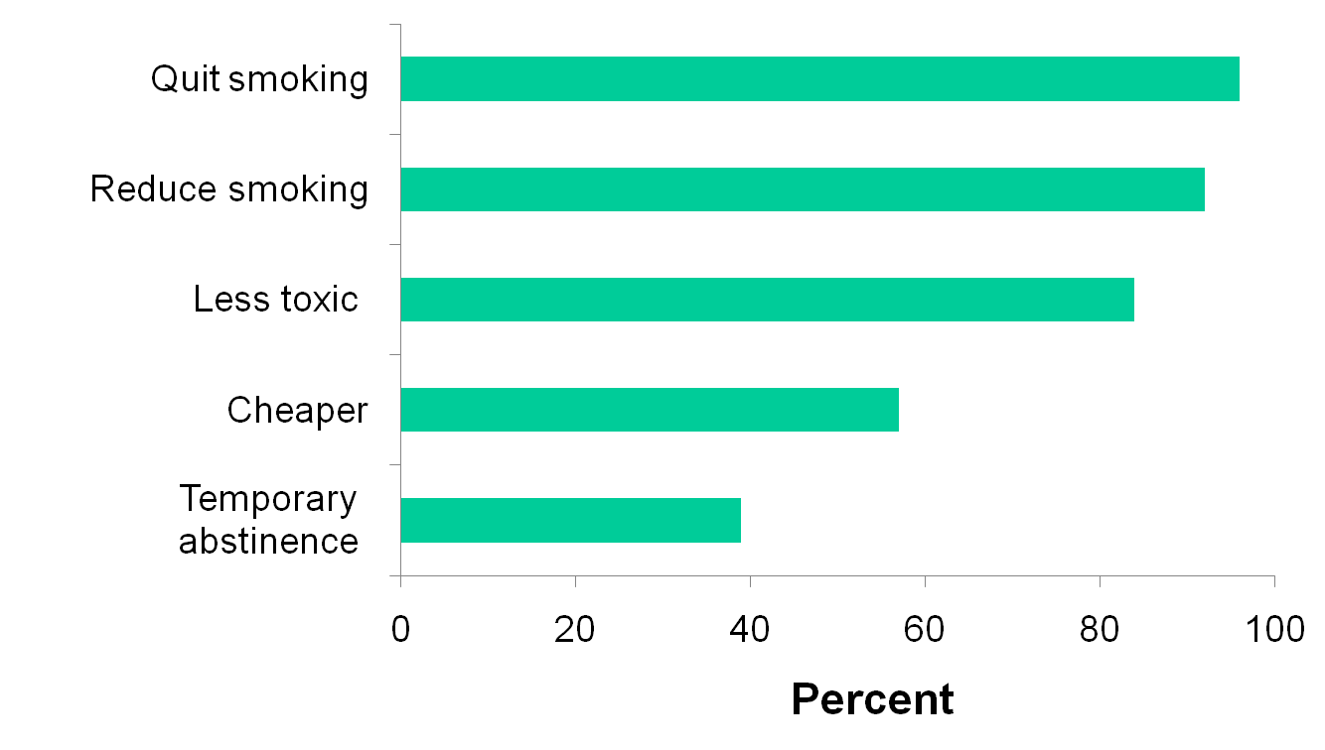
Electronic cigarettes: reasons for use
Etter and Bullen, Addiction 2011;106:2017-28

Slide 8
Positive about the development of e- cigarettes?
Welcome addition to smoker choice
Smokers are using them
Could and will get a lot better
Would be good to have standards for purity and promotion …
But: YES.
Notes:
If developed by a pharma company we would be embracing them

Slide 9
… even if developed by subsidiaries of tobacco companies?
Why are we asking this question?
Is it workable to say ‘no’?
Does it matter who makes them?

Slide 10
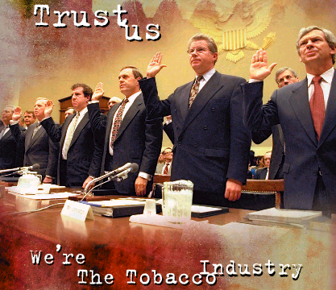

Why are we asking this question?
Notes:
Central objective is to sell more tobacco
Actively oppose and undermine smoking prevention policies
every smoker who quits is a lost customer
FCTC Article 5.3

Slide 11
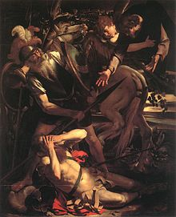
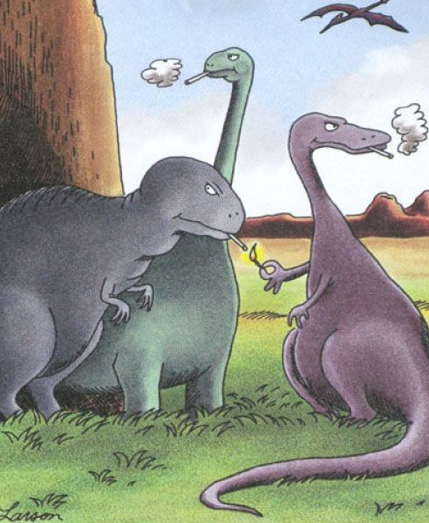
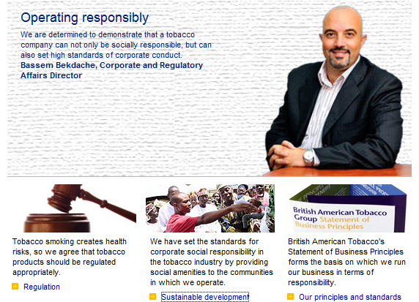


Slide 12

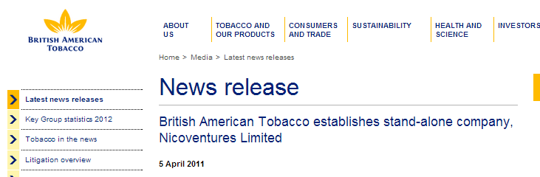
…subsidiaries of tobacco companies?

Slide 13

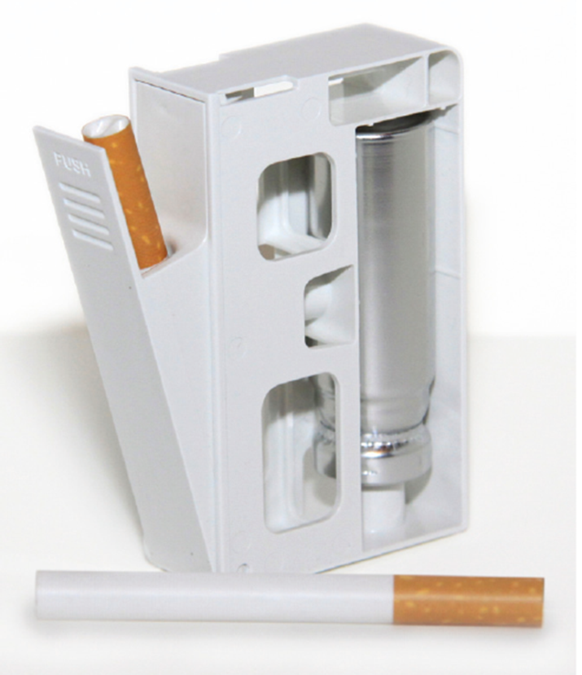

Slide 14


Slide 15
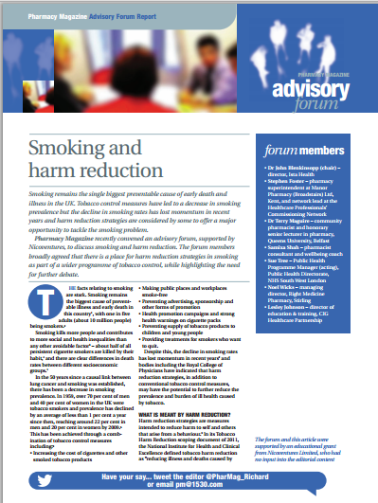



Slide 16
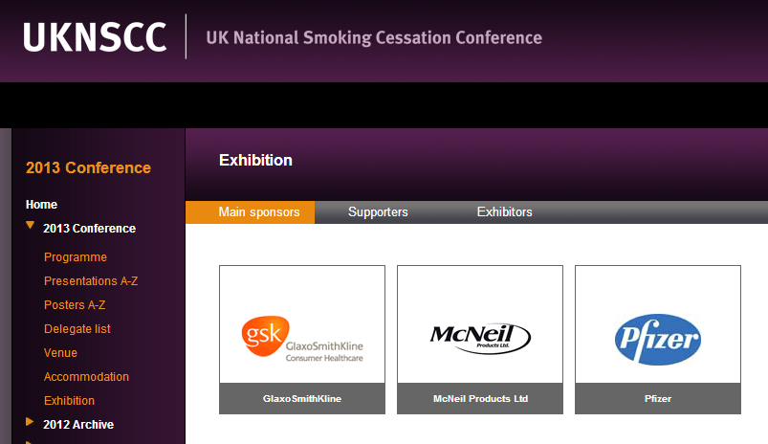

Slide 17
Regional Brand Manager, Europe and Canada
Pfizer
Public Company; 10,001+ employees; PFE; Pharmaceuticals industry
April 2009 – April 2011 (2 years 1 month)
Led key European smoking cessation policy report project from conception to development, and launch.
…..worked with influential opinion leaders to develop an important report highlighting the necessary actions required at a country and European level in order to comply with the WHO's Framework Convention for Tobacco Control's legally binding Article 14 guideline
Successfully developed and ran the first medical education project to be delivered within the new Pfizer structure: a key meeting series on smoking cessation delivered to 1000 GPs across Europe
Quickly developed excellent relationships with KOLs in order to gain customer insights to develop brand strategies and tactics
(http://uk.linkedin.com/pub/...............................)

Slide 18


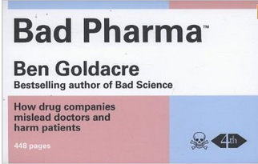
Pharmaceutical company ethics…

Slide 19

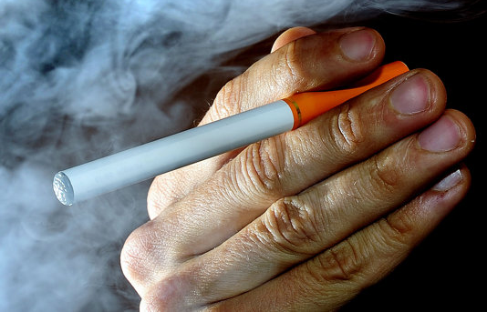
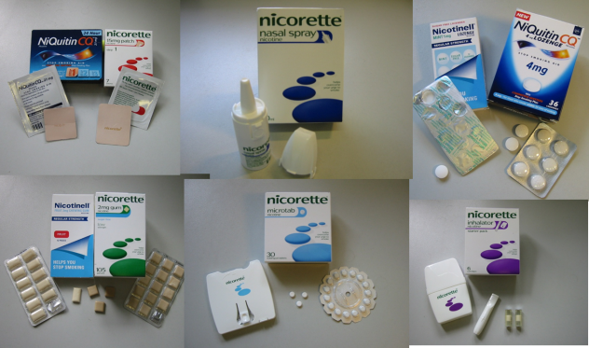
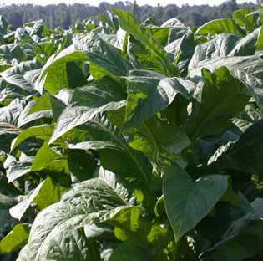
Is it workable to say ‘no’?
FCTC Article 1: “tobacco industry” means tobacco manufacturers, wholesale distributors and importers of tobacco products

Slide 20



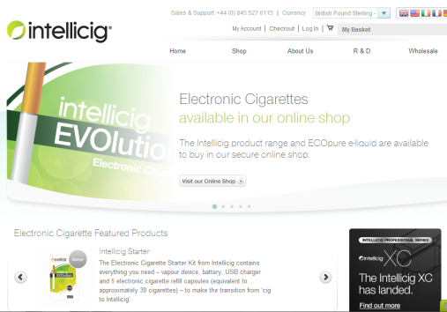

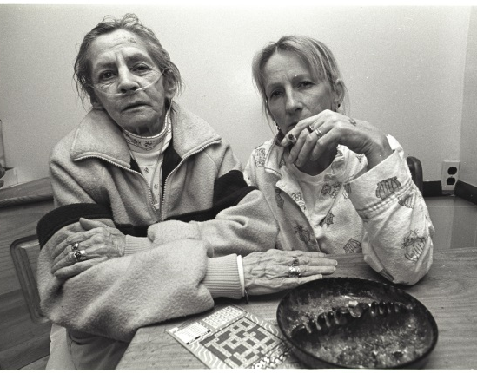
Brittonconsumer
Taking a liberty, making a mint
Zappex
?

Slide 21
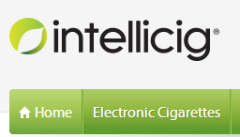

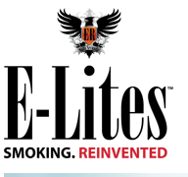












Slide 22
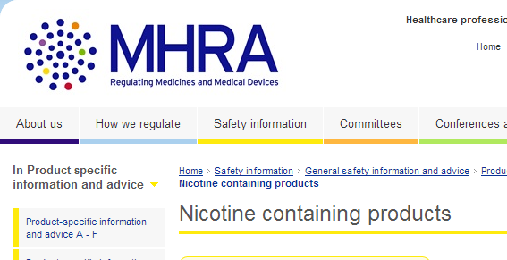
So does it matter who makes them?
Promotion to children
Promoting dual use, hence continued smoking
Undermining denormalisation of smoking
Undermining smoke-free policy
Product safety, reliability, long-term toxicity
Cross promotion of cigarettes etc etc ….
… so regulate the product, not the maker

Slide 23
