Slide 1
Evaluation of the ‘skycig’ electronic cigarette for nicotine delivery and subjective effects following acute use in regular users
Lynne Dawkins¹ & Olivia Corcoran²
¹Drugs and Addictive Behaviours Research Group;
http://www.uel.ac.uk/psychology/research/drugs
²Medicines Research Group; http://www.uel.ac.uk/mrg/index.htm

Slide 2
Conflict of Interest & Funding
This study was funded by SKYCIGS
Lynne Dawkins has previously undertaken research for e-cigarette companies, received products for research purposes and funding for speaking at research conferences
Olivia Corcoran has no conflicts of interests to declare

Slide 3
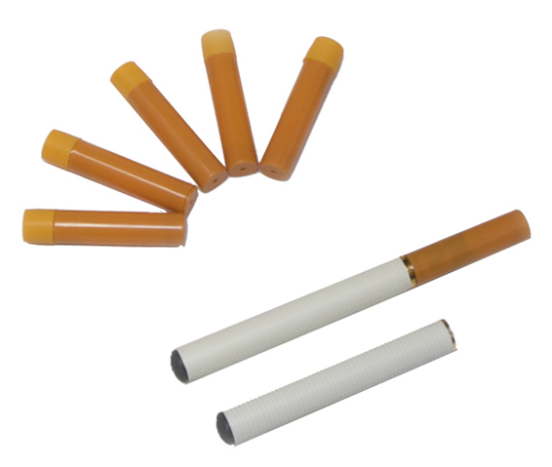
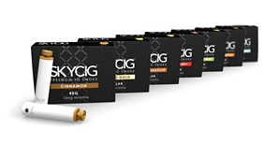
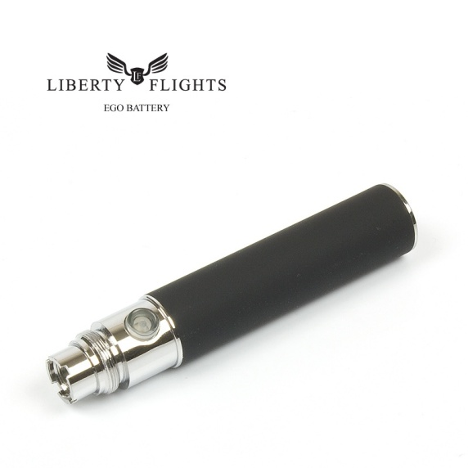
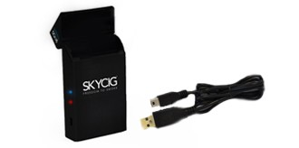
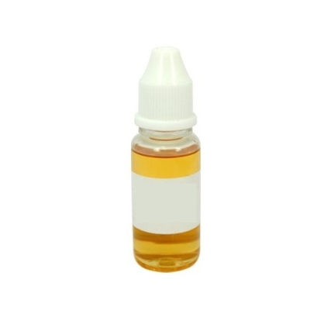
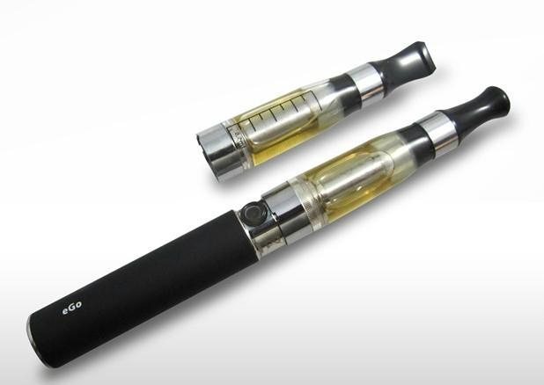
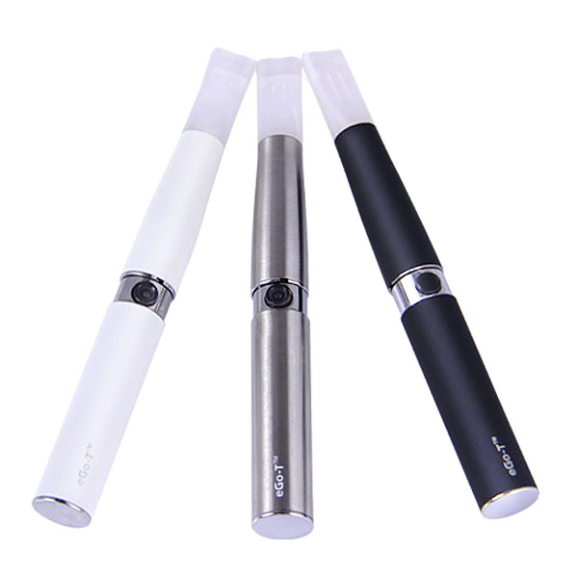
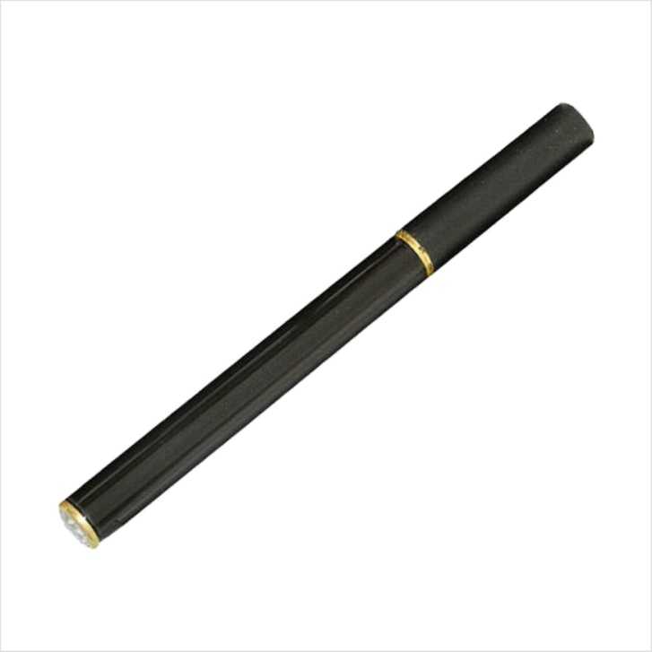
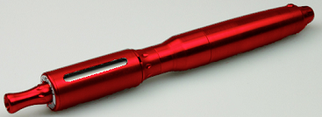
E-cigarettes: what are they?

Slide 4
Previous Research:
Survey data suggest that the majority of smokers use e-cigs to stop smoking (74%; Dawkins et al., 2013)
Bullen et al. (2010)
Relative to 0mg, the16mg (Ruyan) e-cig reduced craving but not withdrawal symptoms over 60 minutes.
Mean tmax: 19.6 mins; mean Cmax: 1.3ng/ml
Eissenberg (2010)
Compared 2 brands of 16mg e-cigs to tobacco smoking
Only tobacco smoking sig raised blood nicotine levels
Both e-cigs ineffective at suppressing craving

Slide 5
Previous Research:
Ineffective / inconsistent vaping in naive users?
Vansickel & Eissenberg (2013)
Effective nicotine delivery in 8 experienced ‘vapers’
Increase from 2ng/ml at baseline to 10.3ng/ml within 5 mins
Mean tmax: 60 mins; mean Cmax: 16.3ng/ml

Slide 6
Current Aims:
To replicate the Vansickel & Eissenberg (2013) study design in a sample of habitual e-cigarette users (vapers) using a standard cigarette-like cartomizer e-cigarette (the SKYCIG) with 18mg/ml nicotine cartridge
To explore effects of the e-cigarette on urge to smoke, tobacco-related withdrawal symptoms and adverse effects

Slide 7
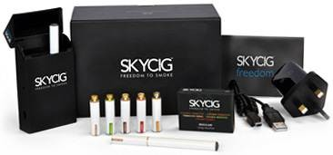
Methods
Participants: 14 regular SKYCIG users (3 female; mean age 37)
The E-cigarette: skycig 2-piece cartomizer e-cigarette fitted with 18mg/ml Crown Tobacco Bold cartridge

Slide 8
Procedure
Overnight abstinence
60m ad lib vaping
60m rest (no vaping)
baseline
10 puffs
B = blood
Q = questionnaires
B
Q
B
Q
B
B
B
B
Q
B
Q
Analysis of nicotine from plasma samples conducted by ABS Labs via mass spectrometry

Slide 9
Questionnaires
Fagerström Test of Cigarette Dependence (baseline)
Mood & Physical Symptoms Scale (MPSS; West & Hajek, 2004): depressed, irritable, restless, hungry, poor concentration (all rated from 1-5) & urge to smoke (rated from 1-7).
21 item VAS assessing side effects – e.g.:
Nausea
Not at all
extremely

Slide 10
Demographic & smoking/vaping related information
 | N | Min | Max | Mean | SD
Age started smoking | 14 | 13 | 20 | 15.6 | 1.9
Duration of smoking cessation (months) | 8 | 1.5 | 12 | 5.6 | 3.2
Duration of skycig use (months) | 14 | 1 | 17 | 4.7 | 3.8
Cartridges per day | 14 | 1 | 4 | 1.8 | 0.8
Puffs per day | 9 | 25 | 200 | 98.3 | 65.1
FTCD | 14 | 0 | 8 | 4.0 | 2.6
CO level | 14 | 1 | 5 | 3.2 | 1.4
Plasma nicotine (ng/ml) | 14 | 0.5 | 1.4 | 0.7 | 0.3

Slide 11
Mean plasma nicotine levels
Error bars = 1SE
Sig increase from mean of 0.7 ng/ml at baseline to 5.4 ng/ml at end of 10 puff period (p < 0.01)
Mean max of 13.8ng/ml by end of 60 mins ad lib vaping

Slide 12
Individual nicotine levels
Mean puffs: 29
Moderate, non-sig correlation between number of puffs and plasma nicotine (r = 0.48, p = 0.16)

Slide 13
Withdrawal symptoms & Urge to smoke
Error bars = 1SE
Sig reduction in MPSS scores and urge to smoke from baseline to 10 puffs and 60 mins ad lib vaping (p < 0.05)

Slide 14
Adverse Effects
Side Effect | Min | Max | Mean | SEM
Light-headedness | 4 | 85 | 41.36 | 7.37
Throat irritation | 3.5 | 75.5 | 27.25 | 7.53
Dizzy | 3.5 | 59 | 24.82 | 5.54
Salivation | 3.5 | 66.5 | 20.71 | 5.58
Mouth irritation | 4.5 | 62 | 16.54 | 4.75
Weak | 4 | 69 | 14.86 | 4.90
Cold hands/feet | 3 | 50 | 10.82 | 3.32
Pounding heart | 3 | 29 | 10.71 | 2.40
Headache | 0 | 56 | 10.61 | 3.81
Sweaty | 3.5 | 48.5 | 9.79 | 3.08
Mean TOTAL | 3.9 | 21 | 12.81 | 1.45

Slide 15
Summary/Conclusions
Effective plasma nicotine concentrations can be achieved via use of an e-cigarette cartomizer device (skycig) in habitual users
Wide individual variation & gender effects
The skycig seems to be effective in alleviating urge to smoke and tobacco-related withdrawal symptoms…
…And associated with low reporting of adverse effects

Slide 16
Future Directions/Implications
Future work should explore effects of vaping topography and device characteristics in relation to nicotine delivery
Level of nicotine in cartridges may not be important if vapers can adapt the way they vape to influence nicotine delivery

Slide 17
Acknowledgements:
Thanks to:
Skycigs for funding the study
ABS labs for bioanalysis of nicotine from plasma
Paula Booth for recruitment and data collection
Participants

