Slide 1
Using air quality feedback to reduce SHS levels in homes: working in partnership with a local champion to deliver the REFRESH approach Amanda Amos, Donald Lockhart, Rory Morrison, Deborah Ritchie, Sean Semple, Steve Turner, John Watson

Slide 2
REFRESH Reducing Families Exposure to Secondhand Smoke in the Home
Aim- to reduce children’s SHS exposure by creating a smoke-free home
Feasibility study/pilot rct
Intervention- letter from GP to mothers who smoke with children aged 1-5 years, personal air quality feedback (24hrs) from Sidepack monitor + motivational interview
Follow-up at one month

Slide 3
Learning from REFRESH
Delivering the intervention was feasible
The intervention was understandable and acceptable
Improved home air quality measures at one month
BUT
Only 3.5% uptake
Delivering the intervention was resource intensive, the Sidepack monitor was expensive and required technical skills to install

Slide 4
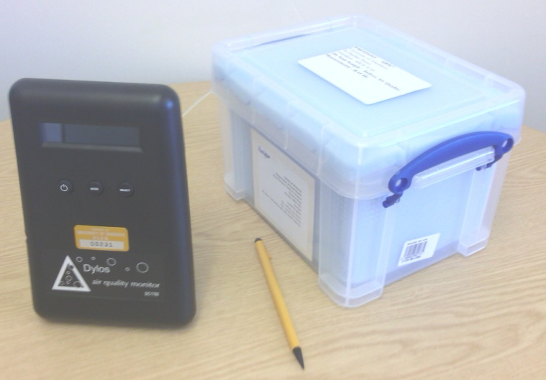
Greendykes Project
A follow-on from main REFRESH project
Investigated the feasibility of delivering low-cost SHS intervention with the Dylos machine
Dylos is cheaper, less noisy, smaller, can be posted, simple to operate, differentiates SHS from other household PM sources
Delivered at Greendykes Child and Family Centre (children 0 to 5 years) by a non-expert ‘local champion’
Low cost, relatively light touch – - - solution to recruitment and delivery barriers identified in REFRESH?

Slide 5
Greendykes Child and Family Centre

Slide 6
Project Aims
To test the feasibility of offering a modified version of the REFRESH intervention providing home air quality monitors to smoking parents and carers whose children are enrolled at Greendykes
To evaluate the experiences and outcomes of participating households receiving this intervention
To evaluate the experiences of the Greendykes staff and ‘local champion’ of the manageability of intervention.

Slide 7
The pilot
Aimed for 10 participants
Postal or Centre delivery and return of Dylos
Intervention (recruitment, personal feedback) delivered by local champion (a Group Worker at Greendykes)
Training: 2.5 hours local champion + 20 mins all staff briefing
Follow up interviews with participants, interview with local champion and focus group with staff

Slide 8
Diagram of participant path through intervention
Recruitment & completion of baseline questionnaire
1st Air quality measurement period 5 days (spanning a weekend) of air quality logging in the home, instrument sent back to REFRESH team for analysis & summary.
1st Feedback session
Written feedback on results of 1st air quality monitoring discussed with participants by local champion, information on reducing SHS in home provided.
2nd Air quality measurement period & follow-up questionnaire Complete follow-up questionnaire and further 5 days (spanning a weekend) of air quality logging in the home, instrument & completed questionnaire sent back for analysis & summary.
2nd Feedback session Written feedback on results of 2nd air quality monitoring, including comparison with 1st measurement, discussed with participants by local champion.
Interviews with participants 30 minute 1:1 semi-structured interviews exploring behavioural changes around SHS in the home & experience of the research process. Gift voucher given to participants.

Slide 9
Written feedback given to participants with verbal explanation from local champion

Slide 10
Measurement results (1)
Recruitment:
8 participants recruited
7 provided baseline data (1 withdrew)
4 received follow-up Dylos (1 failed to collect data)
3 provided follow-up data

Slide 11
Measurement results (2)
Baseline measures:
25 days of data
Average PM_{2.5} 77μg/m³ (range 20-175 μg/m³)
40% of time above WHO guidance value (25 μg/m³)
Follow-up measures:
3 follow-up participants
Baseline average of 51 μg/m³
At follow up was 20 μg/m³
14% of time above WHO guidance value

Slide 12
Interview findings- participants
5 of 8 were interviewed (3 had left the Centre)
All expressed desire to protect child health, reported already taking steps to limit child exposure (smoking in kitchen, at back door, cooker hood fan etc)
Delivery and self-install generally worked well, preferred to collect/return to Centre
Expressed surprise and disbelief at PM_{2.5} levels
All had discussed AQM with friends/family
Highlighted facilitators (eg childcare, removing ashtrays) & barriers (eg stressful situations)

Slide 13
Focus group and interview- staff
Data collection and feedback package worked well, and was comprehensible
Local champion was crucial
Large time demand for local champion (pt)
Other centre staff could possibly have been engaged to a greater extent for additional benefit- requires more training

Slide 14
Conclusions
A small pilot study but
Demonstrated as feasible a way to deliver air quality interventions that overcome some of the barriers identified in the original REFRESH project
Need to develop and test this approach with larger numbers involving more staff
‘First Steps to Smoke-Free’ trial with NHS Lanarkshire First Steps

Slide 15
Thanks
http://www.refreshproject.org.uk

