Slide 1
E-cigarette use within a local Stop Smoking Service
Frances Sherratt - PhD Student - Liverpool Lung Project

Slide 2
Overview
The rise of electronic cigarette use
The current e-cig study
Implications for future research and practice

Slide 3
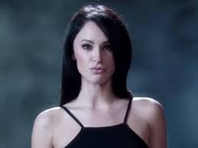
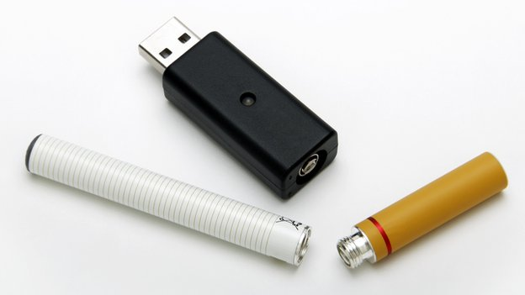
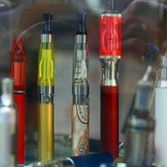
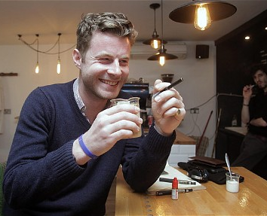
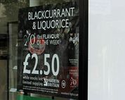
The rise of e-cigarettes
The Independent. ‘Put it in my mouth’: Viewers outraged by apparent reference to oral sex in VIP e-cig advert [photograph]. Retrieved from http://www.independent.co.uk/news/media/advertising/put-it-in-my-mouth-viewers-outraged-by-apparent-reference-to-oral-sex-in-vip-ecig-advert-8982918.html
Marketing Magazine. E-Lites secures product placement 'first' in Lily Allen's 'Hard Out Here' video
[photograph] Retrieved from http://www.marketingmagazine.co.uk/article/1220802/e-lites-secures-product-placement-first-lily-allens-hard-here-video
Mingay, Jane (for The Telegraph). The Great British Vape-off debate. [photograph]. Retrieved from http://www.telegraph.co.uk/health/10747395/The-Great-British-Vape-off-debate.html

Slide 4
Increasing popularity
ASH (2014)
- 2.1 million e-cig users in the UK
- 1/3 former smokers and 2/3 current smokers
Herzog [Wells Fargo Securities] (2013)
- E-cig sales surpass regular cigarettes?
ASH (2014)

Slide 5
Effectiveness

Slide 6
Safety
Short term toxicity – low. Long term -unknown (Bertholon et al., 2013)
Improvements in spirometry data (Polosa et al., 2014)
Long term carcinogenic and lung function effects unknown (Drummond & Upson, 2014)

Slide 7
Current guidance
The regulation of e-cigs has been welcomed to ensure they are safe and effective (BMA, 2014; ASH, 2014)
IASLC advises against recommending using them presently (Cummings et al., 2014)

Slide 8
Stop Smoking Services (SSS)
Beard et al. (2014) [In Dec 2012] practitioners reported:
- No users – 10.4%
- Less than a quarter of clients - 52.3%
Variability in practitioner advice
Limitation – no objective data

Slide 9
E-cig study: aims
To ascertain the demographic characteristics associated with e-cigarette use.
To explore patterns of e-cigarette use.
To examine e-cigarette risk perceptions.
To identify contributing factors of e-cig use.

Slide 10
E-cig study: methodology
Participants (n = 256)
Roy Castle FagEnds, Liverpool
Consent acquired within drop-ins
Questionnaire completed

Slide 11
1. Results: demographics
E-cig use not associated with marital status, ethnicity, age, or educational attainment (p = 0.87, p = 0.31, p = 0.72, p = 0.65, respectively)
E-cig use more common among females (p<0.05)

Slide 12
2. Results: patterns of use
Current 18.8%/ former 30.5%/ never 50.8%
Majority:
- used within past month (53.8%)
- viewed e-cigs as a short-term smoking cessation aid (75.4%)
- used their e-cig ≤15 times per day (70.9%), with 44% using it less than 5 times per day
Many used the e-cig in a place where they wouldn’t normally smoke (35.4%)
Significant association between e-cig use and smoking status (p < 0.05)

Slide 13
3. Results: risk perceptions
E-cig risk perception was associated with e-cig use (p < 0.01).
No association between e-cig risk perception and smoking status, sex, marital status, educational attainment and age.

Slide 14
4. Results: reason for use
Common responses included:
- Dissatisfaction with current NRT products/ wanting to try something new (13.9%)
- Social encouragement or endorsement (13.9%)
- A similar experience to smoking (13.2%)

Slide 15
Summary and limitations
E-cig use prevalent in this SSS
Use is higher among females and those who perceive them to be less harmful
Generally not excessive use but some evidence of potentially problematic use
Limitations:
- results based on self-reports
- recruitment from one SSS only

Slide 16
Implications
Common use in SSS
- How does this impact on services?
Excessive/long-term use
- Will this increase nicotine dependence?
- Feasibility of provision in SSS
E-cig research priorities – further studies regarding safety/ effectiveness

Slide 17
Acknowledgements
Roy Castle FagEnds staff and participants
Supervisors:
Professor John Field
Professor Jude Robinson
Dr Michael Marcus
Funding:
Liverpool Clinical Commissioning Group (PCT)
Ede & Ravenscroft – travel grant

