Slide 1
Development of a Profit Analysis Tool to Motivate Stop Smoking Service Provider Performance
Presentation by Helen Pearce
Gateshead, South Tyneside and Sunderland
NHS Stop Smoking Service

Slide 2
Aims
Context
GSTS model and function
Model Overview
Purpose and variables
Model Examples
Worked examples using different scenarios

Slide 3
GSTS Model
New programme management model commenced 1st January 2013
Replaced the old ‘specialist’ service
Aimed to increase access to stop smoking support in Gateshead, South Tyneside and Sunderland
All stop smoking support is delivered through a network of Active Intervention (AI) providers (including pregnant smokers, young people, people with mental health problems and those with complex health issues)

Slide 4
GSTS Function
Training
All AI advisors complete a mandatory two day training programme and annual half day refresher
Mentoring
Recruitment of new providers, intensive support and target review meetings, identification of opportunities for quality improvement
Hub Facility
First point of contact for all queries, maintenance AI provider database, referral management and follow up

Slide 5
Business Model Introduction
Prior to initial implementation of new service model, commissioners employed a Pharmacist as pharmacy mentor to increase the number of AI providers and increased target groups, accessibility and choice

Slide 6
Model Overview
Designed to recruit and improve the performance of Level 2 providers
Based on payment for quit dates set plus four and 12 week quit outcomes
Complies with best practice guidance
Variables include
Numbers setting quit dates
Numbers quitting at four weeks
Numbers quitting at 12 weeks
Advisor hourly rate of pay

Slide 7
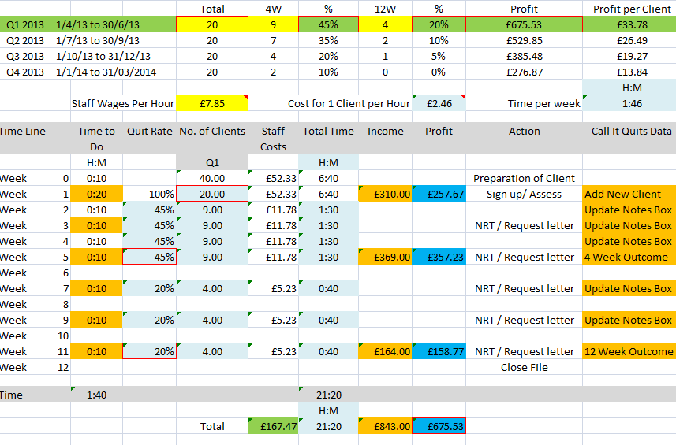

Slide 8
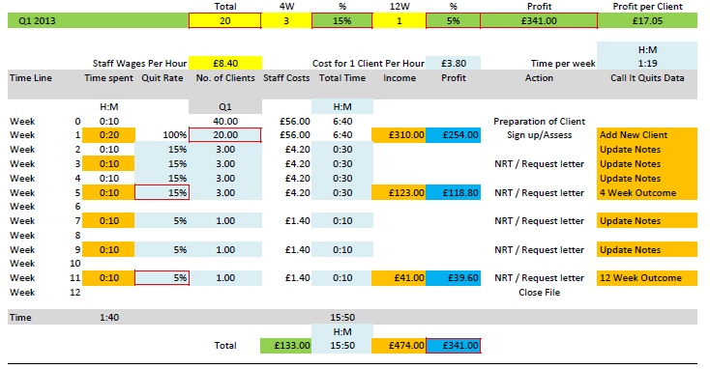

Slide 9
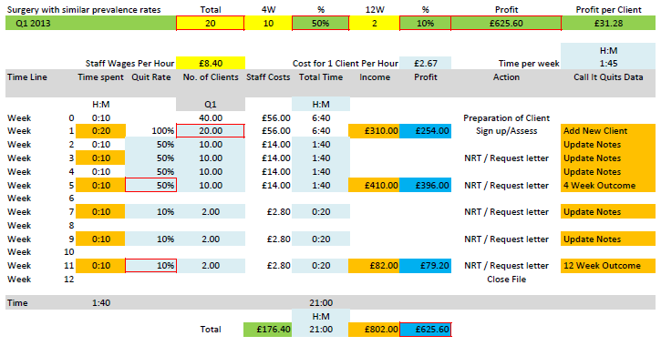

Slide 10
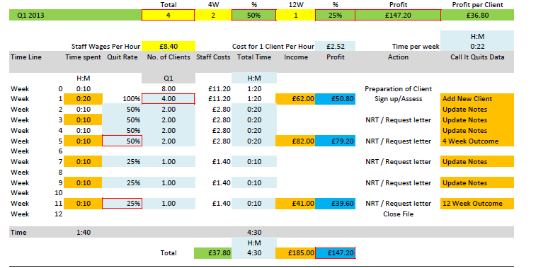

Slide 11
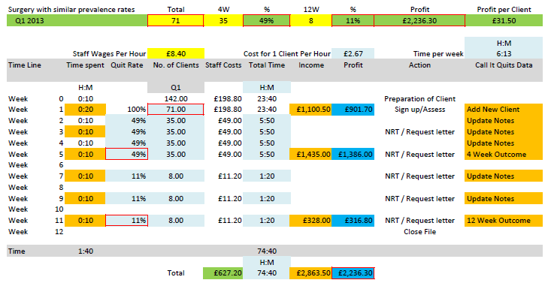

Slide 12
Conclusion
Whilst the pilot profit analysis tool appears to be useful in aiding recruitment of AI providers and encouraging investment in the delivery of quality stop smoking support, more work is needed to develop the tool to maximise and analyse its effectiveness

