Slide 1
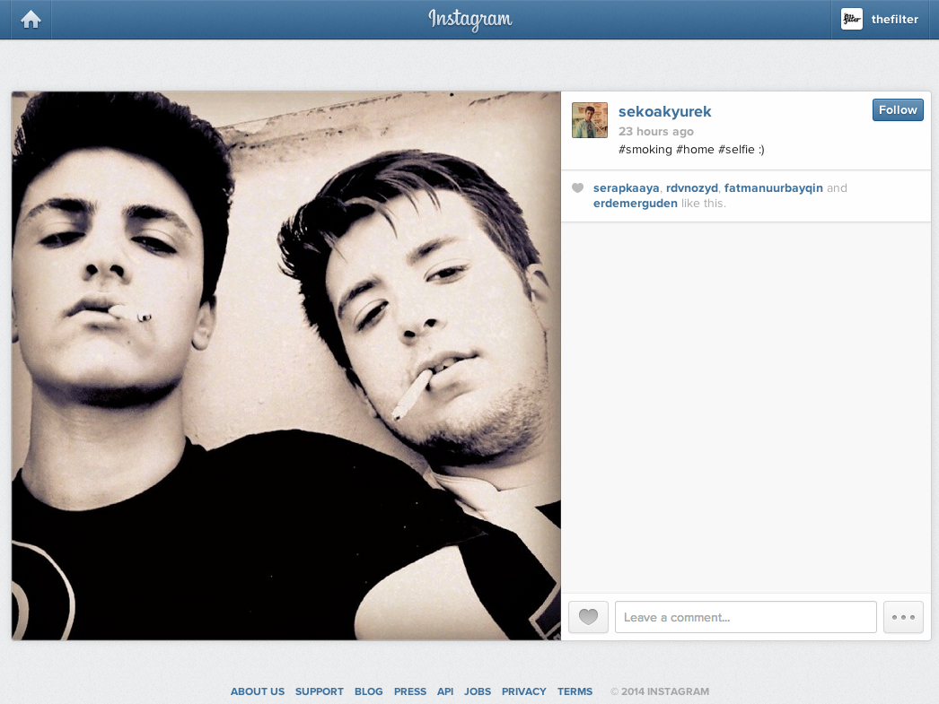

Slide 2
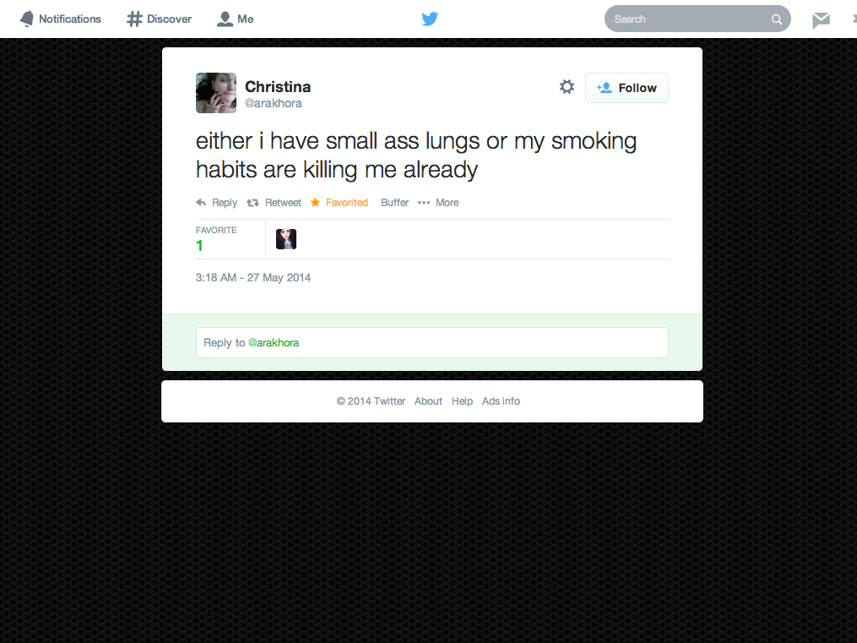

Slide 3
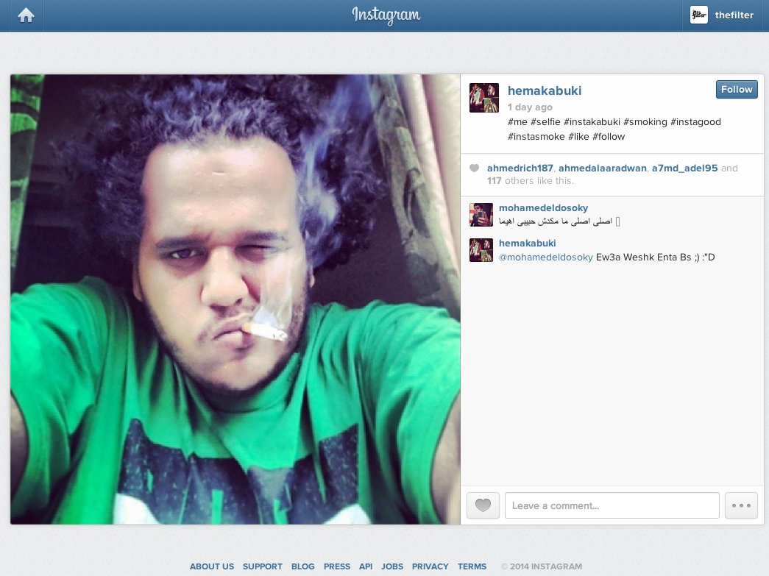

Slide 4
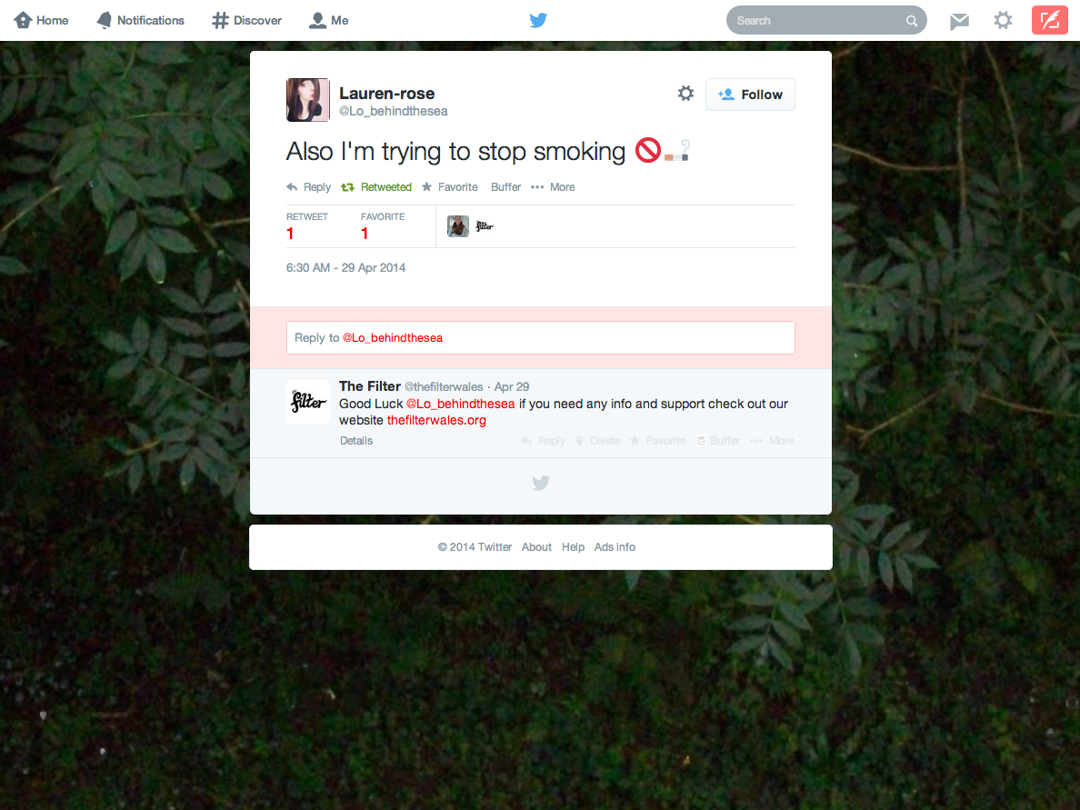

Slide 5
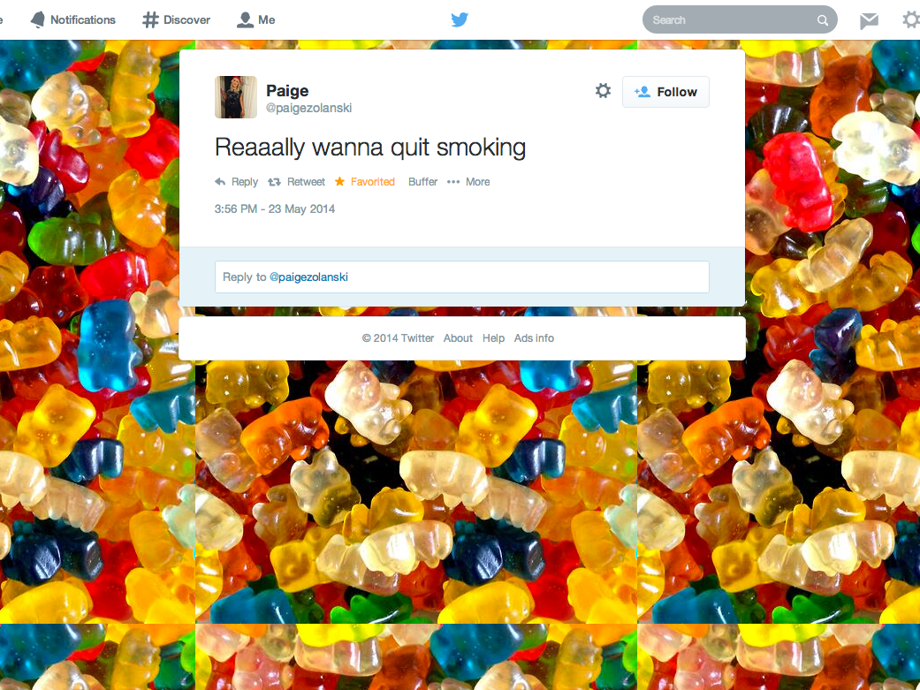

Slide 6
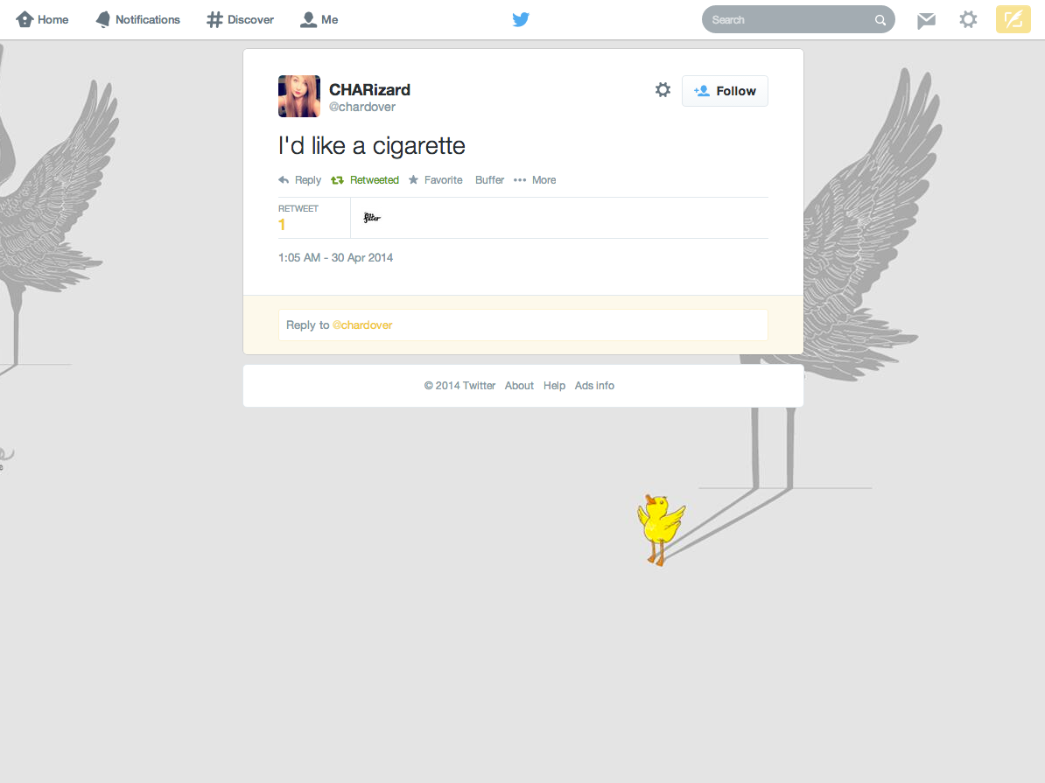

Slide 7
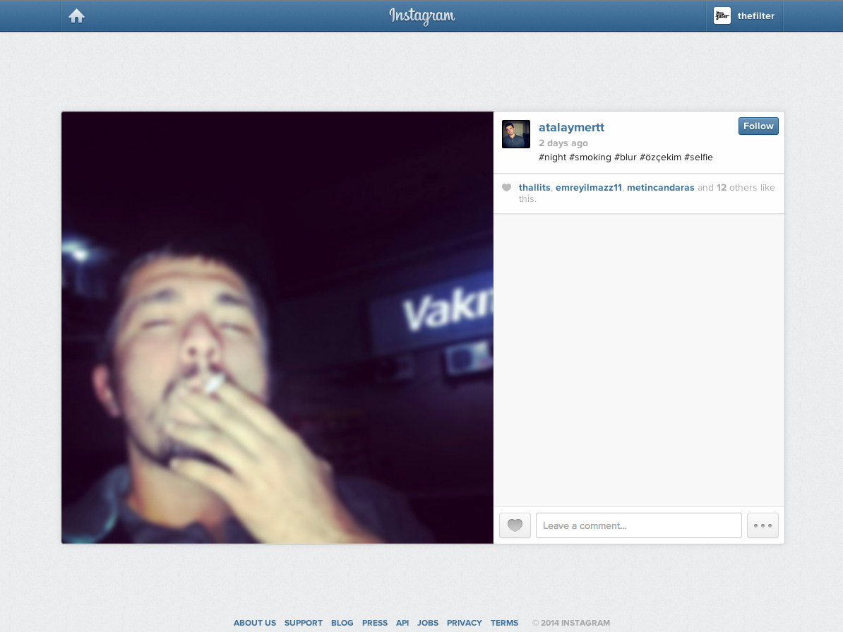

Slide 8
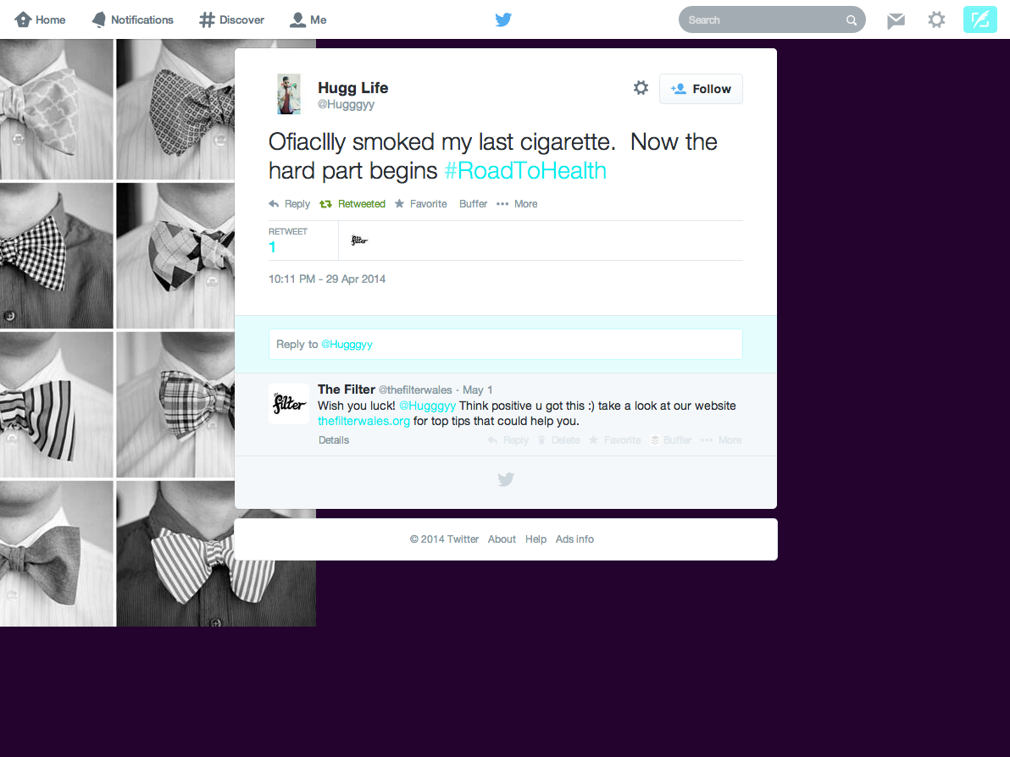

Slide 9
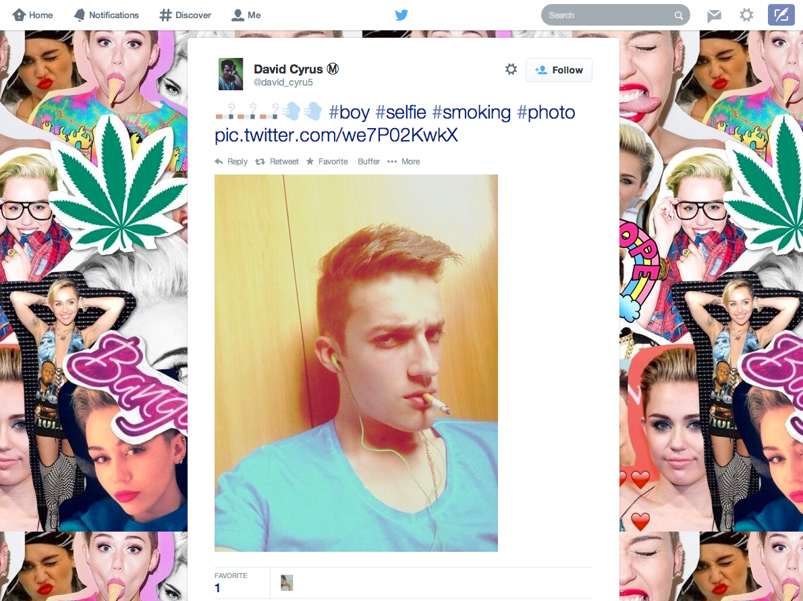

Slide 10
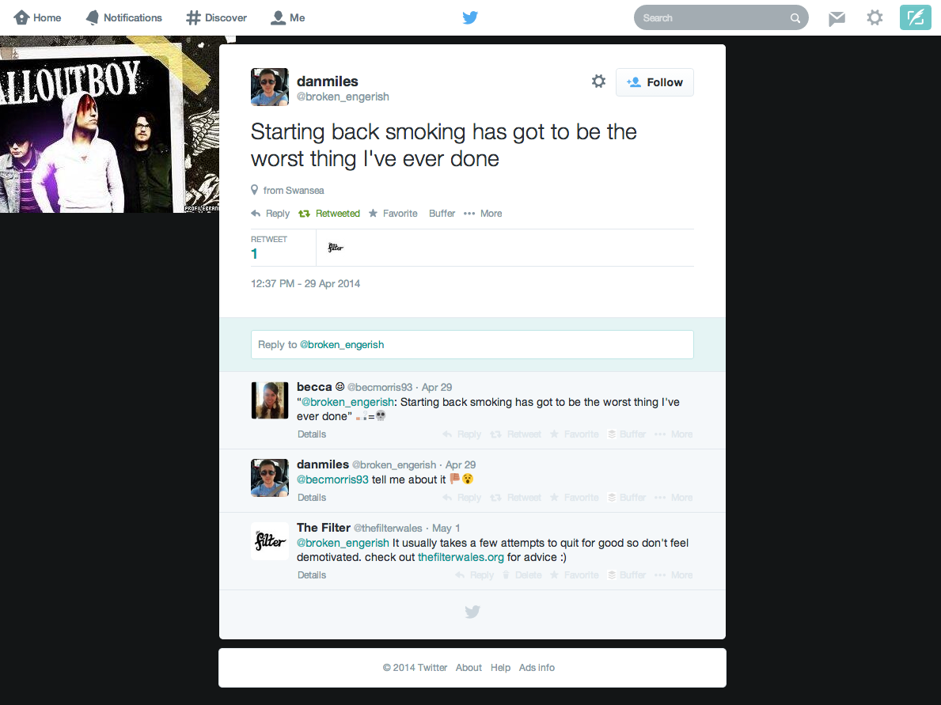

Slide 11
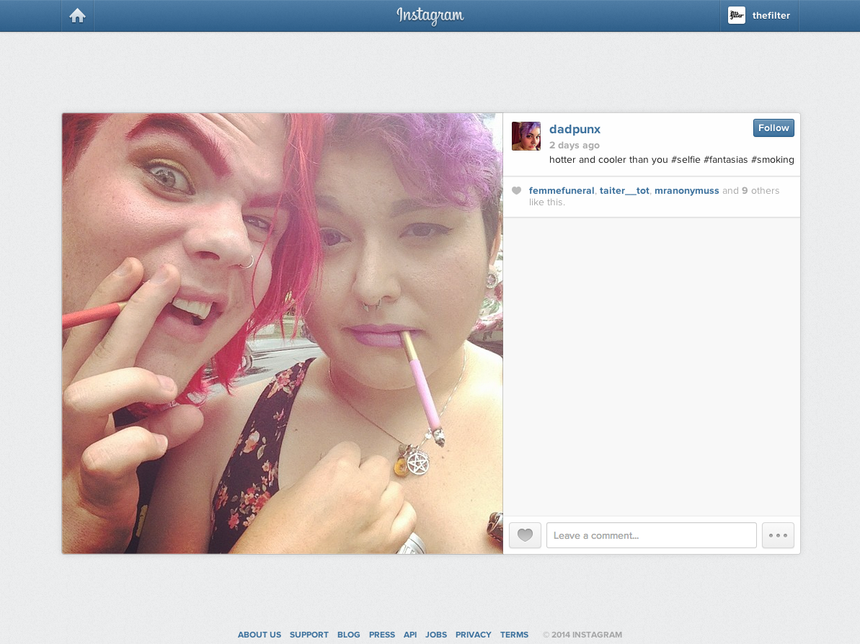

Slide 13
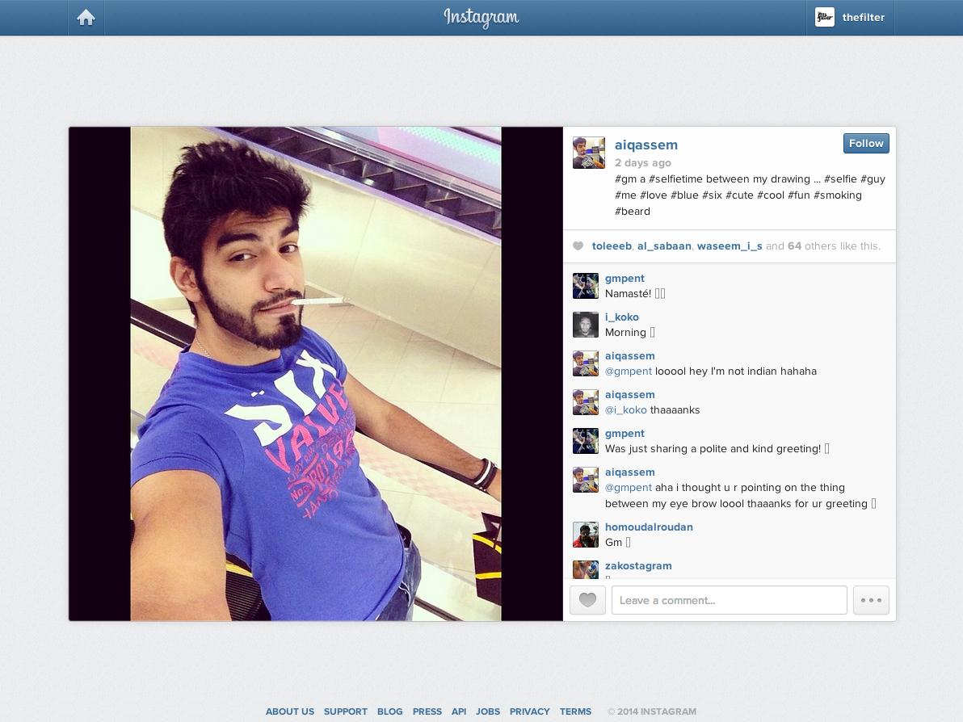

Slide 14
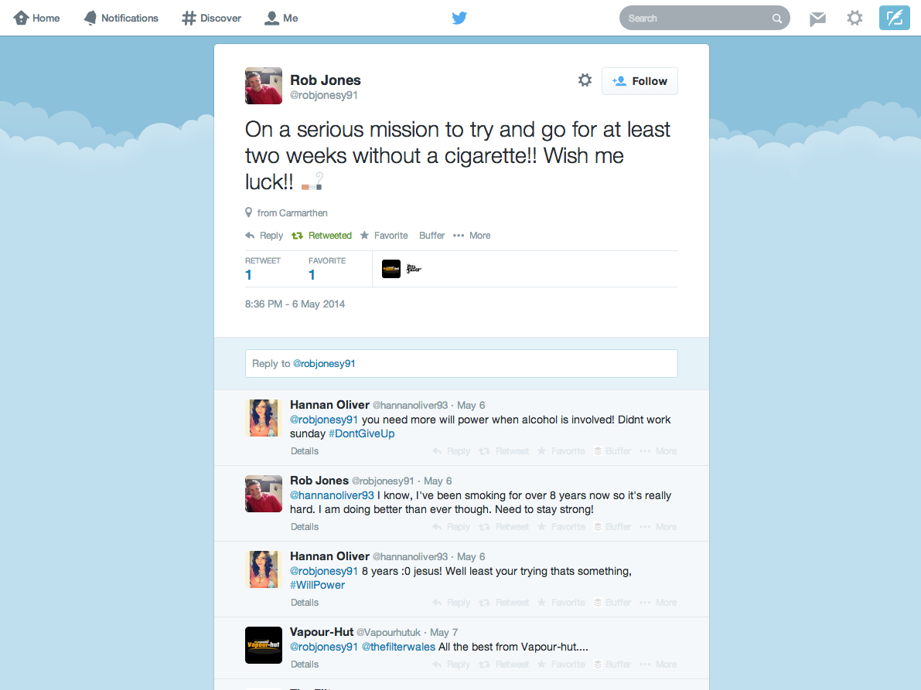

Slide 15
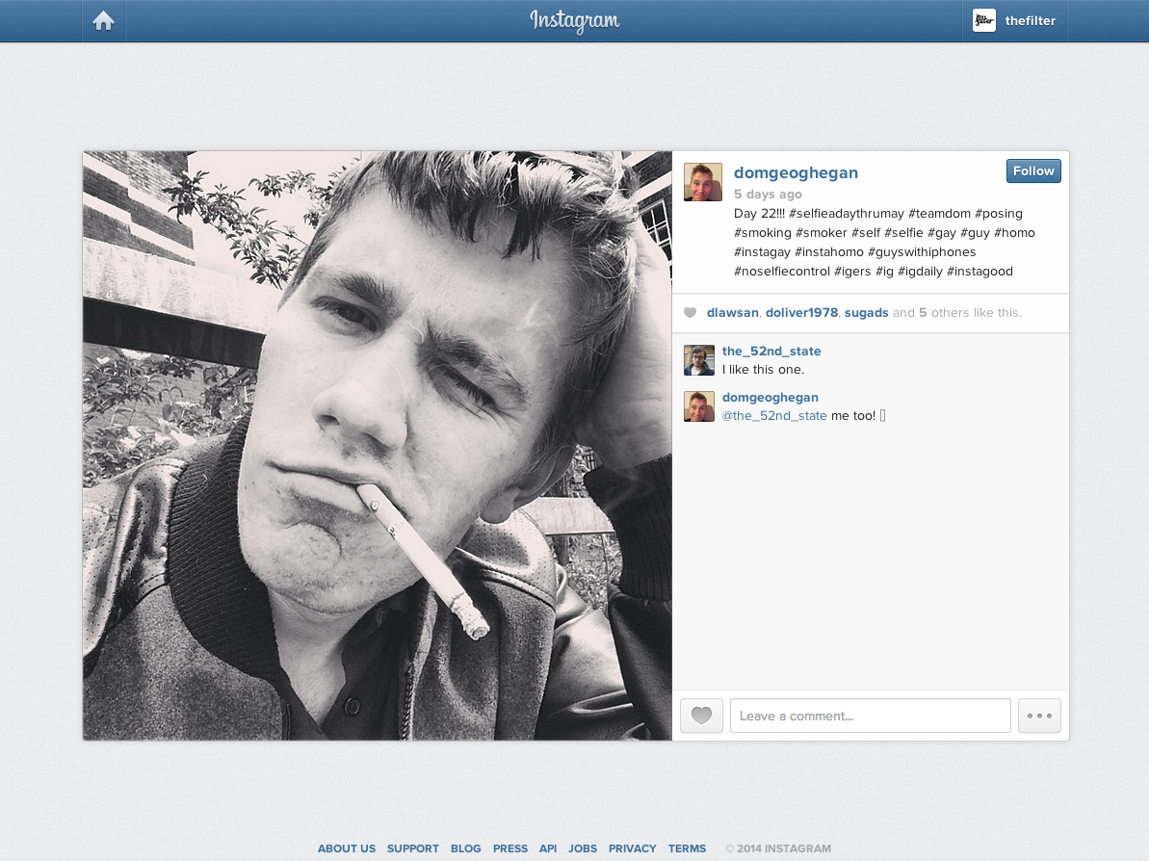

Slide 16
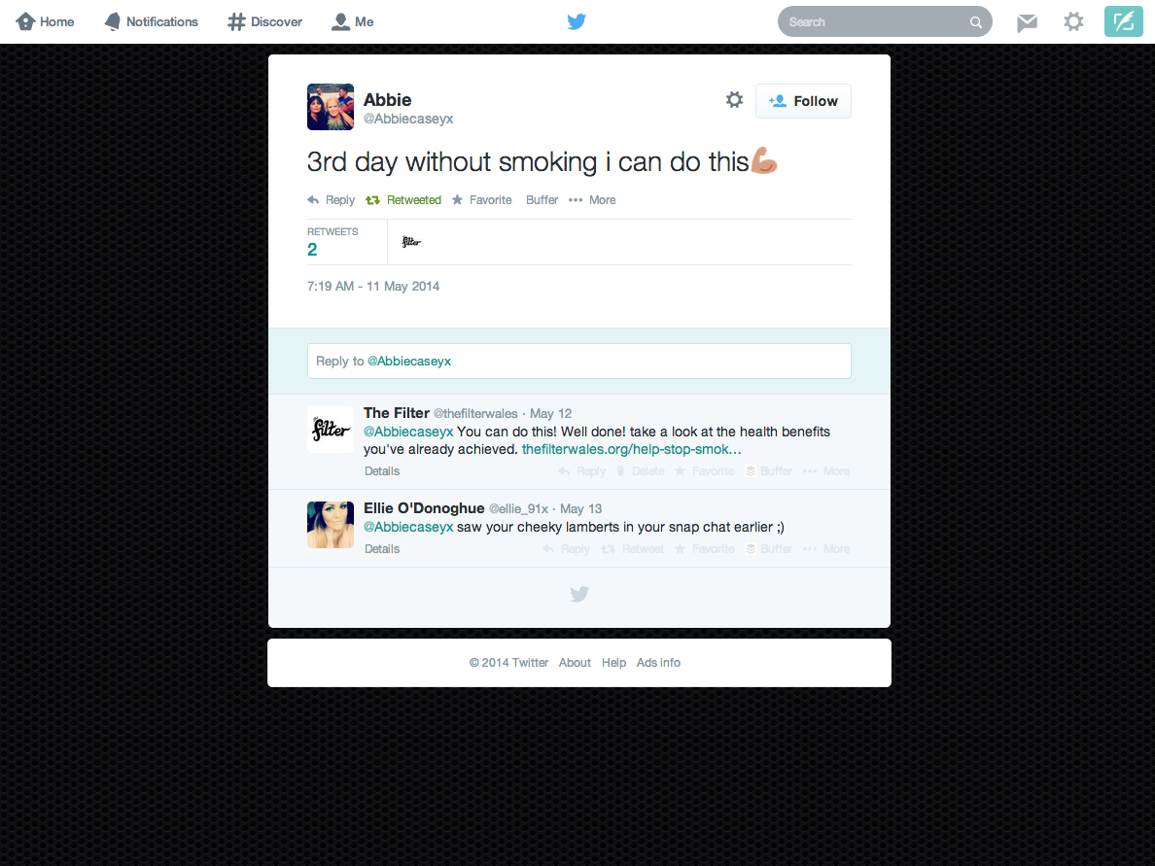

Slide 17
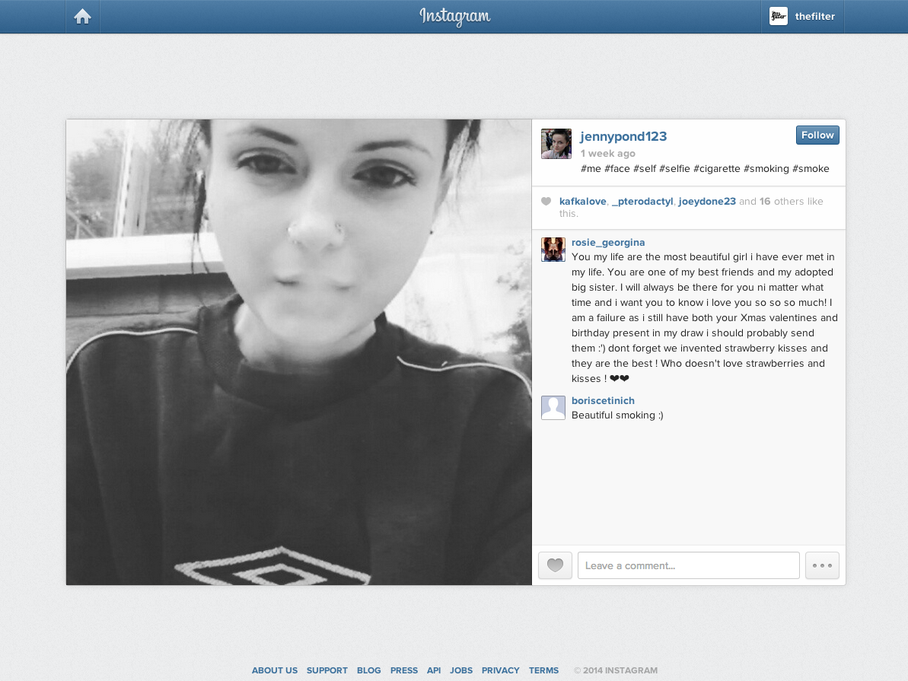

Slide 18
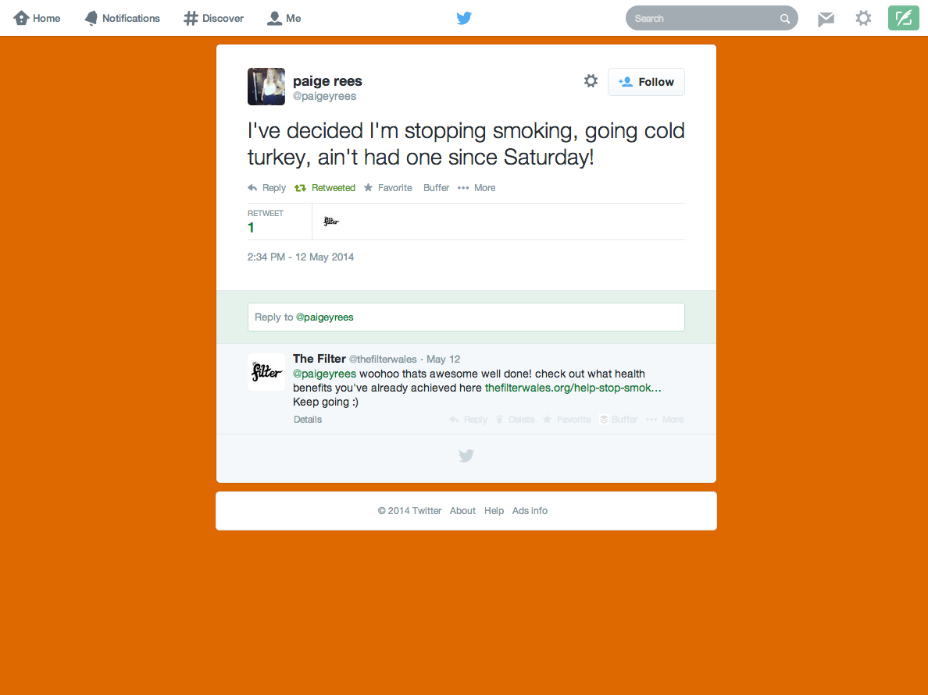

Slide 19
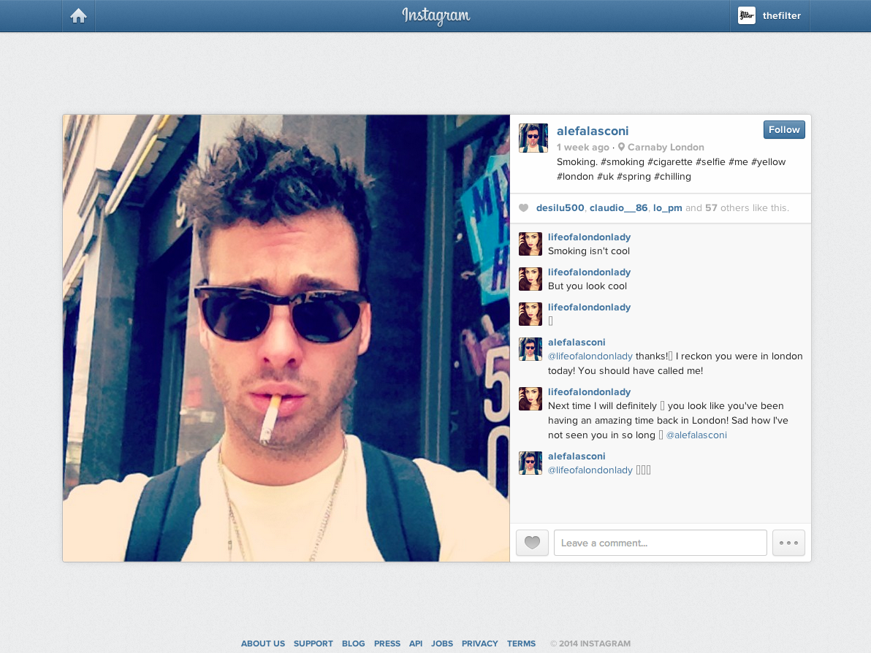

Slide 20
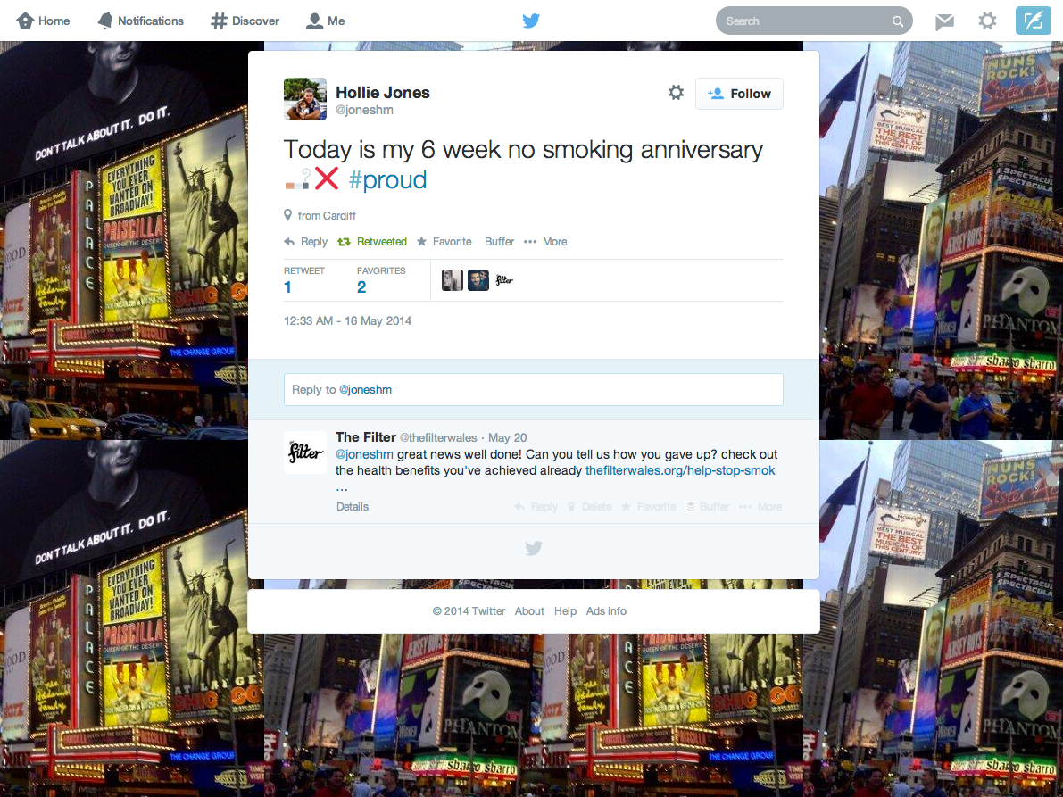

Slide 21
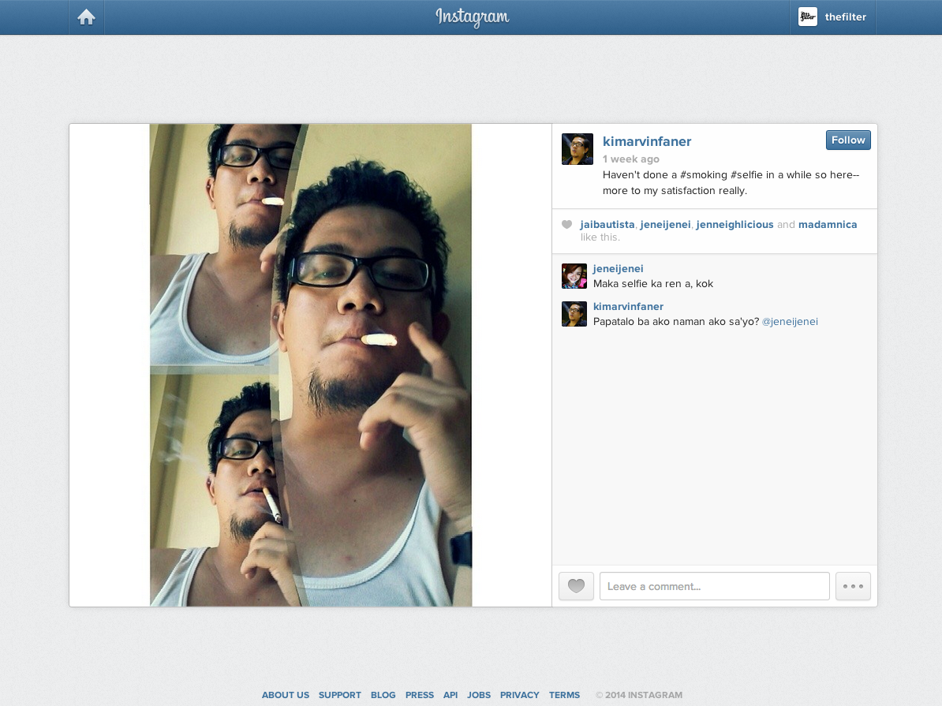

Slide 22
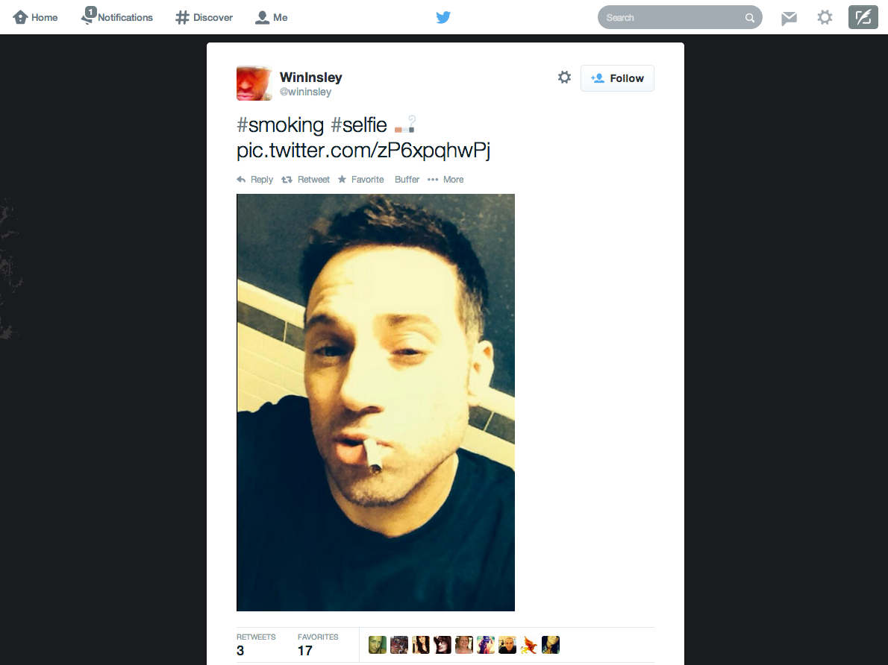

Slide 23
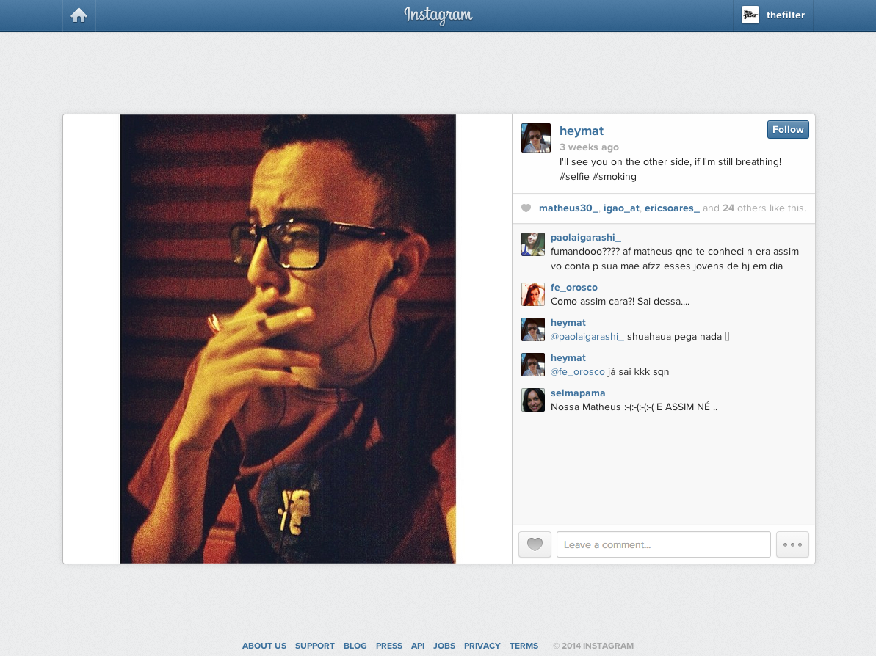

Slide 25
Social Media for Smoking Cessation
UKNSCC 2014
Jen Thornton
@jenthornton01
@thefilterwales

Slide 26
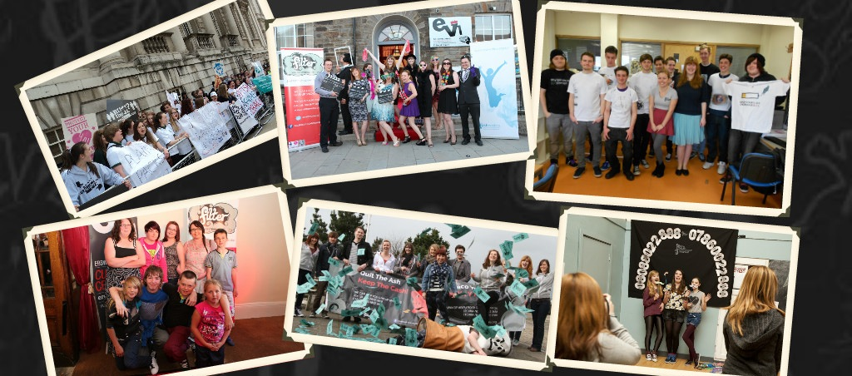
Introduction
About The Filter project
How we are using social media for cessation advice
What are the next steps?

Slide 27
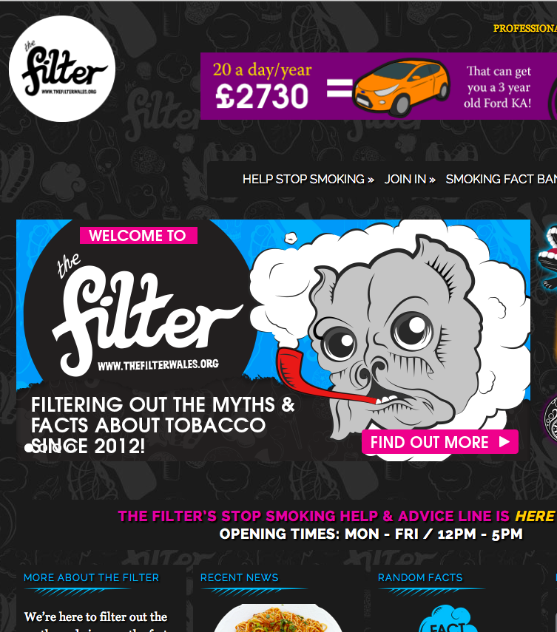
The Filter Project
Part of ASH Wales
Funded by BIG Lottery Fund Wales
Launched in January 2012
Information / Website
Campaigns
Training
Workshops
Smartphone app
Advice Line

Slide 28
Advice Line
Free, accessible
Advisors trained in both youth work and smoking cessation
Responsive

Slide 29
We Go To Them
Most young people are already using social media
Why invite them to a new ‘place’ where they are not comfortable?
Outreach more effective

Slide 30
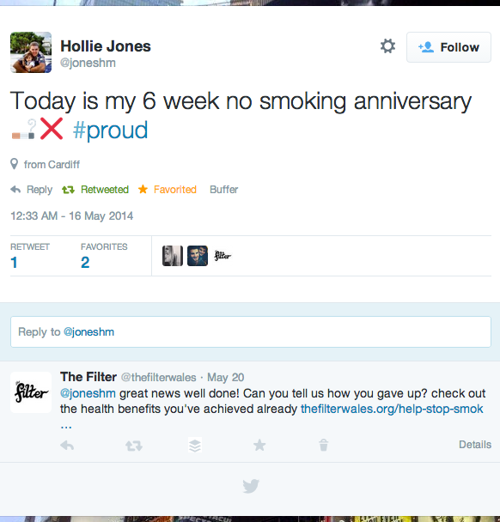
Connecting On Twitter
Social Media team finds relevant Tweets and favourites them
Advice Line team responds directly
Information and support, not instruction

Slide 31
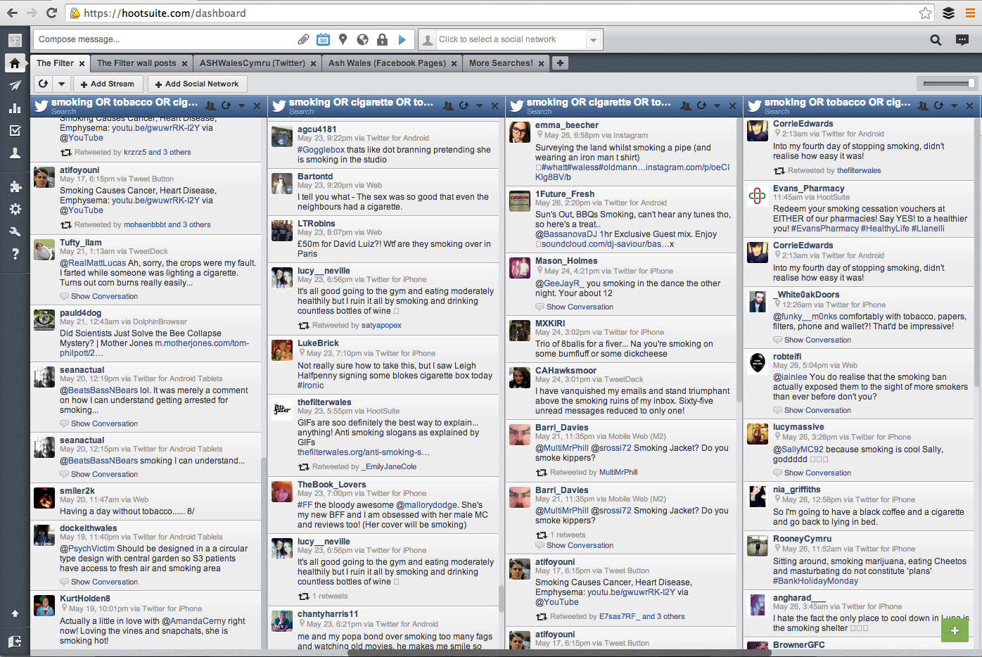

Slide 32
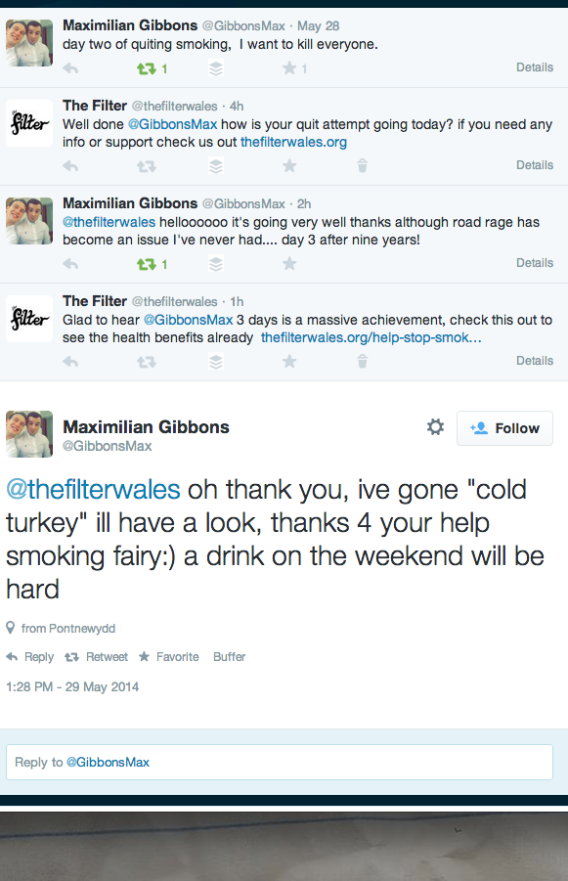
Different Conversations
Connecting on Twitter
After initial intervention, conversation led by young person
Some people want to chat, others just get the information
Effectively the same as offline brief intervention

Slide 33
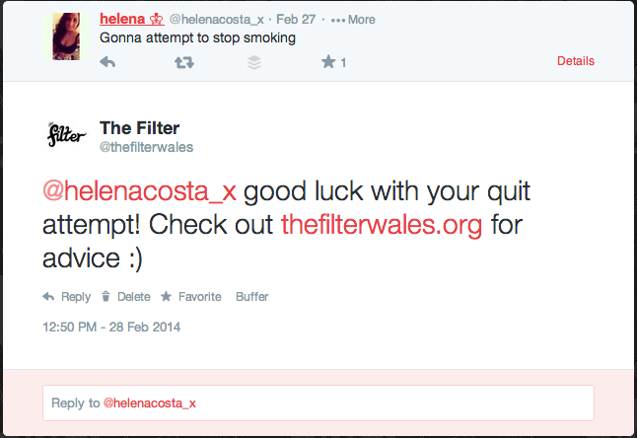
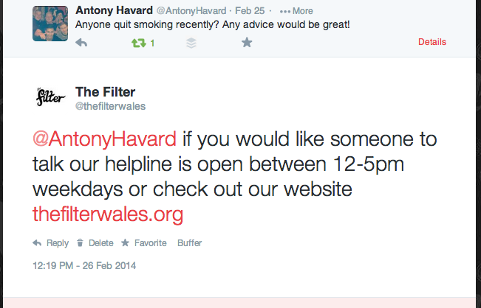
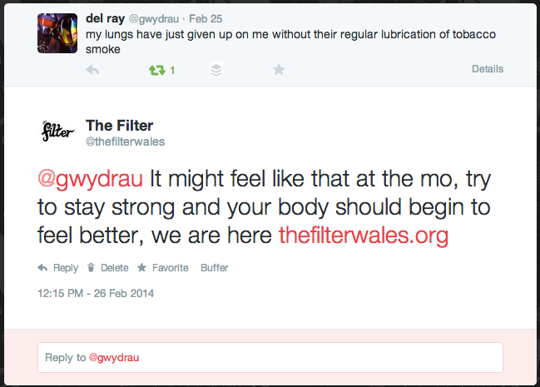
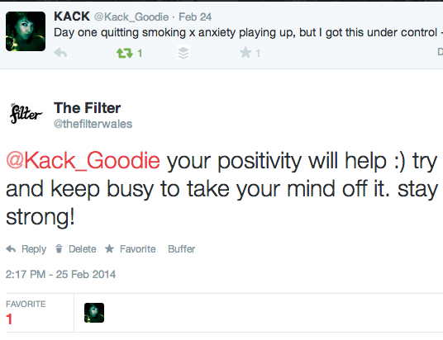

Slide 34
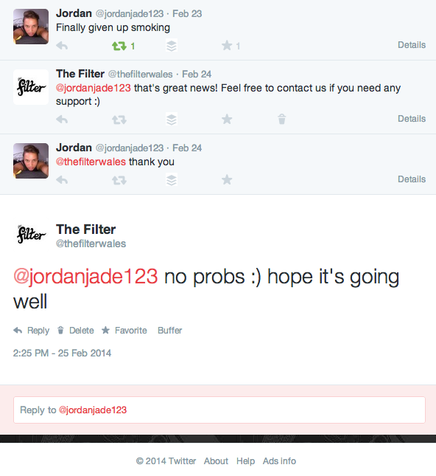
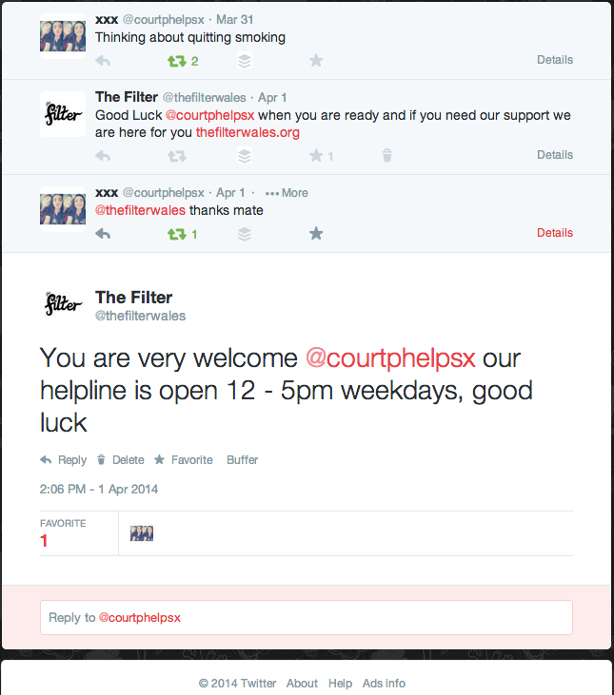

Slide 35
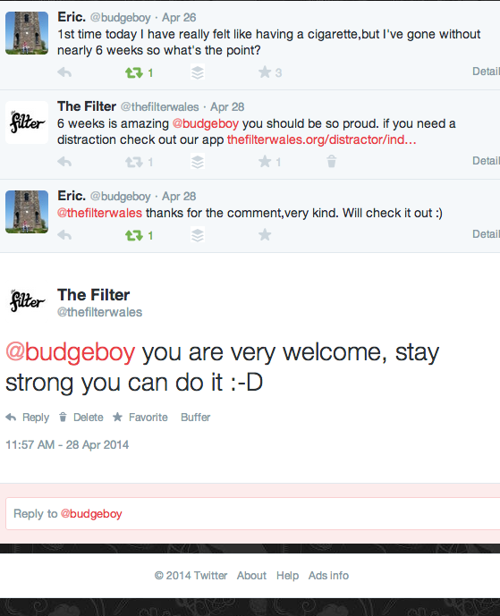
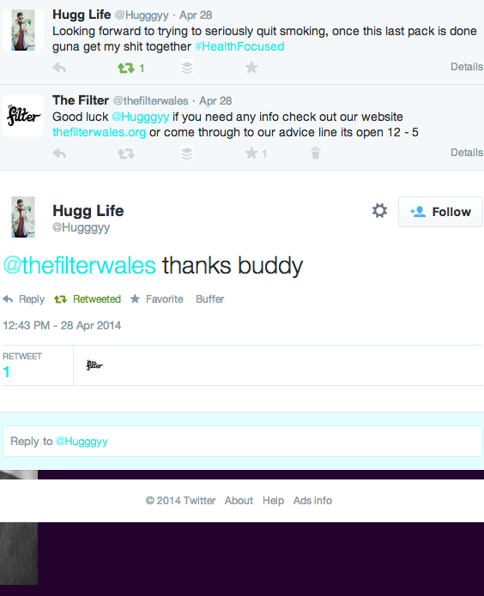
*
*

Slide 36
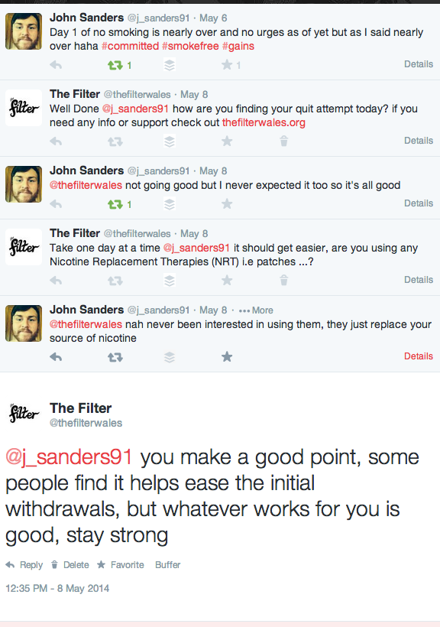
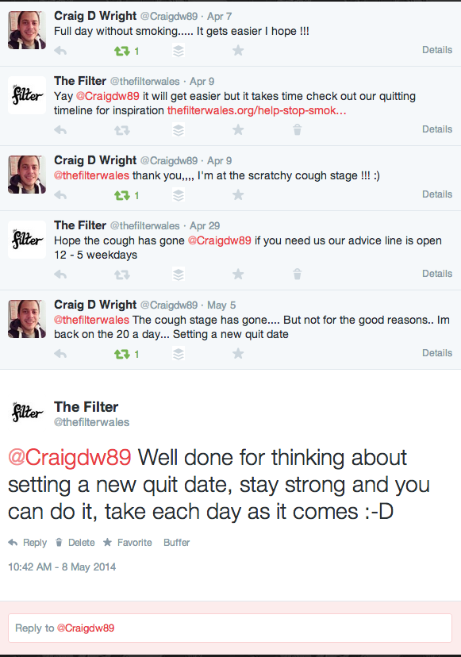

Slide 37
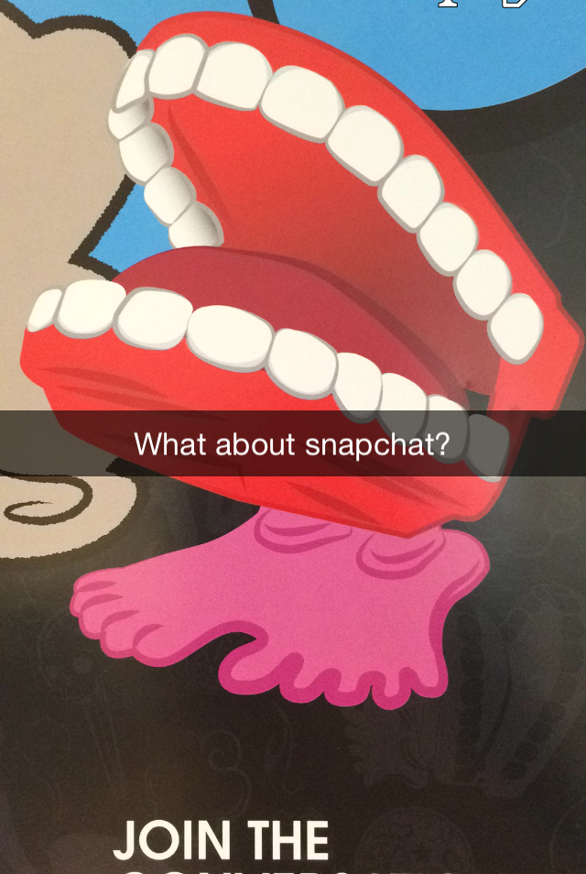
Other Platforms
Engaging across the social web
Which other platforms might work?
Ethics are important
Practicality

Slide 38
Facebook Experiment
Facebook
Deliberate post to encourage comments
Promoted with £20 over a week
Pinned to top of page
Intervention not possible on Facebook because of privacy settings

Slide 39
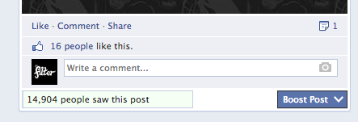
Results?
Facebook
Almost 15,000 people saw the post
Nobody commented at all!

Slide 40
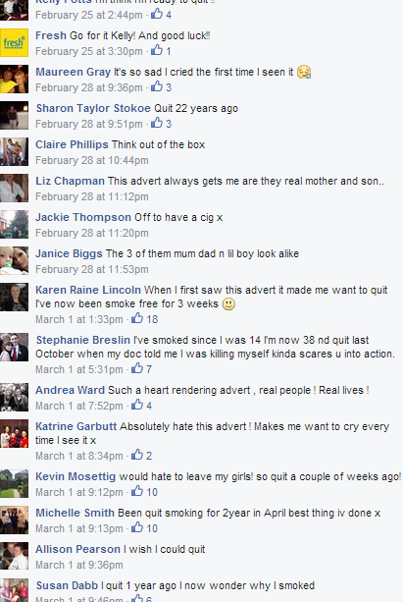
Fresh Smokefree
Facebook
North East England charity
Accompanied TV adverts
Target audience: adults, C2DE
Adverts played on emotion and family

Slide 41
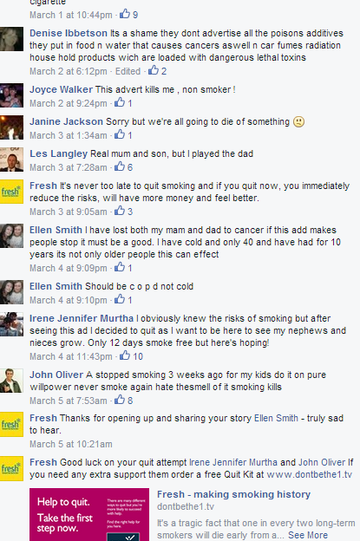
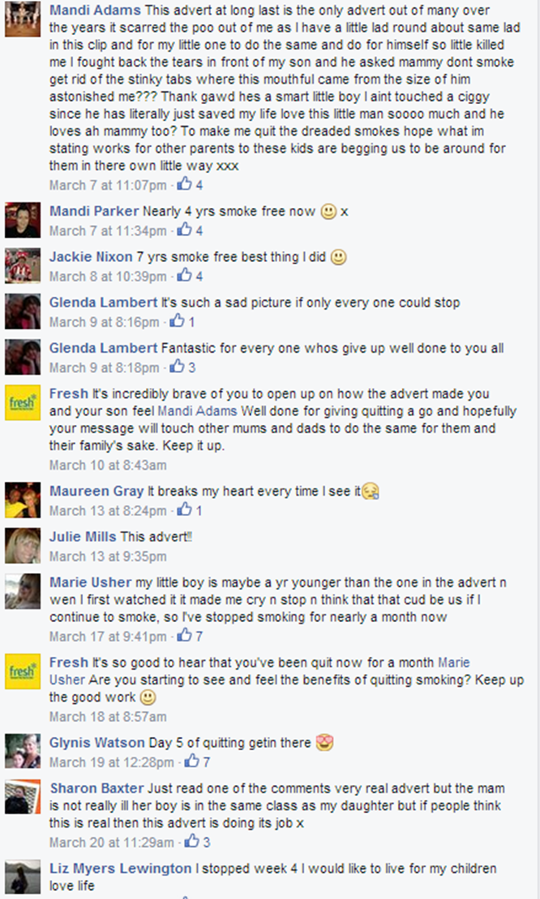

Slide 42
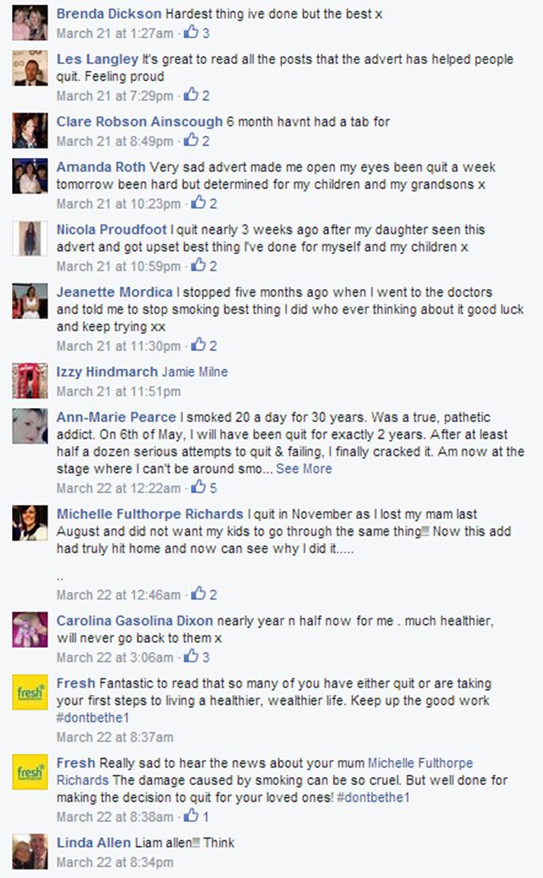
Fresh Smokefree
Facebook
Much larger response
Mainly adults telling their stories
Solidarity with other people

Slide 43
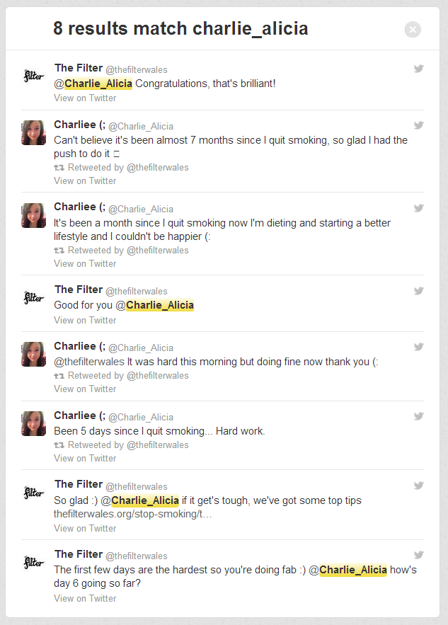
Longer-Term Conversations
Connecting on Twitter
Starting to see long-term successes
Young people self-report quitting
How to track more accurately?

Slide 44
Tracking Success
Important to track and evidence
Challenges: intrusiveness, ethics
Casual nature of social media conversations

Slide 45
What’s Next?
Full evaluation of the project
Expanding reach beyond Wales
More experimentation!

Slide 46
Thank you!
UKNSCC 2014
Jen Thornton
@jenthornton01
@thefilterwales
Photographic image credits:
https://www.flickr.com/photos/garryknight/5546912391 (CC)
https://www.flickr.com/photos/jeff_kontur/3913819300 (CC)
https://www.flickr.com/photos/weinand/5313296821 (CC)
https://www.flickr.com/photos/brianscott/4592678880 (CC)
All Instragram and Twitter screenshots are from the public
domain, copyright remains with the originators.
Graphics by Burning Red for ASH Wales

