Slide 1
First vs. Second Generation E-Cigarettes: Predictors of choice and effects on tobacco craving and withdrawal symptoms
Dr. Lynne Dawkins
Drugs and Addictive Behaviours Research Group (DABRG), School of Psychology
http://www.uel.ac.uk/psychology/research/drugs

Slide 2
Disclosures
Lynne Dawkins has previously undertaken research for e-cigarette companies, received products for research purposes and funding for speaking at research conferences

Slide 3
Talk Overview
E-cigarettes – an introduction
Existing findings from the e-cig and smoking literature
Studies 1-3
  Exploring effects of visual appearance on urge to smoke, withdrawal symptoms…
  …and choice
  Comparing a 1st vs. 2nd generation device
A few more findings
Conclusions and future directions

Slide 4
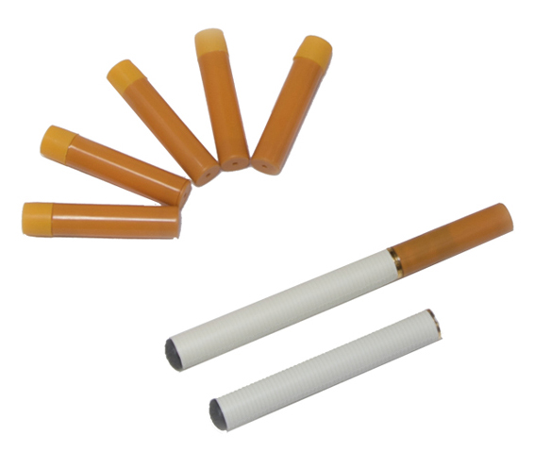
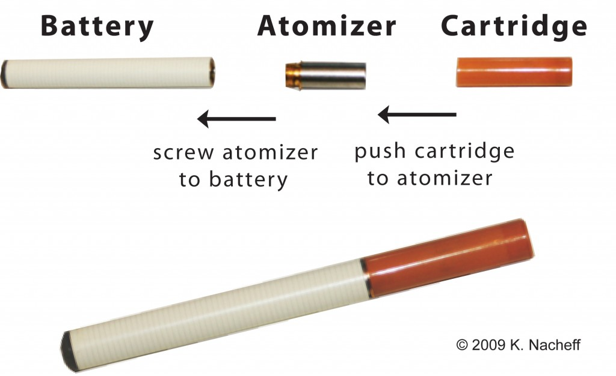
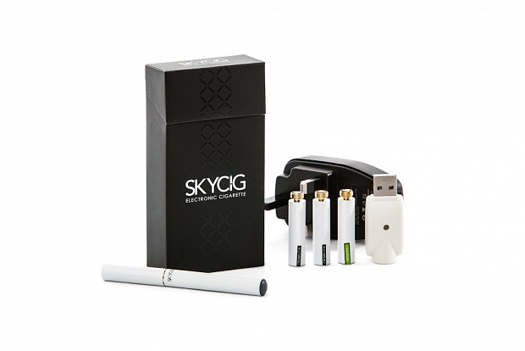
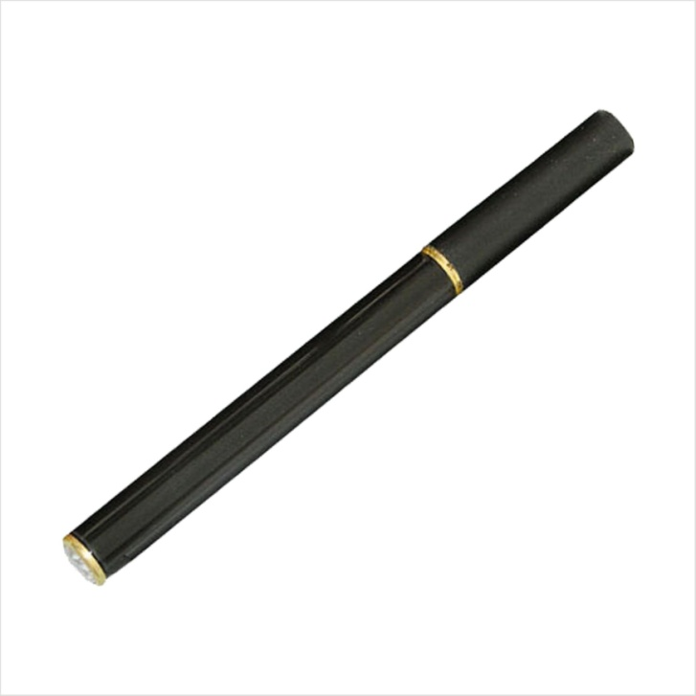

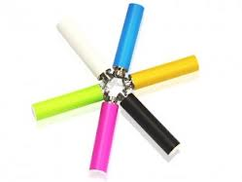

First Generation E-cigarettes

Slide 5
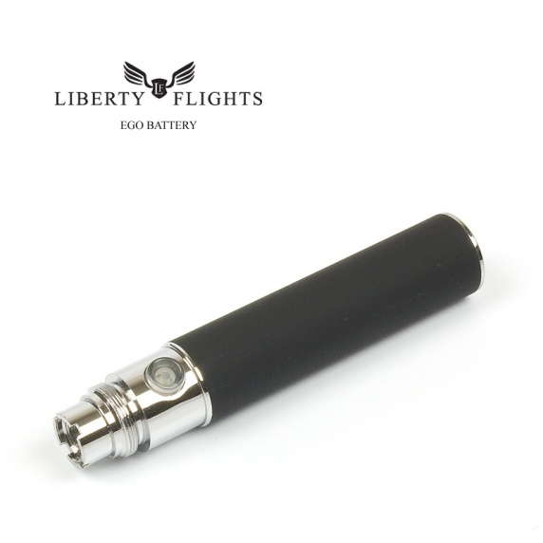
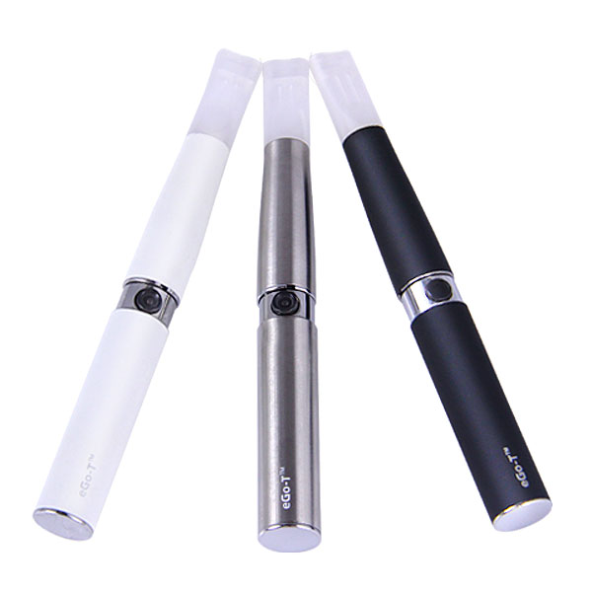
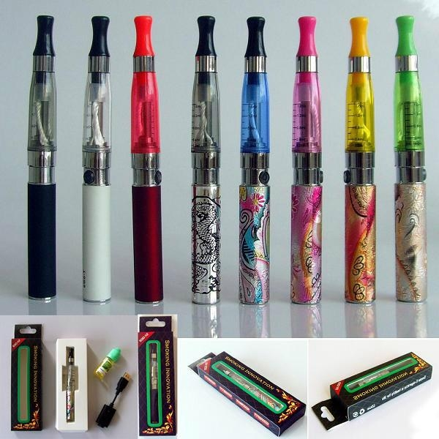
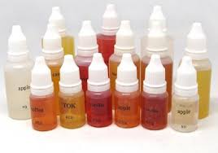
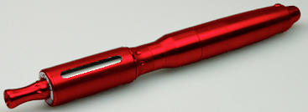

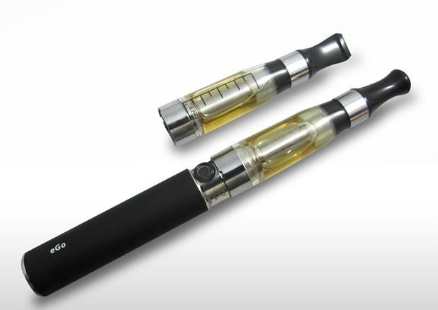
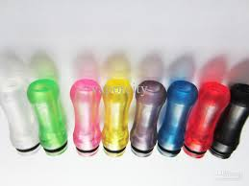

Second Generation E-cigarettes

Slide 6
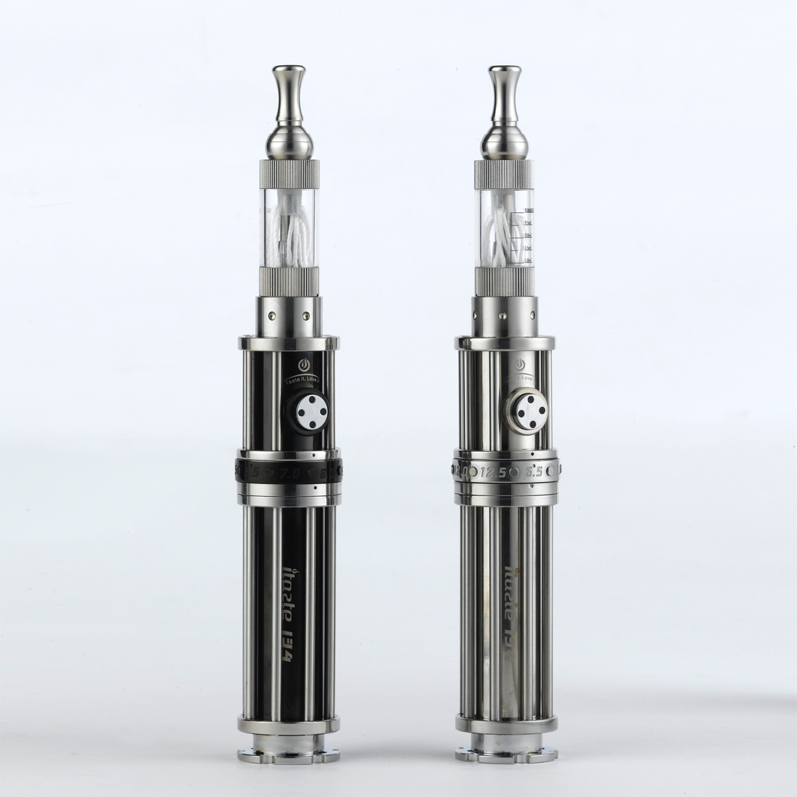
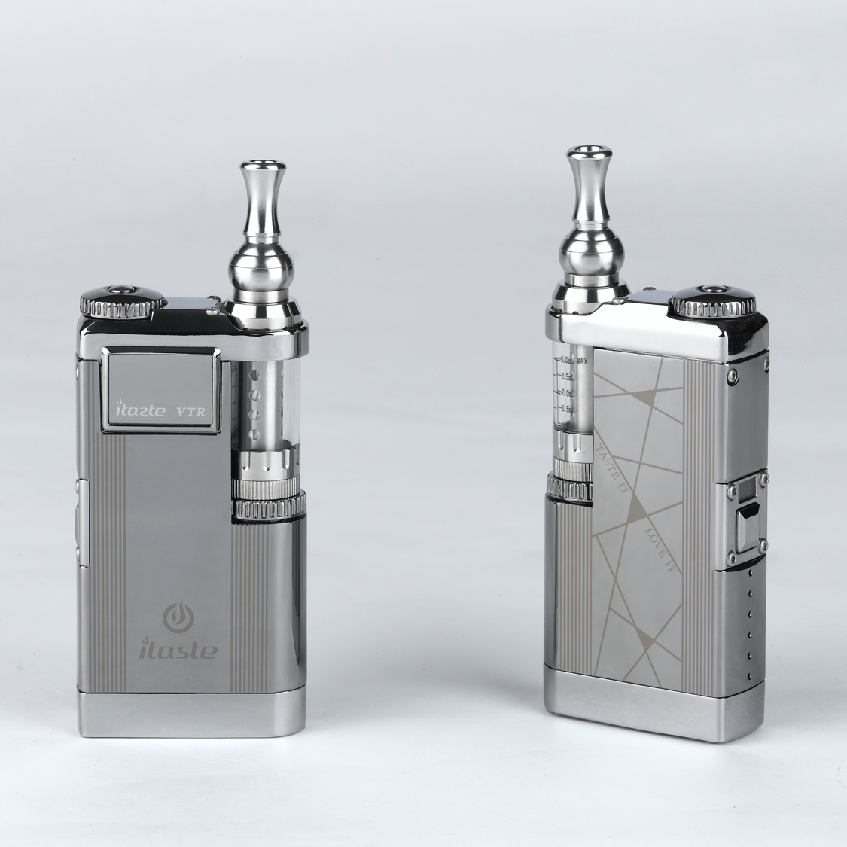
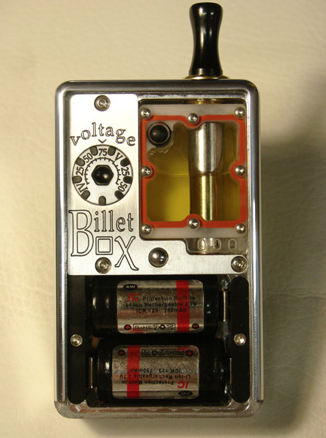
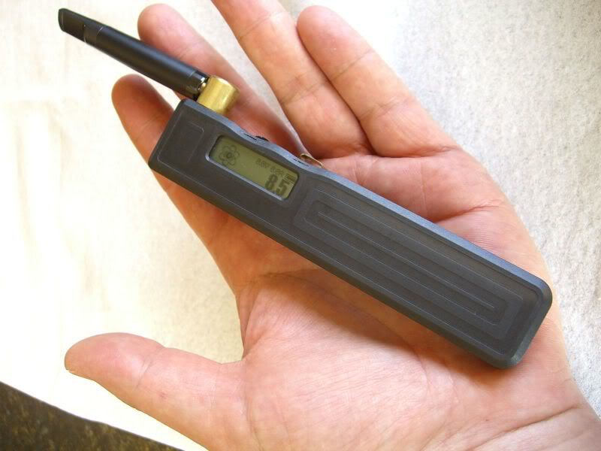
Third Generation E-cigarettes (‘mods’)

Slide 7

Effects on Urge to Smoke / withdrawal symptoms
E-cig (1st gen) can reduce urge to smoke & withdrawal symptoms in deprived smokers but not as effectively as tobacco cigarette (Bullen et al., 2010; Vansickel et al., 2010)
Lower urge to smoke & withdrawal symptoms after using nicotine vs. placebo (2nd gen) E-cig (Dawkins, Turner & Crowe, 2013).

Slide 8
Placebo & Gender Effects
Placebo (0mg/ml) e-cig (1st gen) also associated with decline in urge to smoke after 5 mins and..
Further reduction in urge to smoke with nicotine e-cig after 20 mins only in males (Dawkins et al., 2012)
Survey of e-cig users: Females more likely to use 1st gen cigalikes. Males more likely to use 2nd gen devices (Dawkins et al., 2013)

Slide 9

Nicotine vs. non-nicotine aspects of smoking
Smokers report enjoying sensory and tactile aspects of smoking (Parrott & Craig, 1995)
And prefer smoking a de-nic cigarette over intravenous nicotine (Rose et al., 2010)
De-nic smoking can alleviate urge to smoke and nicotine withdrawal symptoms (Barrett, 2010; Perkins et al., 2010)
Is it important for e-cigs to look like cigarettes? If so, for whom?

Slide 10


Study 1: Is Visual Appearance Important?
63 abstinent smokers allocated to red or white e-cig
Current e-cig users excluded
35% had used at least once in past
Ten 3s puffs with 30s IPI (Vansickel et al., 2010)
Rated urge to smoke and withdrawal symptoms before and (10 mins) after use (MPSS, West & Hajek, 2004)

Slide 11
Effects of visual appearance on urge to smoke
Sig main effect Time: F(1,59) = 41.65, p<0.0001
Sig Time x Condition x prior use interaction: F (1,59) =4.36, p<0.05

Slide 12
Effects of visual appearance on withdrawal symptoms
Sig main effect Time: F(1,59) = 73.53, p<0.0001
Sig Time x Condition interaction: F (1,59) =9.13, p<0.01
No interaction with prior use

Slide 13
Study 1 summary
It is important for an e-cigarette to look like a cigarette for alleviation of urge to smoke and withdrawal symptoms especially for naïve users…
BUT only looked at short term effects

Slide 14
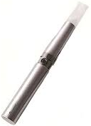
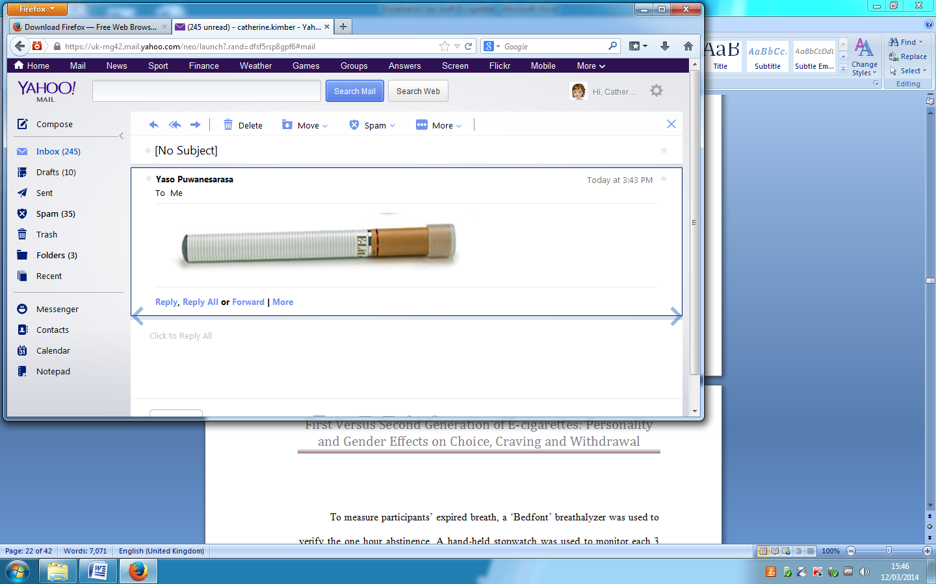
Study 2: Importance of visual appearance on e-cigarette choice
100 abstinent smokers (current e-cig users excluded)
97% heard of e-cigs; 57% used at least once in the past
Asked to choose between 1st and 2nd generation e-cigarette
Predictors of choice: gender, prior e-cig use, age, tobacco dependence (FTND).

Slide 15
E-cigarette Choice
Device chosen | N
1st generation (‘cigalike’) | 49
2nd generation (‘pen-like)’ | 51
No overall preference for 1st or 2nd generation device.

Slide 16
Predictors of E-cigarette choice
Multiple predictor hierarchical logistic regression
No significant predictors of e-cig choice
Predictor | B (SE) | Odds ratio | p
Constant | 1.65 (1.72) | 5.21 | 0.34
Age | -.02 (.03) | 0.98 | 0.45
Gender | -0.36 (0.43) | 0.70 | 0.39
Prior e-cig use | -0.15 (0.48) | 0.86 | 0.75
FTND | -0.09 (0.13) | 0.91 | 0.49

Slide 17

Study 3: 1st vs. 2nd generation e-cigarettes: Subjective Effects
70% of regular e-cigarette users use 2nd generation devices (Dawkins et al., 2013)
100% of smokers who had successfully quit used 2nd (91%) or 3rd (9%) generation devices (Farsalinos et al., 2013)

Slide 18


Study 3: 1st vs. 2nd generation e-cigarettes: Subjective Effects
100 abstinent smokers randomly allocated to 1st or 2nd generation device
Ten 3s puffs with 30s IPI
Rated urge to smoke and withdrawal symptoms before and (10 mins) after use (MPSS, West & Hajek, 2004)
Rated satisfaction and hit after use

Slide 19
Effects of device type on urge to smoke:
Sig main effect TIME: F(1,95)=73.58, p<0.0001
No sig interactions with device type or prior use: F(1,95)<1, ns)

Slide 20
Effects of device type on withdrawal symptoms
Sig main effect TIME: F(1,92)=29.21, p<0.0001
No sig interactions with device type or prior use: F(1,95)<1, ns)

Slide 21
Effects of device on satisfaction & hit
How satisfying did you find the e-cigarette?
  Not at all (0); Fairly (1); Very (2)
Did you feel a ‘hit’ from the e-cigarette?
  No (0); Partly (1);Yes (2)
Main effect of device type on satisfaction: F(1,95)=10.68, P<0.01. No sig effect of device on hit. No sig interactions (All Fs <1.5, ns).

Slide 22
Studies 2 & 3: Summary of findings
Equal numbers of participants selected 1st & 2nd generation e-cig types
Gender, prior use, age & dependence did not predict choice
1st and 2nd generation types were equally effective at alleviating urge to smoke and withdrawal symptoms
2nd generation device associated with higher levels of ‘satisfaction’

Slide 23
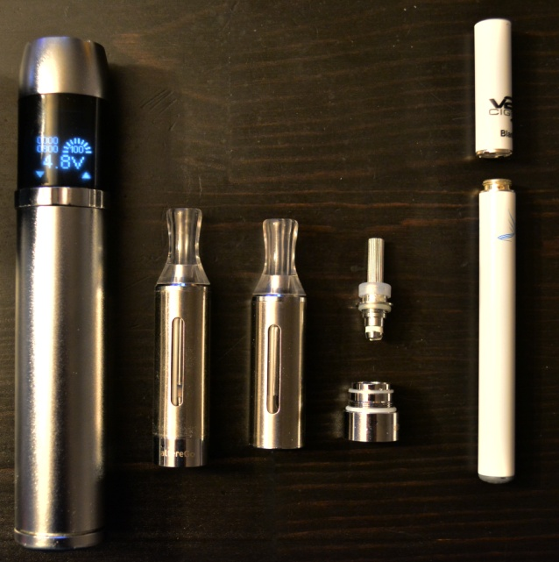
1st vs. 3rd generation devices (Farsalinos et al., 2014)
23 experienced e-cig users used a 1st gen cartomiser and 3rd generation device
In 3rd generation condition:
‘Craving to vape’ lower (p<0.001)
Satisfaction and hit higher (p<0.01)
Plasma nicotine levels higher at all time points (p<0.001)

Slide 24
Differences between studies
2nd vs. 3rd generation device used
The 1st generation disposable device shown to produce relatively high levels of nicotine released to vapour (Goniewicz, Hajek & McRobbie, 2014)
Nicotine delivery vs. visual appearance
Naive vs. experienced e-cig users

Slide 25
Conclusions
Visual appearance may be important in early stages of abstinence for short term alleviation of urge to smoke and withdrawal symptoms...
...Particularly for e-cig naive smokers
E-cig choice reflects individual preference and none of the variables here predicted 1st vs. 2nd generation choice.
1st generation devices can be as effective as 2nd for alleviation of urge to smoke & withdrawal symptoms
But cannot generalise to other types and 3rd generation devices may be superior.

Slide 26
Further Questions & Future Directions
Are 3rd generation devices more effective than 2nd?
Differences between 1st generation devices
Is visual appearance important over the longer term?
What other non-nicotine factors are important?

Slide 27
Acknowledgements
Catherine Kimber
Yaso Puwanesarasa
Gina Christoforou
Naomi Olumegbon
E-Lites
Totally Wicked

