Slide 1
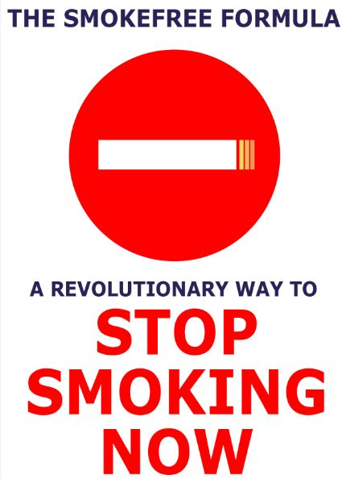

Slide 2
Why the SFF?
1 billion smokers in the world
<10 million use ‘evidence-based’ methods
☺
100+ million try to stop each year
90 million use methods that limit their chances of success
☹
If every smoker who tried to stop, used evidence-based methods tens of thousands of lives would be saved each year

Slide 3
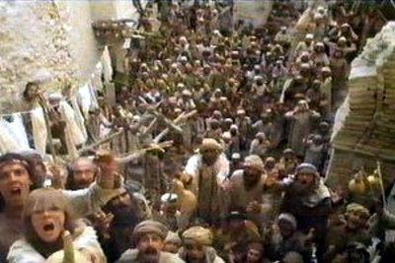

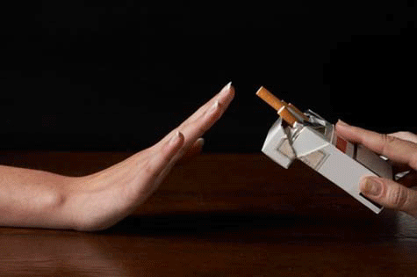
The truth about stopping smoking
We are all different:
No matter what some people say, there is no single easy way to stop smoking
Keep trying and give yourself the best chance each time:
Every attempt is another roll of the dice
Use methods that give you the best chance of success
Every quit attempt is a success:
Every day not smoking is less exposure to toxins and more money saved

Slide 4
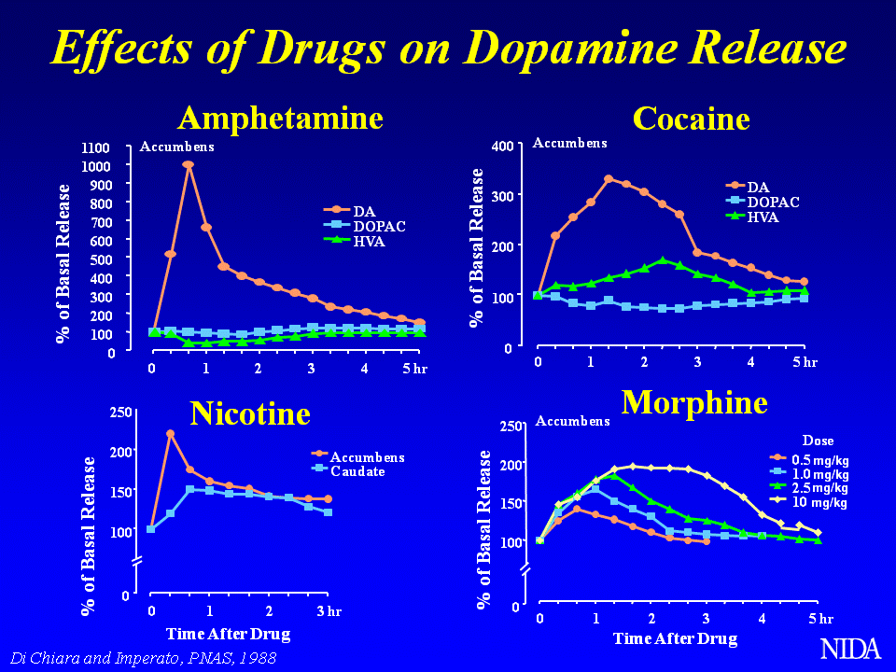

What is the SFF?
A book that aims to bring the science of stopping to smokers
Billions of pounds and dollars have been spent on research aimed at helping smokers to stop
SFF aims to encourage as many smokers as possible to make use of this investment

Slide 5
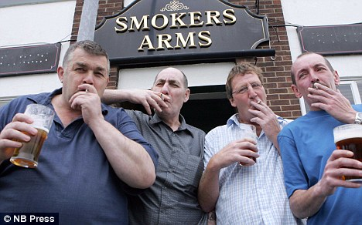


Who is the SFF for?
Every smoker who is thinking about stopping
For use every time they try to stop
Stop-smoking advisors
For use with their clients
Health professionals interested in encouraging their patients to stop
To help them give the best possible advice

Slide 6


Style
Very personal
Lots of stories
Interviews with ex-smokers
Lots of activities to try
A pledge:
Everything I claim as true is backed by a source
When I state my opinion I make it clear
✗
✓

Slide 7
Content
Part 1:
The truth about nicotine addiction and why it is often so hard to stop, even for smokers who can go long periods without smoking
Part 2:
29 ingredients smokers can put into their ‘SmokeFree Formula’
Each one gets a star rating showing the strength of evidence supporting it

Slide 8
Why people smoke
Main reasons smokers give:
Enjoyment 50%
Stress relief 40%
Relief of boredom 20%
Help with concentration 10%
Weight control 10%
Socialising 10%
None of these predict success or failure at quitting

Slide 9
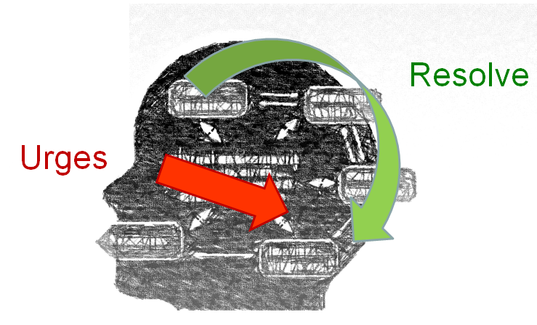
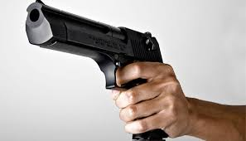
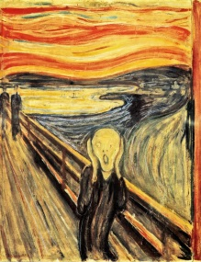
The real reason …
When smokers try to stop they experience urges to smoke that overpower and undermine their resolve to abstain
Nicotine from cigarettes …
Links certain situations with ‘triggered impulses’ to smoke
Creates ‘nicotine hunger’ when brain levels dip
www.primetheory.com
+

Slide 10
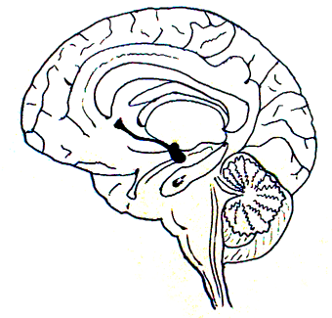
Addiction to cigarettes
I really want to stop smoking: it’s costing me money and it will probably kill me
Human brain
Just smoke!
Animal brain

Slide 11
When the urge is stronger than resolve and cigarettes are available, a lapse will occur
Urge to smoke
Time
Resolve
Strength of urge

Slide 12
How to stop smoking: keep these lines apart!
Urge to smoke
Time
Resolve
Strength of urge

Slide 13
Ingredients in the SmokeFree Formula
Ingredient | Rating | Ingredient | Rating | Ingredient | Rating
In-person support |  | Abrupt stop (vs gradual) |  | Deep breathing | 
NRT (supported) |  | Identity change |  | Exercise | 
Champix |  | Avoiding smokers |  | Isometric exercise | 
Zyban |  | Avoiding alcohol |  | Mental exercises | 
Cytisine |  | Changing routine |  | Healthy snacks | ★
Quitline |  | Keep busy |  | Go to bed early | ★
Internet |  | One day at a time | ★ | Get rid of cigs | ★
SMS support |  | Tell others | ★ | Smartphone app | ★
Book or booklet |  | Quit together | ★
E-cigs |  | Count savings | ★
Glucose | 
 Strong evidence
 Moderate evidence
★ Some evidence

Slide 14
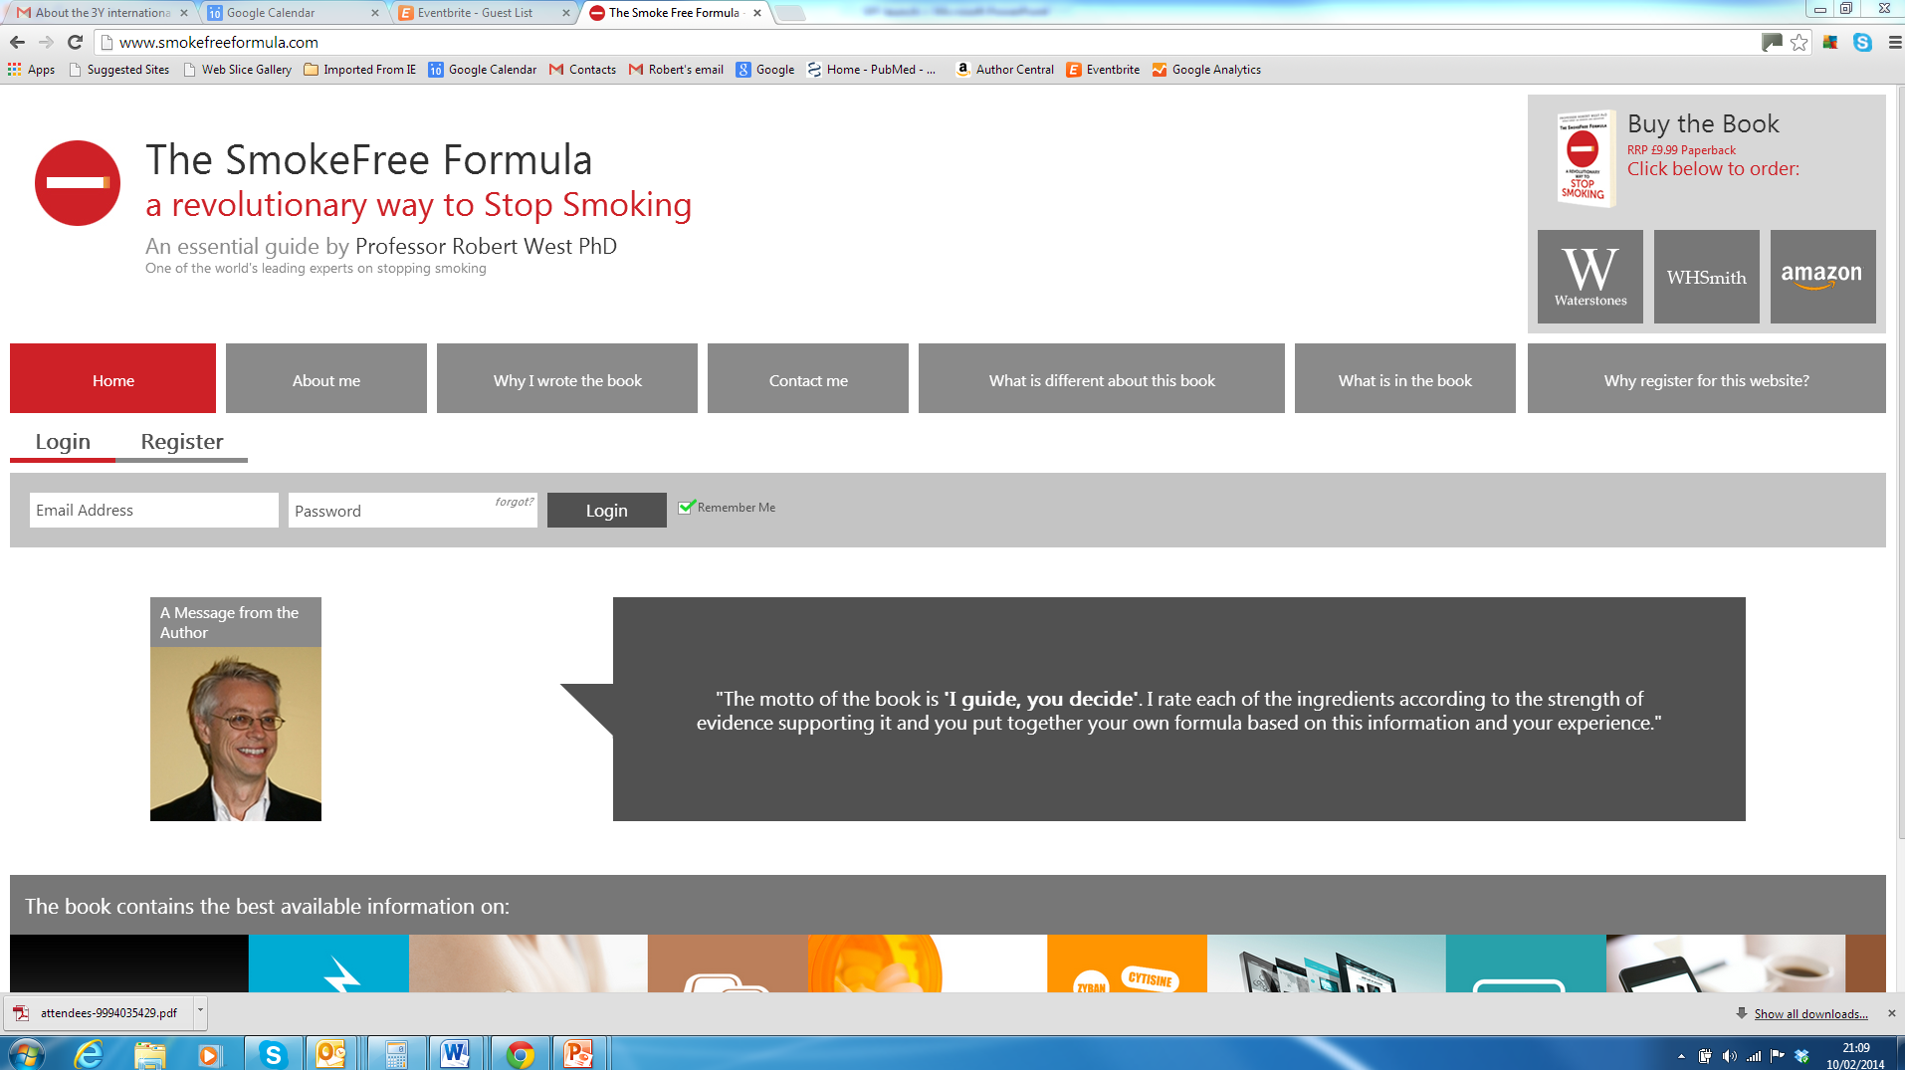
www.smokefreeformula.com

Slide 15
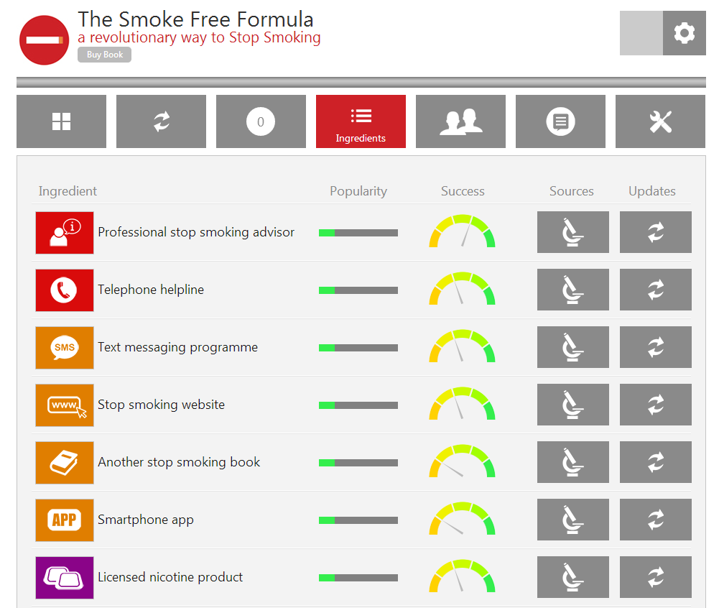
About the ingredients

Slide 16
Publication schedule
Date | Version
January 2014 | UK, Australian, NZ
August 2014 | Spanish, German
November 2014 | Dutch, Russian, Norwegian, Romanian, US, Canadian, Turkish

Slide 17
Thanks for listening
Questions and discussion

