Slide 1
NICE guidance for supporting smokers in secondary care
John Britton
Notes:
Thank organisers, welcome on behalf of srnt and ukctcs,
Stress this is predominantly european union
by way of introduction to ukctcs.....

Slide 2
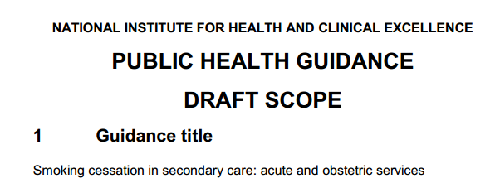
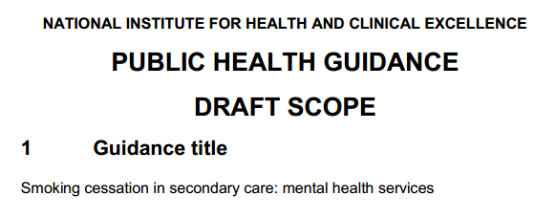

Slide 3
Context
Evidence reviews
Main findings
Responses

Slide 4
PDG members NICE staff
Matthew Alford Community Member
Gary Bickerstaffe Health Improvement Specialist
John Britton Professor of Epidemiology
Jonathan Campion Consultant Psychiatrist
Amanda Farley Lecturer in Epidemiology
Elizabeth Fisher Health Improvement Manager
Liz Gilbert NCSCT
Gill Grimshaw Community Member
Yvonne Hermon Smoking and Pregnancy Coordinator
Jo McCullagh Tobacco Control /SSS
Lisa McNally Consultant in Public Health
John Moxham Professor of Respiratory Medicine
Rachael Murray Lecturer Health Policy
Carmel O'Gorman Specialist Midwife
Shalini Patni Consultant Obstetrician
Giri Rajaratnam Deputy Regional Director PHE
Elena Ratschen Lecturer, Tobacco Control
Fraser Serle Community Member
Matthew Taylor York Health Economics Consortium
Hilary Wareing Tobacco Control Collab. Centre
Tricia Younger Associate Director (to 12.12)
Simon Ellis Associate Director (from 12.12)
Pete Shearn Lead Analyst
Amanda Killoran Analyst (until June 2012)
Linda Sheppard Analyst
Patti White Analyst
Lesley Owen Health Economics
Patricia Mountain Project Manager
Denise Jarrett Coordinator
Sue Jelley Senior Editor (to 2.13)
Jaimella Espley Senior Editor (from 2.13)
Alison Lake Editor (until May 2013)
Rebecca Boucher Editor (from May 2013)
Mike Kelly CPH Director
Tonya Gillis Press and Media

Slide 5
Smoking and NHS secondary care, England 2011 http://www.hscic.gov.uk/catalogue/PUB11454/smok-eng-2013-rep.pdf
10 million adult admissions/year
1.5 million for diseases caused by smoking
463,000 attributable to smoking
25% of respiratory
81% of lung cancer
86% COPD
15% cardiovascular
11% cancer

Slide 6
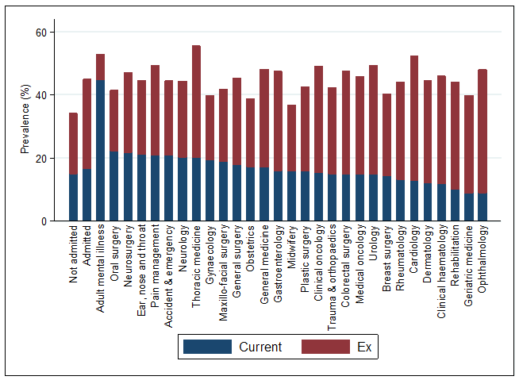
Smoking in people admitted to English hospitals, 2010-11 Szatkowski et al, preliminary data
Total of ~ 2.6 million smokers admitted to hospital

Slide 7
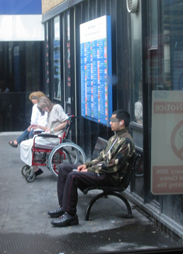
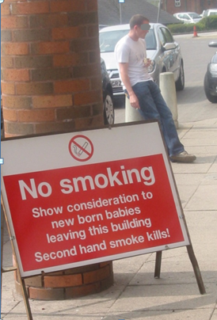
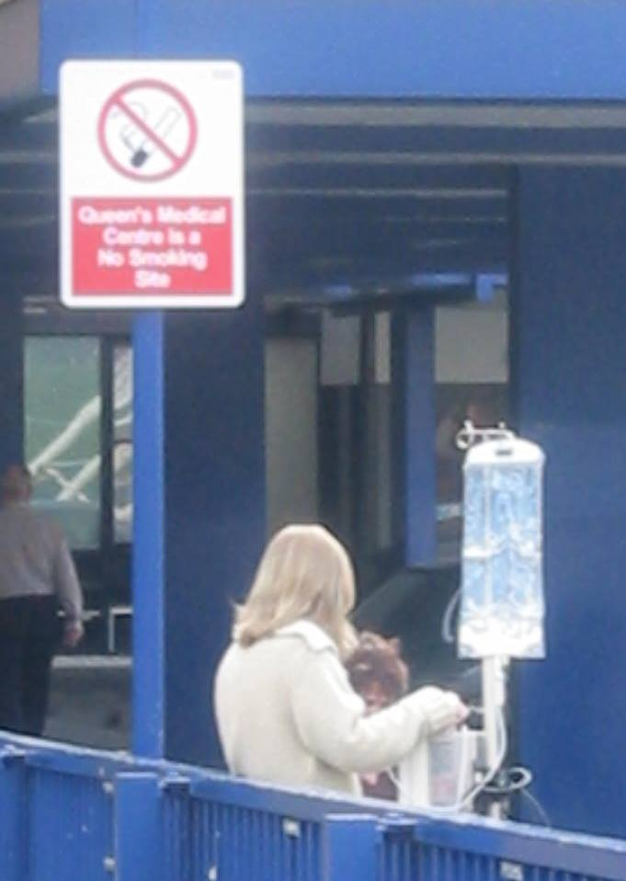

Slide 8
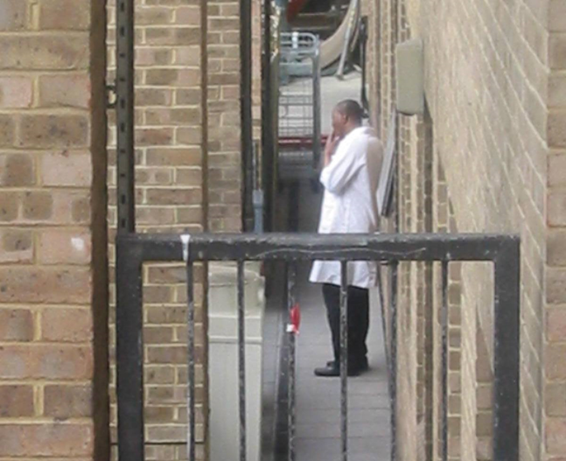

Slide 9
NICE guidance on tobacco dependence

Slide 10
What is an effective stop smoking intervention?
Treatments, either separately or combined, including:
brief interventions [by healthcare professionals]
individual or group behavioural counselling
NRT, varenicline or bupropion pharmacotherapy
self-help materials
Delivered by NHS Stop Smoking Services with adequate staffing and a full-time coordinator]
Targets for the number of smokers using the service [5% of population] and one-month quit rates [35% ]

Slide 11
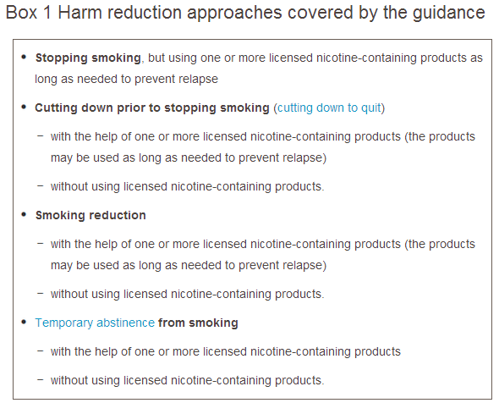

Slide 12
Evidence sources: Commissioned reviews
Effects of nicotine
Smoking cessation interventions in acute and maternity services
effectiveness
barriers and facilitators
Smoking cessation interventions in mental health services
Effectiveness
Barriers and facilitators
Smoke-free strategies
Effectiveness
Barriers and facilitators
Cost effectiveness

Slide 13
Evidence sources: Expert papers
Stop smoking interventions in secondary care
Streamlined secondary care system: project report
RCT of systematic identification and treatment of smokers
Association between smoking and mental disorders
Smoking in people with mental health problems
Ethics of smoking cessation and smoke-free policies
South London and Maudsley NHS Trust Smoke-free pilot

Slide 14
Evidence reviews: Nicotine effects
No RCT signal of risk in terms of adverse events, changes in CVD, MI or stroke
No evidence of adverse effect on :
stable CVD
unstable CVD
bone healing
surgical complications
Weak evidence that NRT should be removed before microvascular reconstructive surgery
Increased insulin resistance, though < smoking
Positive effect in ulcerative colitis

Slide 15
Smoking cessation interventions in acute services
Intensity | Content | Effect | Add drug*
1 | Single contact + written/other material, no follow up | None | No effect
2 | Longer or more contacts + other materials but not beyond quit date | None | No effect
3 | Any contact + follow-up after quit date but <4 weeks | Modest (OR 1.17) | Modest (OR1.19)
4 | Any contact + phone/letter/email + > 4 weeks follow-up | Works (OR 1.51) | Works (OR 1.66)
5 | Any contact + follow-up with face-to-face contact for > 4 weeks | Works best (OR 1.28) | Works best (OR 2.26)
Validated!
Validated!
*(typically NRT)
Notes:
NRT has most effect. Others less convincing. Pregnancy not nec nrt

Slide 16
Smoking cessation interventions: maternity services (behavioural only; NRT ineffective)
Intensity | Content | To term | Post-partum
1 | Single contact + written/other material, no follow up | No effect | No effect
2 | Longer or more contacts + other materials but not beyond quit date | No effect* | No effect*
3 | Any contact + follow-up after quit date but <4 weeks | Modest (OR 1.48) | Works (OR 3.66)
4 | Any contact + phone/letter/email + > 4 weeks follow-up | Works (OR 1.72) | No effect
5 | Any contact + follow-up with face-to-face contact for > 4 weeks | Works (OR 1.34) | No effect
6 | Incentives | Works (OR 5.77) | Works (OR 5.86)
Validated!
Validated!
Validated!
Validated!
*(or findings based on poor quality studies)
Notes:
NRT has most effect. Others less convincing. Pregnancy not nec nrt

Slide 17
Barriers to intervention in acute and maternity services
Staff smoking
Lack of time, knowledge, skills, training
Poor organisational support
referral processes, prompts, automated systems, audit
No or limited access to behavioural support and medicines
Concern that stopping smoking before surgery increases risks
[no pre-planning for admission]

Slide 18
Smoking and mental health
Abstinence from smoking exacerbates mental health symptoms
Nicotine therapy relieves these negative symptoms
Smoking cessation
does not exacerbate psychosis
improves depression
reduces clozapine, olanzapine, some antidepressant dose requirements
does not affect other substance abuse treatment
Bupropion not contra-indicated in severe mental illness
(likewise varenicline, post review)
Mixed evidence on effect of smoke-free policy on behaviour

Slide 19
Cessation interventions in mental health settings:
Evidence very limited
High intensity behavioural interventions effective, but less so
NRT evidence limited, but dual therapy better than single
bupropion effective in schizophrenia
Short term OR 3.80 95% CI 1.58-9.15
Medium term OR 3.00 95% CI 1.29-7.00
Long term OR 1.60 95% CI 0.23-11.01
Varenicline evidence limited at time of review

Slide 20
Barriers in mental health settings
As for acute trusts, but also:
smoking part of culture
staff-facilitated smoking breaks part of ward routine
smoking used as means of control/build relationships
belief that stopping smoking
exacerbates mental health problems
increases need for medication
Belief that smoke-free policies will
Discourage use of inpatient and outpatient services
cause abuse, aggression, fires
paternalism (‘their only pleasure’)

Slide 21
Short and long-term incremental costs per QALY (Intensity 4 and 5 with pharmacotherapy) NICE 2013
 | 3 years (approx costs/range of costs) | Lifetime
Preoperative patients | Dominant | Dominant
COPD | £7000-9000 | Dominant
Cardiac | Dominant | Dominant
Acute general | (£22,000) | Dominant
Schizophrenia | n/a | £2000-3000
Pregnancy (behaviour only) | Dominant to £155000 | Dominant to £15000
Staff (intervention) Staff (smoke-free policy) | £4000 Dominant | Dominant Dominant
Notes:
Acute gen is pharmacology effect

Slide 22
Smoke-free sites
Effective in reducing smoking on hospital site
Probably effective in reducing staff smoking
No clear evidence of exacerbation of aggressive or disruptive behaviour in mental health settings
Succeed, given leadership and planning to change culture
Effective cessation and temporary abstinence support to patients and staff essential

Slide 23
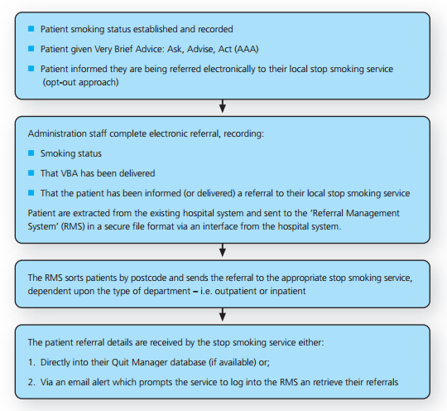
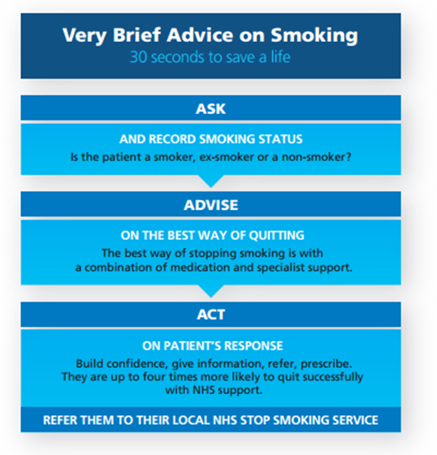
NCSCT Streamlined Secondary Care System http://www.ncsct.co.uk

Slide 24
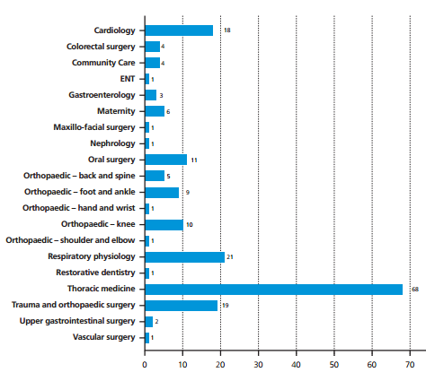
Effectiveness of NHS SSS referral from hospital 3-month Pilot at Queen Alexandra Hospital, Portsmouth. http://www.ncsct.co.uk

Slide 25
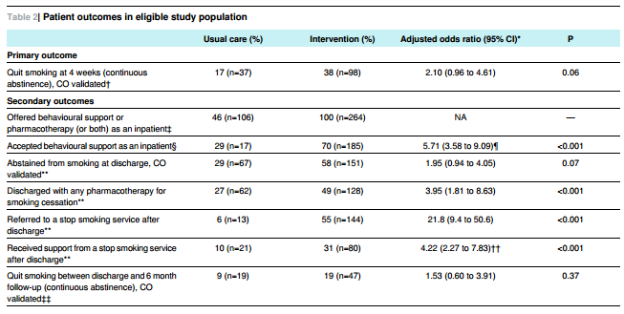
RCT of integrated smoking intervention Murray et al, BMJ 2013;347:f4004

Slide 26
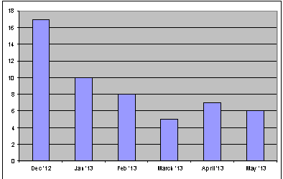
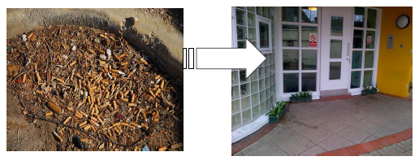
South London and Maudsley Smoke-free pilot
Mary Yates RNHM, RMN, MSc. Matron http://www.nice.org.uk/guidance/index.jsp?action=download&o=65881
Behavioural & Developmental Psychiatry CAG
500 staff, 10 wards, 162 beds
92% smoking on forensic wards
Smoke-free from 13.3.13
Sustained preparation for patients and staff
Marked reduction in smoking incidents
Improved ward routines and engagement
Successful

Slide 27
Smoking and mental health: Ethical considerations Richard Ashcroft, Queen Marys, University of London
Smoking is as important and deserving of intervention in people with mental disorder as in anyone
Smoking cessation and smoke-free policies are just as important in mental health settings as elsewhere in NHS
This patient group may need more, and more intensive, interventions – and hence more investment
A need to see health, and not just mental health (or order, discipline and safety), as a key institutional goal of mental health, and prison/youth offender institutions

Slide 29
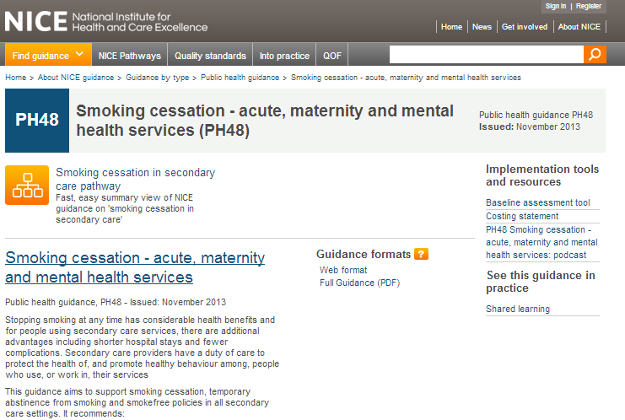

Slide 30
Stopping smoking at any time has considerable health benefits
Secondary care providers have a duty of care to protect the health of, and promote healthy behaviour among, people who use or work in their services
Strong leadership and good management required to:
make premises and grounds smoke-free
Help staff to stop smoking, or else abstain while identifiable as NHS staff
Train staff to support people to stop smoking
Ensure that cessation services provided onsite
Help patients, visitors and other users plan for admission

Slide 32
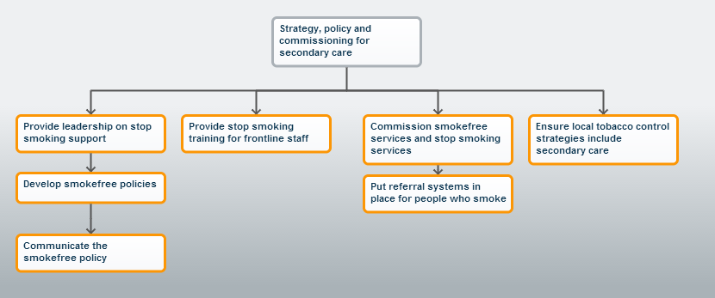
Strategy, policy and commissioning

Slide 33
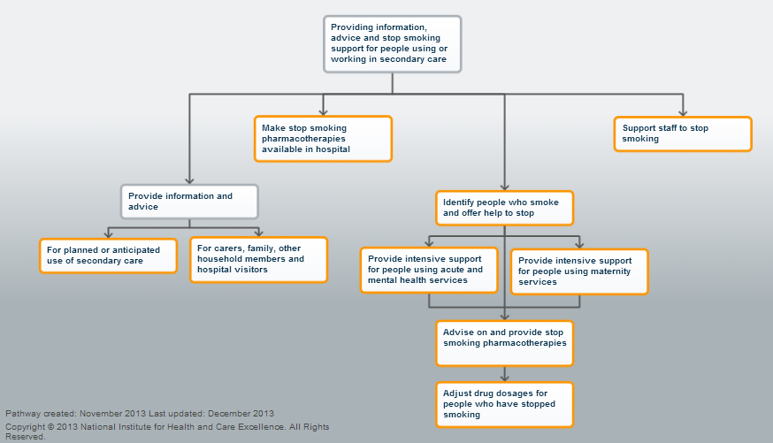
Information, advice and support

Slide 34
For patients:
Identify smokers and advise cessation/temporary abstinence at first face-to-face contact
Provide pharmacotherapy and intensive behavioural support, immediately if necessary, or else within 24 hours
Provide behavioural support as often and as long as needed during admission.
Provide or arrange follow up after discharge
Manage doses of clozapine, olanzapine, theophylline, warfarin
Engage with family and friends

Slide 35
Commissioners and Managers
Commission smoke-free services
Assign senior director to implement smoking policy and care
Make buildings and grounds smoke-free
Communicate policy to public, staff, contractors, all service users
No designated smoking areas or staff-facilitated smoking breaks
Ensure NRT available for sale to visitors
Support staff to stop smoking in grounds
Train staff to intervene in smoking

Slide 36
Research priorities (recommendations):
Improve effectiveness and uptake of inpatient interventions, especially for mental health settings
Establish whether and how NRT can be effective in pregnancy
Effect of incentives
Interventions for families
Use of varenicline
Relapse prevention
Temporary abstinence approaches

Slide 37
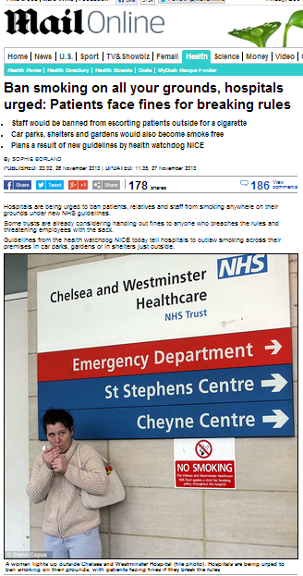
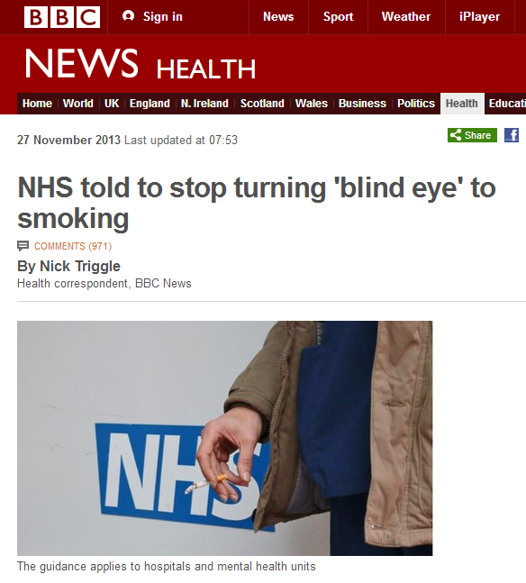
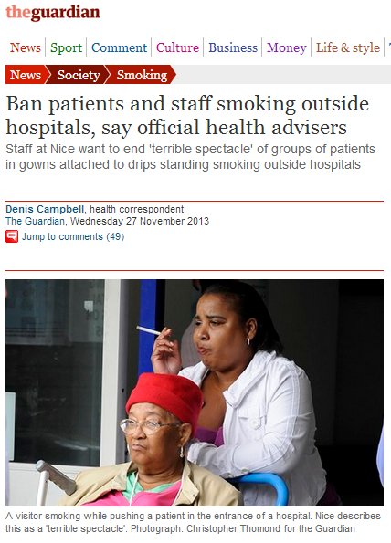
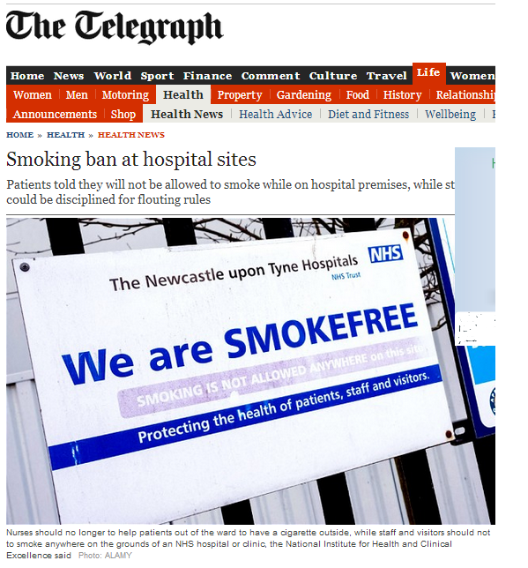

Slide 39
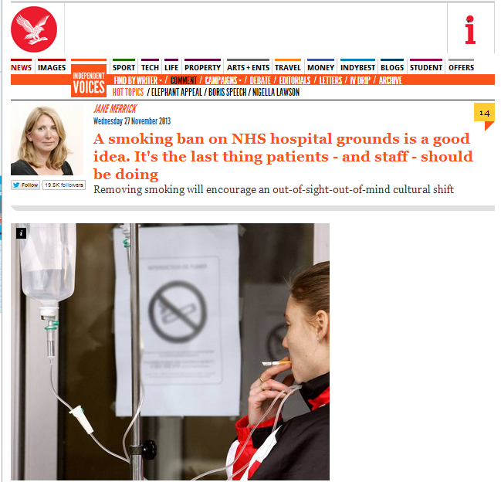

Slide 40
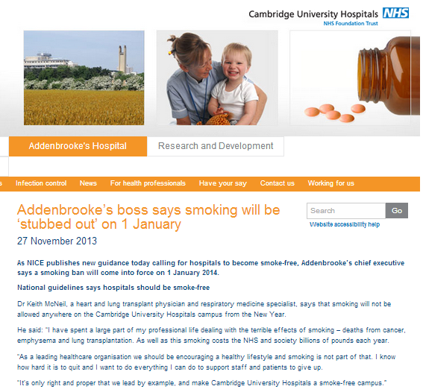

Slide 41
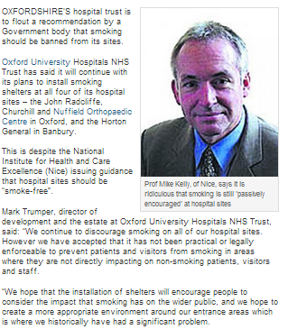

Slide 42
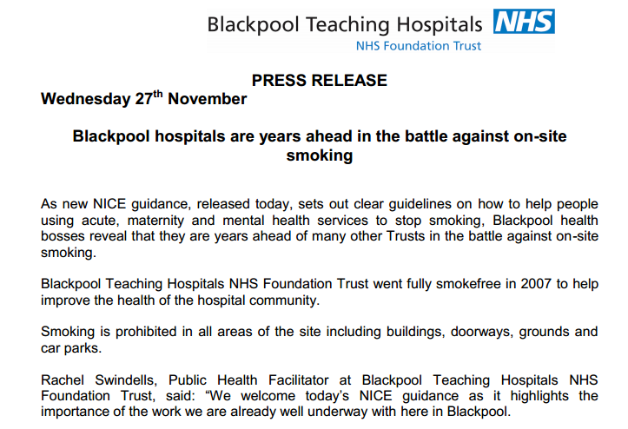

Slide 43
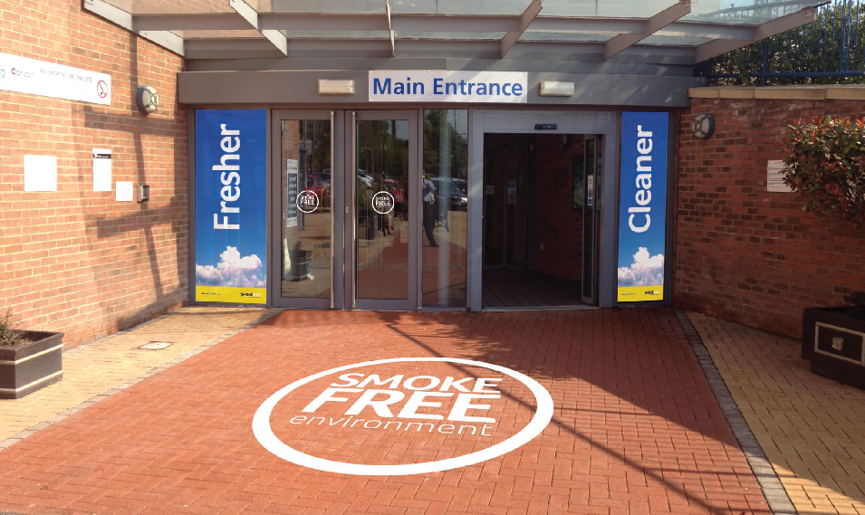

Slide 44
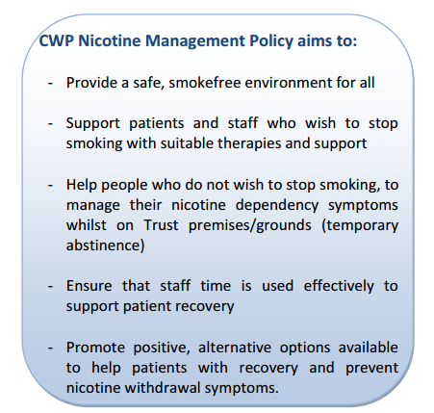
Notes:
Avril devaney

Slide 45
Summary
Treating smoking in secondary care prevents illness and (for the most part) saves money
Should be done for all smokers in secondary care setting
Planning, communication and public relations essential
Staff should not smoke
Grounds should be smoke-free, to support staff and patients
Needs leadership and promotion as positive change
Commissioners can ensure implementation by demanding smoke-free services

