Slide 1
Statistical analysis of pharmacotreatment effect and associated interactions in smoking cessation
Dr Neil Walker, Oxford Biomedical Research Centre

Slide 2
Objectives
Use observational data (Stop Smoking Service) to:
Make inference on effectiveness of pharmacotreatment in smoking cessation
Identify subgroups (demographic or treatment regime) who perform strongly with particular treatments

Slide 3
Stop Smoking Service
12 – week programme offered to smokers wanting to quit throughout UK.
Programme of meetings, max=12 (face-to-face, group session, telephone conversations)
Initial assessment (smoking patterns, motivation) to tailor programme to individual needs
Medication: Nicotine Replacement Therapy (NRT), Champix and Zyban
Follow-up sessions: progress, medication, encouragement

Slide 4
Quit Manager database
Electronic system for tracking patients using Stop Smoking Service:
Standard personal & demographic information (name, DOB, address…)
Session information (date, duration etc)
Outcome recorded at 4,12,26 & 52 weeks (increasing number lost to follow-up at later times)
Anonymised data extracted from Quit Manager for current analysis

Slide 5
Pharmacotreatment
Champix (Varenicline) – prescribed course of tablets, proven efficacy in RCTs. Mode of action: Nicotine receptor partial agonist.
Zyban (Bupropion) – prescribed tablets. Mode of action: Norepinephrine-dopamine Reuptake Inhibitor (NDRI).
Nicotine Replacement Therapy (NRT) – available over the counter/on prescription. Patches, typically in combination with oral product (chewing gum, nasal spray etc).

Slide 6
Observational data
Data provided by Quit-51: operate a number of Stop Smoking Services in England
Data recorded on patients attempting to quit through Stop Smoking Service
Opportunity to analyse a large observational dataset: Can assess smoking quit rates and association with wide range of potential explanatory variables in “real world” setting

Slide 7
Stop Smoking Service treatment programme
NCSCT accredited 12-week programme. Includes:
Sessions with NCSCT-accredited adviser(s)
Initial assessment to establish suitable programme
Quit date agreed (“Not a puff” criteria)
Weekly/fortnightly follow-up sessions (medication, monitor progress, encouragement)

Slide 8
Quit Manager
Patient’s progress recorded electronically;
Patient details (name, DOB, medical history etc)
Details on individual sessions
Outcomes (quit success/failure) recorded at 4, 12, 26 & 52 weeks
Patient data (anonymised) extracted to create database for analysis

Slide 9
DATA
Data from 10 PCTs:
London (Havering [2011-2014], Redbridge [2004-2014], Waltham Forest [2012-2013], Barking & Dagenham [2010-2015]).
Sussex (East Sussex Downs and Weald [2002-2015], Hastings and Rother [2006-2015])
West Midlands (Sandwell [2013-2015], Walsall Teaching [2014-2015], Telford and Wrekin [2013-2015], Worcestershire [2013-2015])
N=89740 in total

Slide 10
Quantitative + qualitative information
Has patient managed to quit? Self-report at 4 weeks then at 12, 26 & 52 weeks. CO validation at 4 weeks (i.e. CO < 10 ppm)
Standard demographic information: Age, Sex, Occupation…
Service used: Group, one-to-one with adviser, treatment prescribed…

Slide 11
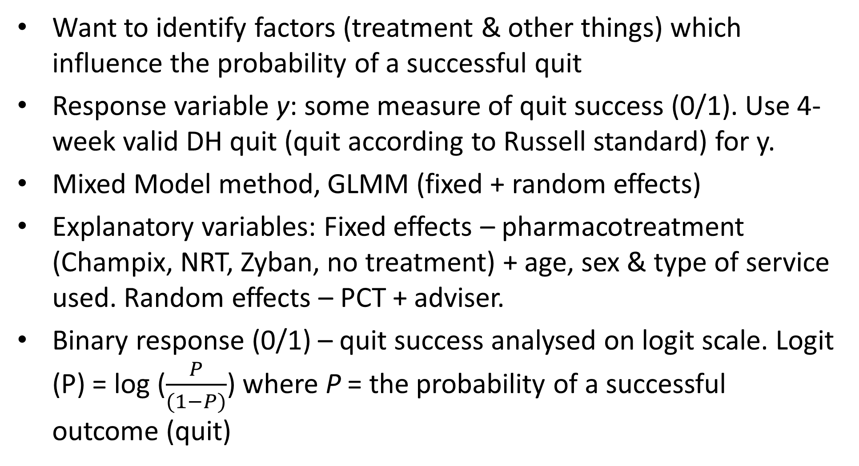
Statistical models
Want to identify factors (treatment & other things) which influence the probability of a successful quit
Response variable y: some measure of quit success (0/1). Use 4-week valid DH quit (quit according to Russell standard) for y.
Mixed Model method, GLMM (fixed + random effects)
Explanatory variables: Fixed effects – pharmacotreatment (Champix, NRT, Zyban, no treatment) + age, sex & type of service used. Random effects – PCT + adviser.
Binary response (0/1) – quit success analysed on logit scale. Logit (P) = log ($\frac{P}{(1−P)}$) where P = the probability of a successful outcome (quit)

Slide 12
Statistical models
Main effects: Assess overall effects of explanatory variables. Logit(y) = Treatment + Age + Sex + Service
Treatment interactions: Do treatments benefit particular subgroups? Logit(y) = Treatment + Age + Sex + Service + Treatment*Age + Treatment*Sex + Treatment*Service

Slide 13
RESULTS Raw data – quit rate by pharmacotreatment

Slide 14
RESULTS Raw data – quit rate by age

Slide 15
RESULTS Raw data – quit rate by service used

Slide 16
RESULTS Main effects GLMM
 |  | Raw data | Model statistics
Variable | Levels | n quit / n total (% quit rate) | β (logit scale) | Wald-stat (df) | p-value
Sex |  |  |  | 10.6 (1,40518.9) | 0.001
 | male | 20012/26491 (75.5%) | 0
 | female | 21713/29684 (73.1%) | -0.080 | 10.6 (1,40518.9) | 0.001
Age Category |  |  |  | 192.1 (2,40440.1) | <0.001
 | 13-19 | 1168/2258 (51.7%) | 0
 | 20-29 | 6120/8518 (71.8%) | +0.56 | 73.5 (1,40331.6) | <0.001
 | 30+ | 34439/45402 (75.9%) | +0.78 | 165.6 (1,39938.2) | <0.001
Service Used |  |  |  | 69.5 (7,21886.2) | <0.001
Treatment |  |  |  | 233.9 (3,39285.9) | <0.001
 | No treatment specified | 5093/6492 (78.5%) | 0
 | Champix | 10969/13593 (80.7%) | +0.34 | 36.7 (1,35716.3) | <0.001
 | NRT | 25329/35650 (71.0%) | -0.14 | 7.6 (1,33938.6) | 0.006
 | Zyban | 336/443 (75.8%) | +0.18 | 1.5 (1,40644.1) | 0.2

Slide 17
RESULTS Interactions GLMM (interactions only)
Interaction | Level | β (logit scale) | Wald-stat (df) | p-value
NRT*Age Category |  | - | 1.6 (2,40468.5) | 0.4
Champix* Age Category |  | - | 3.8 (2,40380.2) | 0.2
Zyban* Age Category |  | - | 0.01 (2,40079.1) | 0.997
NRT* Sex |  | - | 5.2 (1,40320.4) | 0.02
 | NRT*female | -0.17
Champix* Sex |  | - | 0.4 (1,40313.2) | 0.5
Zyban* Sex |  | - | 0.4 (1,40177.0) | 0.5
NRT* Service Used |  |  | 33.8 (7,39177.3) | <0.001
 | NRT*drop-in | 0
 | NRT*GP | -0.30
 | NRT*group | 0
 | NRT*one-to-one | -0.40
 | NRT*pharmacy | +0.14
 | NRT*telephone service | -1.48
 | NRT*workplace | +0.10
 | NRT*unknown | -0.26
Champix* Service Used |  | - | - | -
Zyban* Service Used |  | - | 5.3 (5,40228.1) | 0.4

Slide 18
RESULTS NRT * Sex interaction, raw data

Slide 19
RESULTS NRT * service, raw data

Slide 20
Inference – main effects
Statistical evidence of effects associated with:
Pharmacotreatment – highest quit rates seen in patients using Champix
Sex – Men using stop smoking service are more likely to quit
Age – low quit rates among young smokers, flattens off with increasing age
Service used – statistical evidence that the type of service used can influence chance of successful quit (Group sessions most effective)

Slide 21
Inference - interactions
Patients using NRT have lower chance of quitting than on other regimes – this particularly pronounced in females
Some evidence that effectiveness of NRT varies according to programme regime (positive interaction with “pharmacy” & “workplace”, negative in conjunction with “telephone service”).

Slide 22
Conclusions
Statistical evidence in real world setting to support the use of Champix as an aid to smoking cessation.
Quit rate associated with NRT low in relation to other treatments. This particularly so for women.
Evidence that effectiveness of NRT can be enhanced in combination with particular treatment programmes.
Quit rate low in young age group, rises sharply up to approximately 30 years, then flattens. No statistical evidence for interaction between age and treatment(s) though.
Data from 10 PCTs – can we generalise results to rest of UK?
Haven’t taken into account the different costs of treatments

Slide 23
Further Work
Interactions between treatment & other factors
Geographical differences?
Using later time points (12,26, 52 weeks) for analysis (but data more scarce)
How results compare to RCTs
Non-linear modelling of age

Slide 24
Thank you, merci, grazie, obrigado…
Thanks to Emma Croghan and Hayley Bates (North-51) for providing the data.
Email: Neil.Walker3@ouh.nhs.uk

