Slide 1
Upgrading stop-smoking service provision
Robert West
University College London
June 2015
@robertjwest
#UKNSCC

Slide 2
Declaration of competing interest
I undertake research and consultancy for companies that develop and manufacture smoking cessation medicines: including Pfizer, GSK and J&J
I am a trustee of the cancer prevention charity, QUIT
I am an advisor to the National Centre for Smoking Cessation and Training
My salary and most of my research is funded by Cancer Research UK

Slide 3
The 123 of effective stop-smoking support
An effective stop-smoking service
provides optimum evidence-based support for quitting
is configured appropriately
records accurate and complete information on clients, the treatment provided, and outcomes

Slide 4
Oh yes, and 4 …
An effective stop-smoking service
provides optimum evidence-based support for quitting
is configured appropriately
records accurate and complete information on clients, the treatment provided, and outcomes
is promoted effectively

Slide 5
The 123 of optimum support

Slide 6
1 Medication
Offer varenicline or dual form nicotine replacement therapy – NRT (skin patch plus faster acting form) as standard
Follow NICE guidance on duration and dose, including extended use of varenicline and NRT as required
Engage with clients constructively on e-cigarette use

Slide 7
2 Behavioural support
Offer weekly face-to-face behavioural support sessions by fully trained, qualified and supervised specialist practitioners
Use evidence-based behaviour change techniques (BCTs) for at least 4 weeks following the quit date, scheduled for a total of at least 120 minutes

Slide 8
Key components
Set a very clear quit date at the first session, ideally within the next 2 weeks
Explain the ‘not a puff’ rule and the reason for it
Address key issues around medication usage, including side effects and the importance of adequate dosing
Use CO monitoring as a motivational tool
Praise abstinence

Slide 9
More key components
Support the client in planning how to avoid smoking triggers
Advise on coping with cravings
Ensure the client has plenty of opportunity to raise issues and concerns
Stress the importance of committing to attending all sessions
Explain how to obtain additional support as needed

Slide 10
3 Other stuff
The right staff, in the right premises, with the right infra-structure

Slide 11
The 123 of inadequate support?
Offer of:
no medication
single form NRT
inadequate dose of NRT
a medication/NRT course that is less than 8 weeks
Sessions that are:
less frequent than once a week
do not continue at least 4 weeks beyond the quit date
do not last long enough to cover the key issues
Failing to adopt key behaviour change techniques

Slide 12
Oh yes and …
Lack of specialist supervision and training

Slide 13
It’s really not that hard …

Slide 14
if the service is adequately resourced ...

Slide 15
and the staff are adequately trained ...

Slide 16
and supported …

Slide 17
and motivated

Slide 18
Where to find the evidence

Slide 19
Randomised controlled trials
Hartmann‐Boyce, Jamie, et al. "Efficacy of interventions to combat tobacco addiction: Cochrane update of 2012 reviews." Addiction 108.10 (2013): 1711-1721.
Cahill, Kate, et al. "Pharmacological interventions for smoking cessation: an overview and network meta-analysis." Cochrane Database Syst Rev 5.5 (2013).

Slide 20
Population surveys
Brown, Jamie, et al. "Real‐world effectiveness of e‐cigarettes when used to aid smoking cessation: a cross‐sectional population study." Addiction 109.9 (2014): 1531-1540.
Kotz, Daniel, Jamie Brown, and Robert West. "‘Real‐world’effectiveness of smoking cessation treatments: a population study." Addiction 109.3 (2014): 491-499.
Kotz, Daniel, Jamie Brown, and Robert West. "Effectiveness of varenicline versus nicotine replacement therapy for smoking cessation with minimal professional support: evidence from an English population study."Psychopharmacology 231.1 (2014): 37-42.

Slide 21
Stop-smoking service data
Brose, Leonie S., et al. "What makes for an effective stop-smoking service?."Thorax 66.10 (2011): 924-926.
McDermott, Máirtín S., et al. "Factors associated with differences in quit rates between “specialist” and “community” stop-smoking practitioners in the English stop-smoking services." Nicotine & Tobacco Research 15.7 (2013): 1239-1247.
Michie, Susan, Sue Churchill, and Robert West. "Identifying evidence-based competences required to deliver behavioural support for smoking cessation."Annals of Behavioral Medicine 41.1 (2011): 59-70.
Brose, Leonie S., Andy McEwen, and Robert West. "Does it matter who you see to help you stop smoking? Short‐term quit rates across specialist stop smoking practitioners in England." Addiction 107.11 (2012): 2029-2036.

Slide 22
The importance of the specialist service: a tale of three services (with thanks to Emma Croghan)

Slide 23
What happened?
Service A
Specialist service decommissioned Jan 1 2014
Service B
Specialist service has not had management responsibility over pharmacy service but new provider brought in providing specialist service advisory support from 1 April 2014
Service C
Pharmacies and GP services were placed under specialist service control from 1 April 2013; specialist service took direct control of GP referral from 1 Jan 2014 and stopped drop-ins clinics.

Slide 24
Service A: Number of quit dates
Specialist service discontinued
Fall in numbers setting quit date from 2012/3 to 2014, p<0.001 by chisquared

Slide 25
Service B: Number of quit dates
New specialist service
providing advisory support
Chisquared for difference in Apr-Dec in each year p<0.001

Slide 26
Service C: Number of quit dates
Specialist service took over GP referral and ended drop in clinics
2013 data are prorated (x12/9) to a full year
One-one and GP throughput increased from 2013-2014, p<0.001

Slide 27
The importance of accurate and comprehensive monitoring

Slide 28
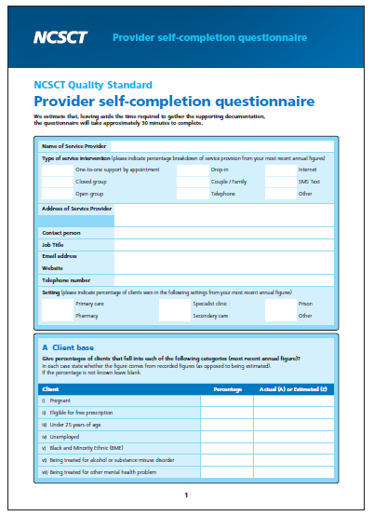
NCSCT Review
Vital that service is subject to independent review, including verification of quit rates
NCSCT Review process
self-completion form
independent check on claimed quits

Slide 29
The importance of primary care in promoting the service

Slide 30
Percent reporting having been offered help with stopping by GP
Base: People who smoked cigarettes in the past 12 months
Data from smoking toolkit study: www.smokinginengland.info

Slide 31
Lots of work to do to upgrade services: but how?

Slide 32
The 123 of getting people to do things
Prompt immediate action
Make it really easy and quick
Make it appealing

Slide 33
Oh yes, and …
Prompt immediate action
Make it really easy and quick
Make it appealing
If you can’t make people want to do it, make them need to do it

Slide 34
Key messages
There is a wealth of evidence about how to deliver effective stop-smoking support
Most stop-smoking services can improve by having a clear action plan for implementing this evidence
Specialist services are crucial to the whole enterprise

Slide 35
Oh yes, and …
Many lists should have more than 3 things in them

Slide 36
Thank you for listening
@robertjwest
#UKNSCC

