Slide 1
Smoking cessation outcomes of an intensive tobacco treatment program within mental health and addictions services
Chizimuzo Okoli, PhD, MPH, RN
Director, Tobacco Treatment and Prevention Division, Kentucky Tobacco Policy Research Program
Assistant Professor, College of Nursing, University of Kentucky
Milan Khara, MBChB, CCFP, cert. ASAM
Clinical Director, Smoking Cessation Clinic,
Vancouver General Hospital,
Clinical Assistant Professor, Faculty of Medicine, University of British Columbia
Notes:
Intro
Innovative program of VCH Addiction Services- 1 year
OBJECTIVE:Treating tobacco addiction in “hard to treat smokers” with INTENSIVE treatment
Describe the program and show some prelim data

Slide 2
Declaration of competing interests
Dr Chizimuzo Okoli has received consultation fees from Vancouver Coastal Health Authority in the previous 12 months
Dr Milan Khara has received unrestricted research funding, speaker’s honoraria, consultation fees or product from the following organisations/companies in the previous 12 months: Interior Health Authority, Pfizer, TEACH, QuitNow Services, Ottawa Heart Institute, Johnson and Johnson, Provincial Health Services Authority, College of Physician’s and Surgeon’s of British Columbia

Slide 3
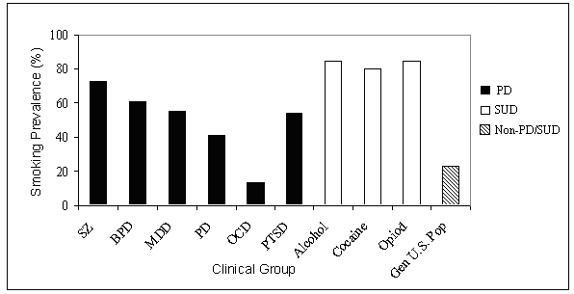
SIGNIFICANCE
Kalman, Morissette and George (2005), Am. J. Addict., 14: 106-123
Notes:
3
1 million people per year receive addiction treatment in the USA.
Smoking prevalence has fallen from 50% to 19% today in Canada….yet some “specific populations” have grossly disproportionate smoking prevalence…amongst which are pts with SUD
44% cigs to the MI (population based survey Lasser et al) and smoking prev 67.9% amongst persons who abuse drugs
Alcohol/ Drug Dependency- 70-90% (Glassman et al 1999)
“hardening” of the smoking population…
-these patients often die of tobacco attributable illness and yet substance abuse programs often ignore tobacco use, for example in a 2003 survey of addiction treatment programs in Canada only 10% reported offering any formal smoking cessation programming…(Currie et al 2003)
BUT…..WHY?.....

Slide 4
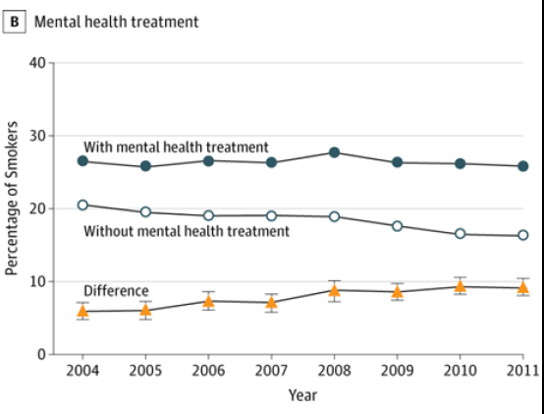
Trends in smoking prevalence by mental health treatment status over time (2004 to 2011)
“This suggests that tobacco control policies and cessation interventions targeting the general population have not worked as effectively for persons with mental illness.”
Cook, B.; Wayne, G.; Kafali, E.; Liu, Z.; Shu, C.; Flores, M. Trends in smoking among adults with mental illness and association between mental health treatment and smoking cessation. JAMA 2014, 311, 172-182.
Notes:
Using nationally representative surveys of noninstitutionalized US residents to compare trends in smoking rates between adults with and without mental illness and across multiple disorders (2004-2011 Medical Expenditure Panel Survey [MEPS])

Slide 5
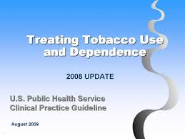
Clinical Practice Guidelines
“All smokers with psychiatric disorders, including substance use disorders, should be offered tobacco dependence treatment, and clinicians must overcome their reluctance to treat this population…. Treating tobacco dependence in individuals with psychiatric disorder is made more complex by the potential for multiple psychiatric disorders and multiple psychiatric medications.”
(Treating Tobacco Use and Dependence: 2008 Update. Clinical Practice Guideline)
Fiore M, Jaén C, Baker T, et al. Treating Tobacco Use and Dependence: 2008 Update. Clinical Practice Guideline. Rockville, MD: U.S. Department of Health and Human Services. Public Health Service. ;2008.

Slide 6
Treatment Philosophy
Tobacco Dependence Clinic Sites
Smoking cessation is a ‘process’ not an event
– as such no specific ‘quit date’.
Concept of ‘titration-to-effect’ – nicotine replacement is provided in increasing doses until the behavior of smoking ceases.
Centre for Concurrent Disorders
Rainier
Pender Clinic
DCHC
Three Bridges
Raven Song
Pacific Spirit

Slide 7
Treatment Approach
8-week structured group:
Phase 1: engagement in the process – weeks 1-2
Phase 2: planning for change – weeks 3-4
Phase 3: sustaining change – weeks 5-8

Slide 8
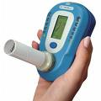
Specific aims
To assess smoking cessation rates at end-of-treatment
To examine predictors of successful smoking cessation

Slide 9
Sample for evaluation
1075
Intent-to-treat
289
Not engaged
(Had < 2 visits)
Marijuana use (18.3% vs. 10.1%)
Younger (45.8 years vs. 48.2 years)
Lower Expired CO at baseline (18.5 vs 20.5)
786
Engagers
163
Non-completers
(Had < 6 visits)
623
Completers
Analysis is based on a retrospective chart review of participants in the Tobacco Dependence Clinic program (between Sept 2007 and Mar, 2012) from 8 clinics, in Vancouver, Canada
Notes:
WHAT TIME PERIOD IS THIS?
9

Slide 10
History of a substance use and/or psychiatric disorder (N = 1075, 58.6% Male)
Percent %
Psychotic
Anxiety
None
Mood

Slide 11
Sample characteristics (N = 1075, 57% male)
 | Mean | Stand. Dev.
Age of participant (years) | 47.6 | 11.4
Age at smoking initiation (years) | 15.2 | 5.7
Importance of quitting (scale of 0 ‘low’ to 10 ‘high’) | 9.1 | 1.3
Confidence in quitting (scale of 0 ‘low’ to 10 ‘high’) | 7.4 | 2.3
Number of cigarettes smoked per day | 20.8 | 9.8
Fagerstrom Test for Nicotine Dependence (scale of 0 ‘low’ to 10 ‘high’) | 5.8 | 2.2
CO level at baseline (ppm) | 20.0 | 13.3

Slide 12
Smoking cessation* outcomes at end-of-treatment
*Smoking cessation at end-of-treatment (i.e., anytime between 8 weeks to 26 weeks) based on 7-day point-prevalence of abstinence verified by expired CO levels

Slide 13
Smoking cessation by SUD and PD among program completers (n = 623)*
Percent %
* No statistically significant differences between groups

Slide 14
Smoking Cessation by length of stay in the program
(n = 1075)
Percent %
Statistically significant linear-by-linear associations χ2=195.7 (df = 1), p <.0001

Slide 15
Multivariate predictorsª of smoking cessation among program completers at end of treatment (n = 623)
Predictors | Odds Ratio | 95%CI
For how long able to quit at last attempt 6 months or less (referent) Greater than 6 months | 1.0 1.73 | - 1.20-2.44
FTND at baseline | .93** | .86-1.00
Number of Visits to the TDC | 1.07*** | 1.04-1.09
Hosmer-Lemeshow goodness-of-fit: χ²= 7.25 (DF=8), p=.510
Employing a two-step model building process in which variables associated with smoking cessation (at alpha < .05) in the unadjusted analyses are included in a second-step for adjusted analyses. Variables included were: Sex, Psychiatric disorder categories, Substance use disorder categories, co-occurring disorder categories, ever used evidence-based modality to stop smoking in the past (yes vs no), length of time able to quit at last attempt (6 months or less vs. greater than 6 months), Type of pharmacotherapy used for treatment (single, combination, varenicline), age, age at smoking initiation, importance of quitting, confidence in quitting, cigs/day, FTND, expired Co levels at baseline, and total visits to the program. Only variables which were significantly predictive of smoking cessation in the final adjusted multivariate model are shown.
* = p <.05, ** = p <.001, *** = p <.001

Slide 16
Effectiveness of type of pharmacotherapy on successful smoking cessation by co-occurring disorders among completers (n = 623)
 | Total (N = 623) |  | PD only (n = 72) |  | SUD only (n = 127) |  | Co-occurring (n = 398)
 | OR | 95%CI | OR | 95%CI | OR | 95%CI | OR | 95%CI
Single NRT (referent)ª | 1.0 | --
Combination NRT | .90 | .58-1.38 | 1.02 | .21-5.07 | .60 | .21-1.65 | .98 | .58-1.66
Varenicline | 2.50* | 1.34-4.70 | 9.5* | 1.59-57.331 | 1.18 | .29-4.77 | 1.85 | .79-4.33
Varenicline + NRT | 1.05 | .46-2.38 | .83 | .06-12.72 | .42 | .05-3.3 | 1.27 | .47-3.46
Note: ª. The single NRT group includes gum/lozenge/inhaler (n = 36), single nicotine patch (n= 196) and 5 individuals who were concurrently taking Bupropion. The Varenicline group includes 108 individuals using only varenicline and 58 individuals using varenicline and NRT.
All analysis adjusted for demographics (sex and age), total number of weeks in program, and switching pharmacotherapy (yes vs. no) during treatment.
* = p <.05

Slide 17
Conclusions
Intensive tobacco dependence treatment enhances smoking cessation for those with mental illnesses or substance use disorders.
Treatment should include best practices using behavioural counseling combined with pharmacotherapy.
Treatment durations beyond 8-12 weeks should be considered to maximize effectiveness of programs
Future studies may explore effectiveness of different combinations of pharmacotherapy by mental health/substance use diagnoses

Slide 18
Questions??

