Slide 1


Implementing the NICE guidelines for smoking cessation in secondary care: From rhetoric to reality
﻿Collaboration for
Leadership in Applied
Health Research and
Care South London
(CLAHRC South London)
Debbie Robson & Ann McNeill
Addictions Department,
Institute of Psychiatry, Psychology & Neuroscience, King’s College London
UKNSCC, 11th June 2015

Slide 2
Overview
Context
Smoke Free Policy & outcomes
  Tobacco dependence treatment protocol
  Electronic cigarette policy
Training & outcomes

Slide 3
Context & background

Slide 4
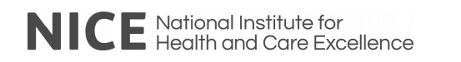
NICE guidelines for smoking cessation in secondary care, acute, maternity & mental health (NICE, 2013)
Changes to treatment of tobacco addiction
Changes to the environment &
behaviour of staff
Identify people who smoke, offer and arrange support
Clinical pathways for provision of tobacco dependence treatment
Integrated stop smoking support inc. on site hospital service
Support for staff smokers
Training for staff
Implement a comprehensive smoke free policy that include the grounds
Ensure there are no designated smoking areas
No exceptions for particular groups
No staff supervised or staff facilitated smoking
Need a policy that enables the successful implementation of both parts
Notes:
In the uk The National Institute for Health and Care Excellence (NICE) provides national guidance and advice to improve health and social care

Slide 5


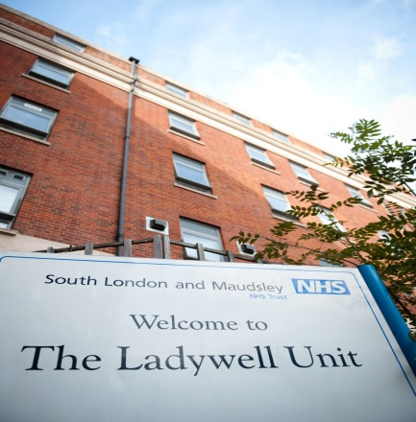
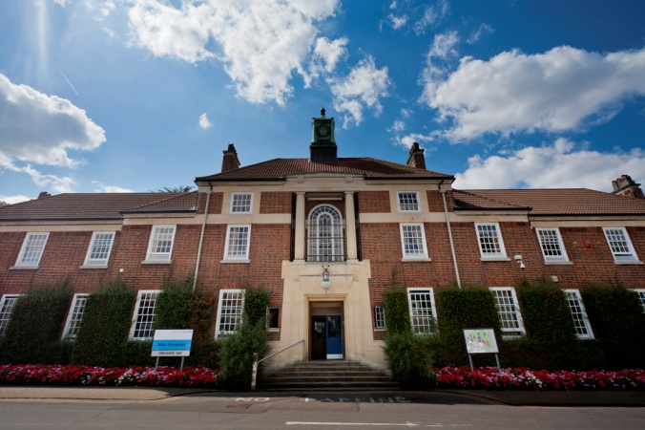
South London and Maudsley
NHS Foundation Trust (SLaM)
Maudsley Hospital
Lambeth Hospital
Lewisham Hospital
Serves a diverse local population of 1.2m
London boroughs of Southwark, Lambeth, Lewisham & Croydon
4 hospital sites: 49 wards: 1000 beds –
treats approx 5,300 inpatients a year
200+ community services (45,000 + patients a year) + specialist/national services
Employs approx 4,800 staff
Bethlem Hospital
Notes:
Each year SLaM provides inpatient care for approximately 5,300 people and treats more than 45,000 patients in the community. Approximately 4,800 staff are employed in the organisation.
In South London, people with a serious mental illness die an average of 15 -20 years earlier than those without, from preventable conditions

Slide 6


Smoking: South London
17.1 to 21.4%
32%
60%
88%
Substance use⁴
Psychosis³
Depression & Anxiety²
Local population¹
1. www.smokinginengland.info 2. McManus et al (2010) NCSR.
3. Wu C-Y et al. (2013). PLoS ONE 8(9): e74262. 4. Cookson C, et al (2014) BMC Health Services Research 2014, 14:304
Notes:
In South London, people with a serious mental illness die an average of 15 -20 years earlier than those without, from preventable conditions

Slide 7
2011
Smoke Free Committee
Health Act
(2006)
2012
Smoke Free Strategy
2006
March 2013
River House Pilot
July 2008
National smoking ban in hospital buildings
Aug 2013
Trust agrees to be
Smoke free ready by 1/10/14
Oct 2013
Smoke Free ready committee
Oct 2014
SLAM Smoke Free Policy
Nov 2013
NICE Guidelines smoking cessation in secondary care
2015
Notes:
The trust hasd been working towars this for a number of years

Slide 8
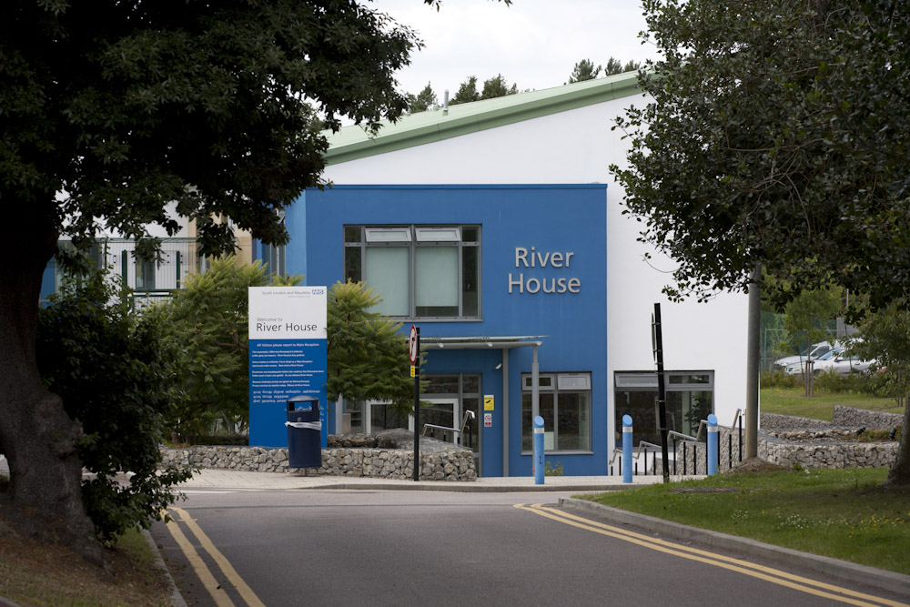

Slide 9
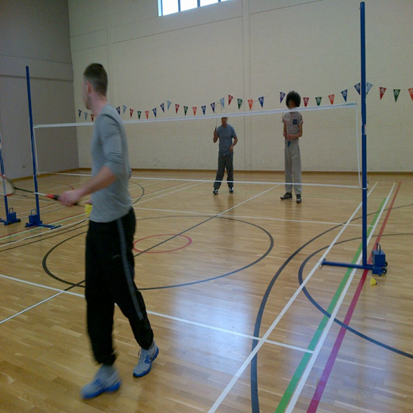
Clinical Outcomes
Reduction in GP contacts
Improved engagement in therapy
Increase in use of leave
Improved sleep
Improved confidence
Money to spend

Slide 10
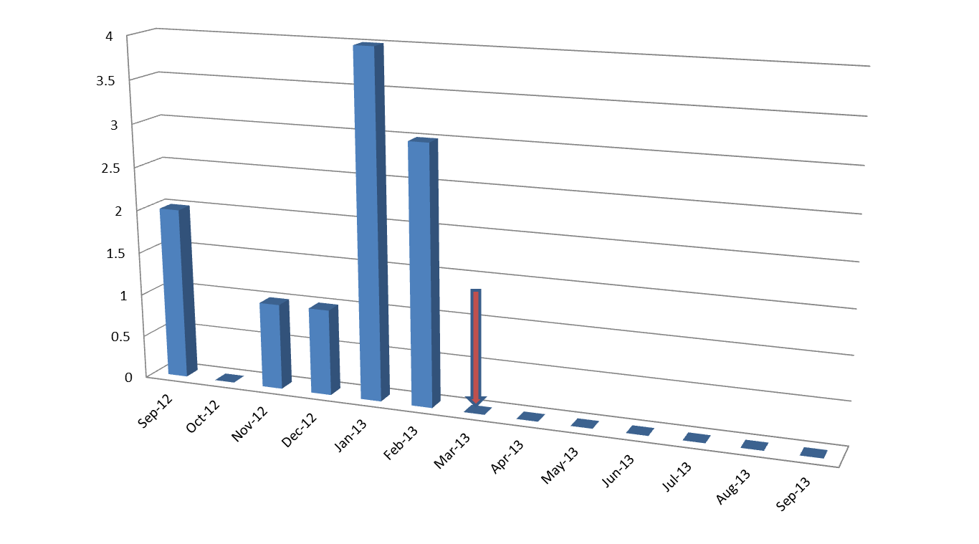
Rapid tranquilisation related to smoking

Slide 11
2011
Smokefree cmte
Health Act
(2006)
2012
Smoke Free Strategy
2006
March 2013
River House Pilot
July 2008
National smoking ban in hospital buildings
Aug 2013
Trust agrees to be
smokefree ready by 1/10/14
Oct 2013
Smokefree ready cmte
Oct 2014
SLAM Smoke Free Policy
Nov 2013
NICE Guidelines smoking cessation in secondary care
2015

Slide 12
Smoke Free Policy

Slide 13
Smokefree Ready Committee
Patient & Public Involvement
Estates: - environmental changes
Communications plan
Clinical Leadership
Quality improvement facilitator
Enhancement to electronic patient records & new refferal system
New treatment pathway
New policies and guidance
Research & evaluation
CORE TEAM
Mark Allen
Ann McNeill
Mary Yates
Debbie Robson
Sylvia Blankson
Smokefree leads site meetings
Education and training
Improved access to NRT products
Notes:
Doing a lot of these simultaneously

Slide 14
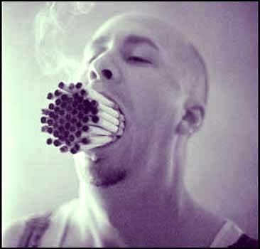
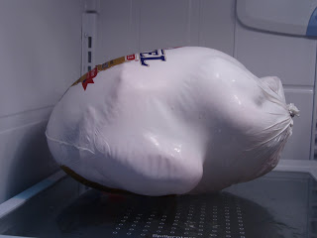
Understanding how we treat tobacco dependence in hospital settings?

Slide 15
Treating tobacco dependence in
inpatient mental health services
Since smokefree legislation (2008), inpatient services in UK implemented ‘smoking breaks’ every 1-2 hours
Patients are forced into nicotine withdrawal several times day
Use of cigarettes deskills clinicians
Cigarettes used to reward and punish behaviour e.g. to de-escalate aggression, encourage compliance with medication, attend to personal hygiene, to keep patients occupied etc
18 wards in one Trust: Time spent supervising smoking
Hours | Unit cost | Unit cost
 | Band 2ª | Band 5^{b}
One day: 40.86 | £926.10 | £4086
One year:16096.50 | £18,782.75 | £1,609,650
Robson & McNeill (in preparation)
Notes:
£98.40 a day for a band 5 nurse to facilate smoking (£41 a an hour
£61.50 for camhs and mhoa

Slide 16
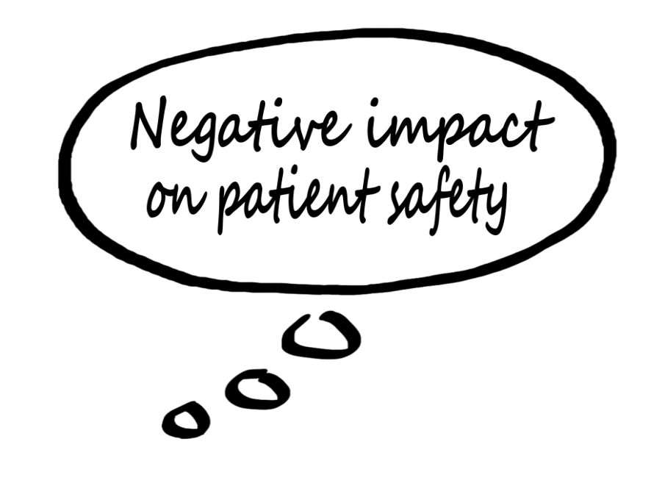

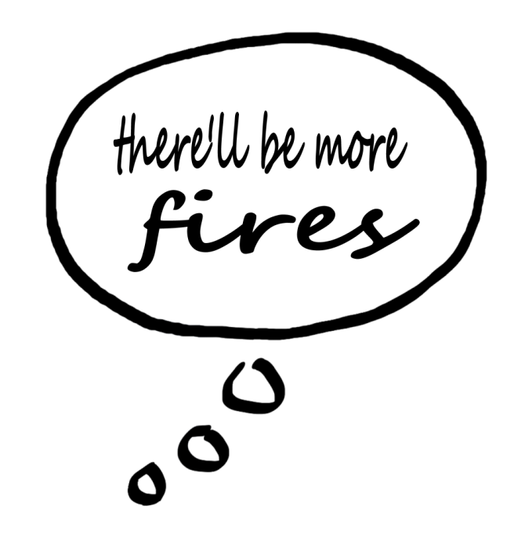
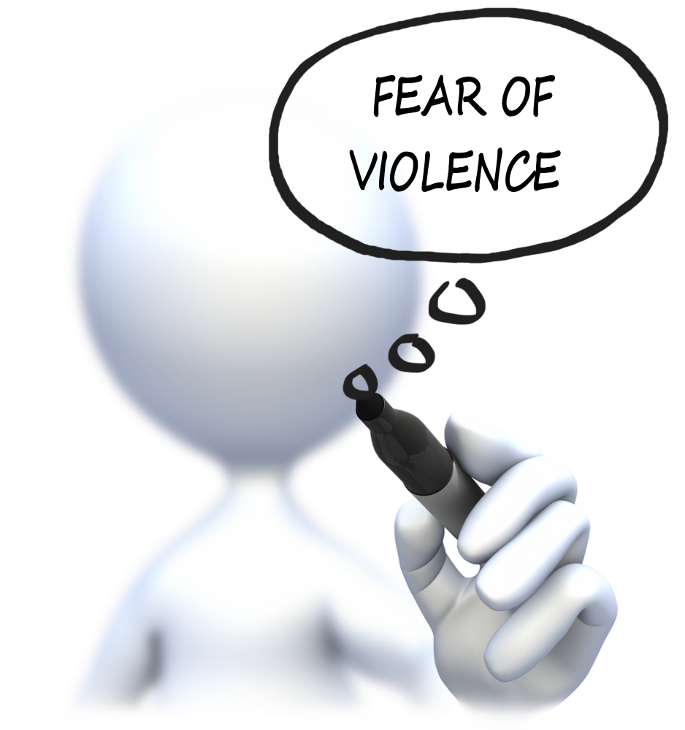
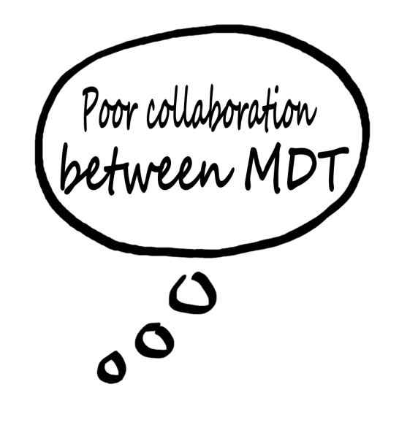



Staff listening exercises

Slide 17
Treatment pathway

Slide 18
Tobacco dependence treatment options during an
in patient admission
(if NICE recommendations are followed)
1
Temporarily abstain from smoking whilst in buildings & grounds, WITH NRT and/or psychological support
2
It’s an OPPORTUNITY, not an OBLIGATION to stop smoking permanently
Temporarily abstain from smoking whilst in buildings & grounds, WITHOUT NRT and/or psychological support
3
Use the opportunity to make a sustained quit attempt , WITH pharmacological and/or psychological support

Slide 19





Maudsley Smokers Clinic
Lead Hospital tobacco dependence treatment advisers
Ladywell
Bethlem
Maudsley
Lambeth
Inpatient and CMHT tobacco dependence treatment advisers
Specialist stop smoking clinics
Lewisham
Croydon Mind
Maudsley
Smokers Clinic
Lambeth
Notes:
We have created a new tobacco dependence treatment pathway and created new posts. Every hospital has a lead tobacco dependence treatment adviser who provides a bridging service between the wards and community specialist stop smoking services
We have also trained over 100 ward staff to provide intensive tobacco dependence treatment support

Slide 20

Implemented a new electronic referral system & integrated it with electronic health record system
Does the patient currently smoke tobacco? Yes__ No__
Usual daily cigarette consumption __
Time to first cig of the day__
CO reading___
Has the patient been advised of support available to stop smoking Yes__ No__
Does the patient consent to a referral to a specialist? Yes__ No__
If no, has the patient been offered NRT for temporary abstinence Yes__ No__
Grant from SLAM BRC – in collaboration with National Centre for Smoking Cessation & Training

Slide 22

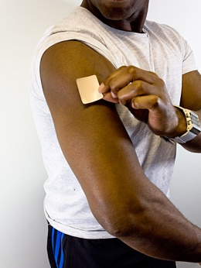
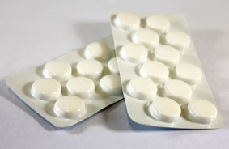
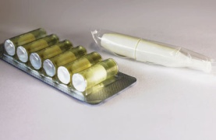
Nicotine replacement therapy
+
NRT Patch + oral NRT + behavioural support
3 options for accessing NRT
Doctor/non medical prescriber
Homely remedy policy
(nurse can administer for limited NRT products up to 24 hours)
Patient Group Direction for NRT
nurses, who have received level 2 training + pass a competency test

Slide 23
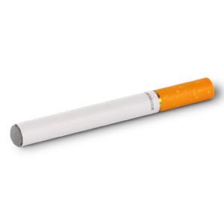

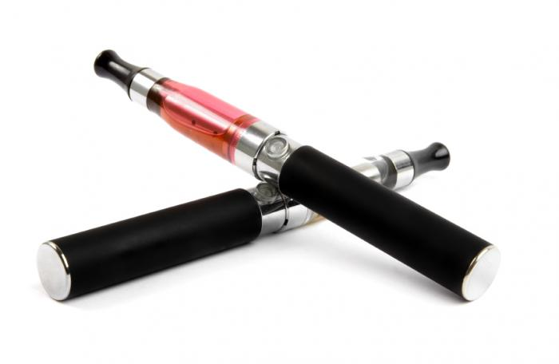

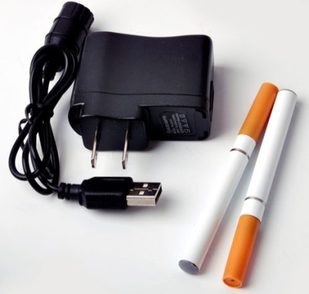
E cigarette policy
Disposable
Fillable
Rechargeable
Prefilled Disposable
Rechargeable
Not offered as first line treatment
Must be part of Care Plan
Not to be used in communal areas
Not to be used during therapeutic conversations
Not to be used in ward gardens

Slide 24




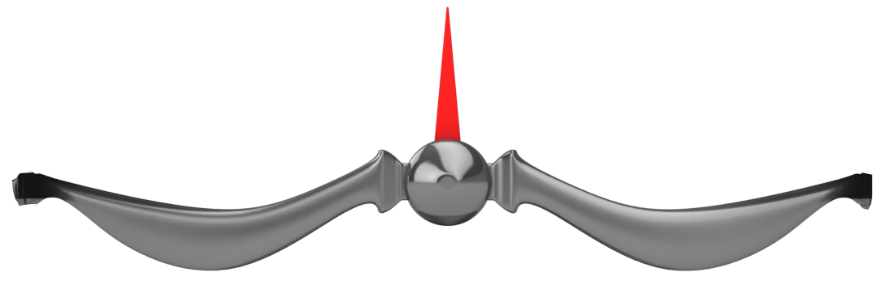
Tobacco dependence treatment
Enforcement
of ban
Getting the balance right between treating smokers and enforcement of smoke free policy is a challenge ……Prioritise treatment of tobacco addiction over enforcement

Slide 25

SLAM Education &Training
LEVEL 1: ELearning. Basic knowledge
( 2 hours)
Tobacco addiction in mental health settings
What works in mental health
Use of NRT, bupropion, varenicline
Providing Very Brief Advice
How to refer for specialist support
1174 staff have completed E Learning Courses
p <0.001
KNOWLEDGE pre & post
Notes:
1174 Knowledge was tested with a random set of 10 multiple choices questions.
The average score before training was 54.4% and after 87.6%, t(47.7)=1061, p <0.001.

Slide 26

SLAM Education & Training
LEVEL 2: Advanced clinical skills (3 days)
Assessing nicotine dependence
Facilitating choice of stop smoking medication (PGD for NRT)
Managing temporary abstinence/smoking cessation
Provision of behavioural support
Use of E Cigarettes
124 staff attended training between 7/2014 and March 2015
Evaluated using a 44 item questionnaire
Knowledge, confidence and attitudes all significantly increase after training
Notes:
Knowledge was tested with 12 multiple choices questions. There was a significant difference in the knowledge scores pre (M=5.2, SD 2.0) and post training (M=9.7, SD 2.5), t(15.4)=100, p <0.001.
Participants were asked to rate their confidence about 21 difference tobacco dependence treatment practices using a 5 point likert scale (1= not confident to 5 = very confident). There was a significant difference in confidence pre (M=54.6, SD 14.8 and post training (M=92.4, SD 7.7), t(24.1)=98, p <0.001.
Attitudes towards treating tobacco

Slide 27
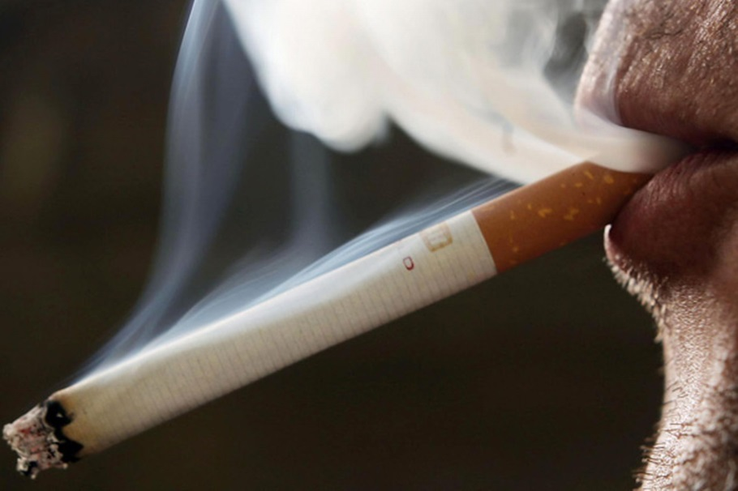
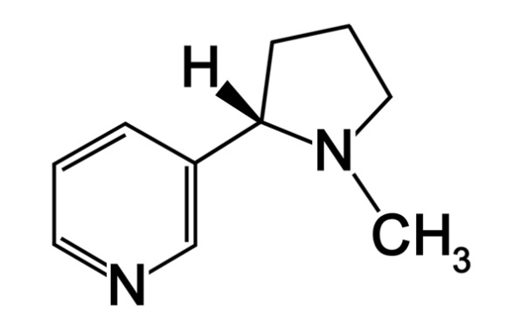

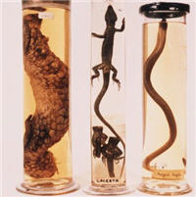

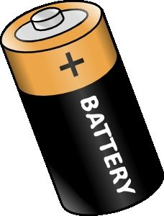
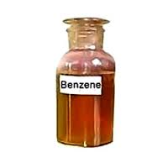
Separate the nicotine from the smoke
“Smokers smoke for the nicotine, but die from the tar”
Professor Mike Russell, Maudsley Smokers Clinic, 1979
Notes:
It stimulates the central nervous system, increasing the heart rate and blood pressure, leaving the heart to work harder for more oxygen.

Slide 28

Are staff’s worst fears realised??

Slide 31
Summary
Implementation of the NICE guidelines requires development, implementation and sustainable treatment and staff training pathways
Support and address staff fears and concerns
Support staff to treat tobacco dependence with nicotine, not tobacco
Invest in improving the experience of tobacco dependence treatment

Slide 32
Thank you deborah.robson@kcl.ac.uk
﻿Collaboration for
Leadership in Applied
Health Research and
Care South London
(CLAHRC South London)
Acknowledgements
Professor Ann McNeill, IoPPN, KCL
Mary Yates, Matron, SLAM

