Slide 1
Transforming services
Learning from those who have achieved success
UKNSCC 2015
Organised and funded by Johnson & Johnson Ltd.
UK/NI/15-4863
Date of preparation: June 2015

Slide 2
Symposium overview
Changing status of smoking cessation services (SCS)
Encouraging uptake of smoking cessation services - what’s worked for others and the tools available to support this
Discussion and Q&A
Notes:
Today we will cover…

Slide 3

Changing status of smoking cessation services
Emma Croghan
Director of Public Health and Lifestyle Services, North 51

Slide 4
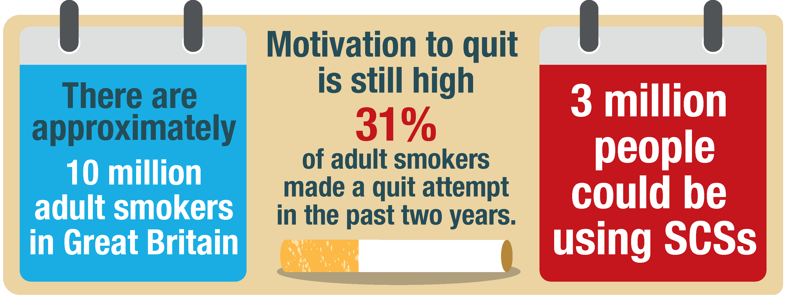
The opportunity still exists in the UK
Lower income groups have the highest smoking rates -14% of adults in managerial positions vs 29% in routine manual occupation (in 2013)¹
2
1, 2
1
¹ASH fact sheet: Smoking statistics. January 2015
²Smoking in England. Latest Statistics. Top-line findings from the STS (STS140721) http://www.smokinginengland.info/latest-statistics/ Accessed May 2015
Notes:
Current smoking statistics show STS (1) The population is in growth and there are still lots of smokers – still with a very significant gap between the most well off and the worst off in society – so the inequalities agenda should be at the forefront of our minds if we are commissioning, delivering or facilitating smoking cessation. STS tells us that motivation/intention to quit is high with a third of adult smokers intending to quit soon –and a similar number who HAVE made a quit attempt in the last year. None of these people intended to make an unsuccessful attempt – they were all hoping for the magic ingredients that would work for them this time. If we could somehow (holy grail) let these people know that for free, they could have the very best chance of quitting by getting support from/coming to us, we would be looking at 3 million service users. So our target market is 3 million people each year. If we did (holy grail) reach all of these, and they all became treated smokers, we would be looking at least half a million long term quitters. So, although it’s a long stretch, it’s a worthwhile ambition. Its also worth noting that the job is by NO MEANS done – we are not looking at smokers who can’t be reached or who don’t want to quit.

Slide 5

Yet we know footfall to SCSs is generally in decline³
In a sample of 6 services where footfall is actually increasing…
6% of service users are also using e cigs
1% are ONLY using e cigs
Approx. 75% of our service users use NRT; 97% of these combination NRT. 25% Varenicline (<1% Zyban)
3
3
3% are using cannabis concurrently³
17% live with children in the household under the age of 5; 29% have LTCs³
NHS reforms have shifted responsibility to local authorities, could there be less interest in SC amongst primary care?
More addicted?
Average Fagerstrom score³
3
Data on file: Emma Croghan, Director Public Health and Lifestyle Services, North 51 Ltd. Data collated through services provided through North 51 Ltd. and covers the year April 1st 2014 to March 31st 2015.
Data supplied to J&J Ltd. June 2015.
Notes:
So – who are those holy grail responders? In 6 services, some are coming to us who use e cigs (a reason which has been given for the reduction in foot fall) – 6% of these service users are using e cigs concurrently in the quit attempt – only 1% are using them alone. Most are using combo NRT or Champix (no surprises there). 3% are reporting at entry to the service that they are using cannabis as well as tobacco at least weekly
There might be a number of reasons for this…
Are E-cigs stopping service users coming?
No - 6% of service users are also using e cigs – only 1% are ONLY using e cigs
Is Cannabis use a barrier?
3% are using cannabis concurrently
Are they now more addicted?
Average Fagerstrom score is 4.9
Is the medication offer good/appealing enough?
Approx. 75% of our users use NRT; 97% of these combination NRT
Are they a different demographic?
17% live with children in the household under the age of 5; 29% have LCTs
Fewer referrals from Primary Care?
NHS reforms have shifted responsibility to local authorities, could there be less interest in SC amongst primary care?

Slide 6

So how do we increase uptake?
Advertise?
Do we need to start selling ourselves more?
Shouldn’t be seen as a separate service
Ensure we are armed with the right information…
Notes:
So should we be delivering high cost, passive advertising like a consumer product?
Its not ‘normal’ practice for those of us from health backgrounds to tout for business – it feels odd. Why haven’t we cracked the primary care and secondary care referral routes?
Example – T&W maternity service send out trimester specific information at trimester 1 about smoking with scan booking info, trimester 2 at 20 week scan and trimester 3 at HV introduction – when the service phones to triage the pregnant woman, they expect it as part of their maternity service.
Introduction to FOCUSED as being able to provide the right information to get ‘buy-in’

Slide 7
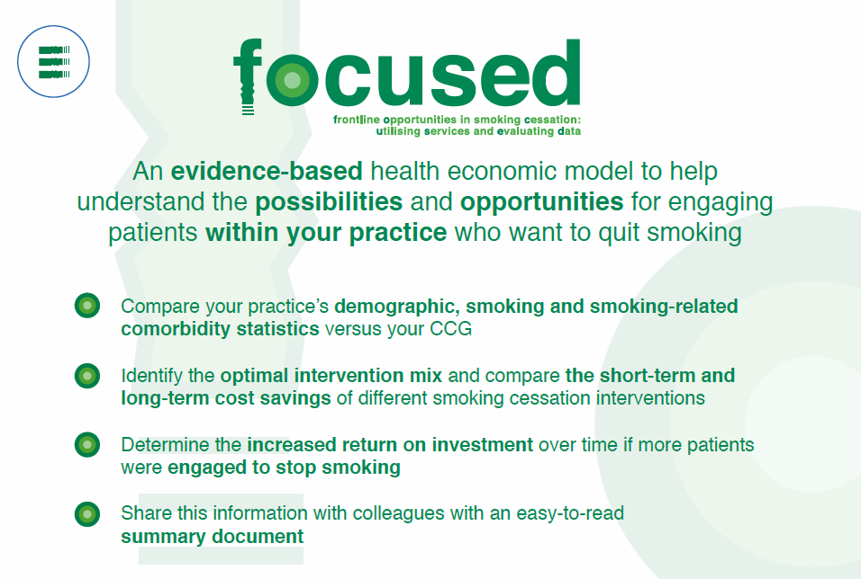
The FOCUSED tool is developed and provided by Johnson & Johnson Ltd. as a service to medicine
Notes:
Overview of J&J Focused tool and why this is helpful from both a service provider perspective and Practice Manager
Move on to introduce Julie and Sonia as examples of individuals who have utilised data (that can now be accessed through FOCUSED) to achieve success
NB Neither Sonia or East Lancs have previously used FOCUSED (as it is still very new), however, they have both used data / information, which can be easily accessed through the J&J tools to increase service uptake and measure benefits of employing smoking cessation i.e. J&J tools can help other service providers and primary care practices to do this also

Slide 8
Service provider perspective: successfully selling your service
Julie Trezise
Stop Smoking Service Manager
East and Central Lancashire
All data were supplied to Johnson and Johnson Ltd by Stop Smoking Service East and Central Lancashire and they cover the time periods April 1st 2014 to March 31st 2015 vs. previous year. No clinical outcomes can be inferred from the data. This presentation has been developed in partnership with Johnson & Johnson Ltd.

Slide 9

The challenge
Footfall fallen by 50% over two years - needed to look at ways in which to recapture smokers into the service. No Primary care LES
Partner working with GPs, pharmacy and leisure services (needed to prioritise)
Increasing outcomes to achieve our challenging quit target
Motivating practice staff and GPs in recognising Smoking Cessation is important to provide an in-house service
Making the most efficient way of utilising resources (staff) within areas of high smoking population given the large demographic area
Notes:
Footfall fallen by 50% due to e cigs over the last 2 years. We needed to look at ways in which the service could re capture smokers into the service. No Primary care LES.
Partner working with GPs, pharmacy and leisure services (needed to prioritise )
Increasing outcomes to achieve our challenging quit target
How to engage and motivate practice staff and GPs in recognising Smoking Cessation is important to provide an in-house service.
Making the most efficient way of utilising resources(staff) within areas of high smoking population given the large demographic area

Slide 10
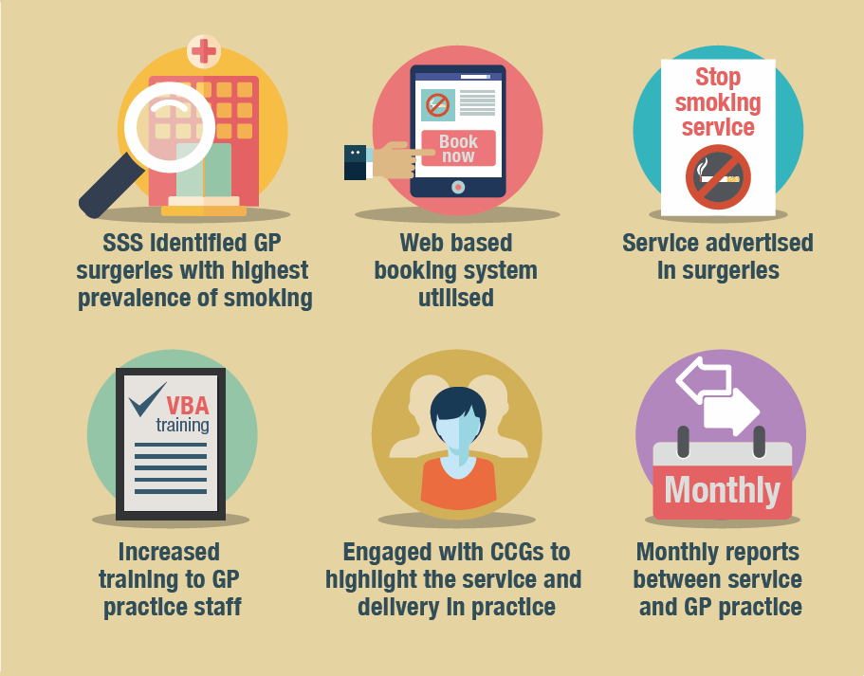
What did you do?
Notes:
Identified the GP practices with high numbers of smokers and prevalence using cegidem data provided by J&J- re partner working decision to focus on practices with high numbers of smokers
Identified which practices were not referring into the stop smoking service i.e. those prescribing independently using cegidem data provided by J&J
Increased brief intervention training, tobacco together training and level 2 training to ensure whole practice approach, which will drive footfall.
Planned to change where we delivered our clinics- focussing on the practices with high numbers of smokers.
Recruited promotional advisors to engage with practices and events
Engaged with CCGs via meetings to highlight the data and offer in surgery clinics. We put together and presented on the benefits of referring patients to the service i.e. 4 times more likely to quit, and how we would work with the practice.
We discussed every contact counts and missed opportunities if interested patients leave the practice without making an appointment to see an advisor.
Encouraged a whole practice approach for referrals and identification of patients
Surgery to book in where possible into the specialist in surgery clinic before they leave
How we could work with the practice to recruit smokers
Advice the practice that they would still gain their QOF points if we provided a service

Slide 11
What tools / support did you use?
Data highlighting how much was being prescribed in practices and also how many smokers were in individual practice - J&J provided this for us- this allowed us to prioritise our resources
Web based booking system
Monthly report for the practice on activity to measure success - feedback on performance of clinic
Developed presentation to sell the specialist service
Working with the practices to identify and recruit smokers
Visibility - produced posters/mouse mats/cards/pens
Advisors ensure that visibility remains high
NICE guidance and best practice to follow evidence-based practice
Notes:
Data highlighting how much was being prescribed in practices and also how many smokers were in individual practice- J&J provided this for us- this allowed us to prioritise our resources.
Web based booking system
Monthly report for the practice on activity to measure success- feedback on performance of clinic.
Presentation which we put together to sell the specialist service
Working with the practices to identify and recruit smokers. i.e. The service provided a letter, practices input the names and addresses, the service posted out and paid for the postage.
Visibility- produced Posters/Mouse mats/Cards/Pens
Advisors ensure that visibility remains high
Nice guidance and best practice to follow evidence based practice

Slide 12
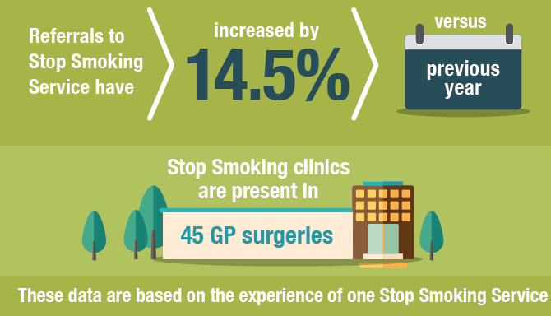
Outcomes
Continuing to reassess clinic performance on a regular basis to ensure resources utilised for maximum quits
Notes:
Seen an increase in footfall v last year
Total clients setting a quit date and achieved, comparing qtrs. 1,2,and 3 2013 v 2014
Setting a quit date = 7360 v 7544 increase of 184
Achieving a quit = 3473 v 3663 increase of 190
Re assessing clinic performance on a regular basis to ensure resources utilised for maximum quits. Extra clinics added or extended to cope with numbers of patients.
This partner working means that we are also now following nice guidance around pregnant women via trained midwifes ( we have trained) in GP practices at first booking. This means that actively trying to reduce infant mortality as this is high in the area- We are able to support the whole practices population.

Slide 13
Primary care perspective: benefits of increasing quit rates
Sonia Simkins
Practice Business Manager
All data were supplied to Johnson and Johnson Ltd by Sonia Simkins, Practice Manager, West Midlands and they cover the time periods April1st 2014 to March 31st 2015 vs. previous year. No clinical outcomes can be inferred from the data. This presentation has been developed in partnership with Johnson & Johnson Ltd.

Slide 14

Goals
*Not actual data
Notes:
Increase footfall
Increase quit rates
Reduce unplanned admissions

Slide 15
What do practices want to know?
Why should helping patients to quit smoking be a priority?
Is it a realistic goal? Look at the category of patients!
Is the process manageable from a practice point of view?
What can realistically be achieved / what are the benefits?

Slide 16

Considerations
All staff must be on board with the project for it to be a success
It is essential there is a good working relationship with the advising team
Referral system should be quick and easy to follow for staff and patients and the clinics need to run effectively
All staff to be informed about the project and have access to the information explaining the service

Slide 17

How?
Efficient correspondence between the practice and service provider i.e. Q51
Referral forms placed in every clinical room
Encouragement from referring staff to ensure patients are on board with the process!
Referrals managed efficiently by practice staff
Notes:
Referral forms placed in every clinical room
Encouragement from referring staff to ensure Patients are on board with the process!
Efficient correspondence between the Practice and Service Provider i.e. Q51
Referrals managed efficiently by Practice staff

Slide 18
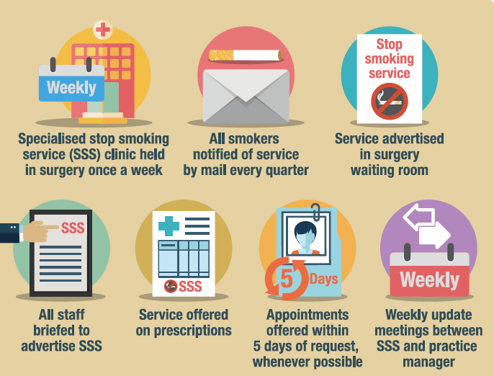
How?
Notes:
Weekly clinics were set up in the practice
Discharge letters were used as a tool to contact Smokers and offer the service
Service well advertised
All staff briefed to advertise SSS
Service offered on prescriptions
Appointments offered within 5 days
Weekly updates with PM and SS advisor

Slide 19
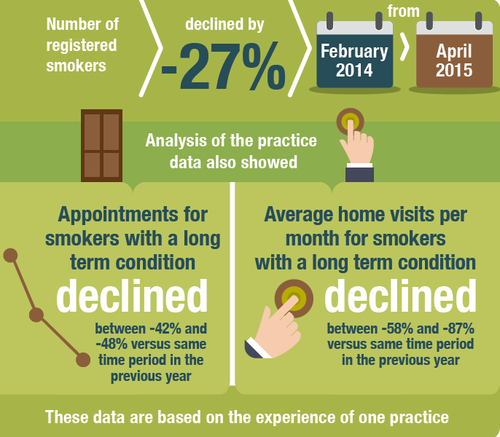
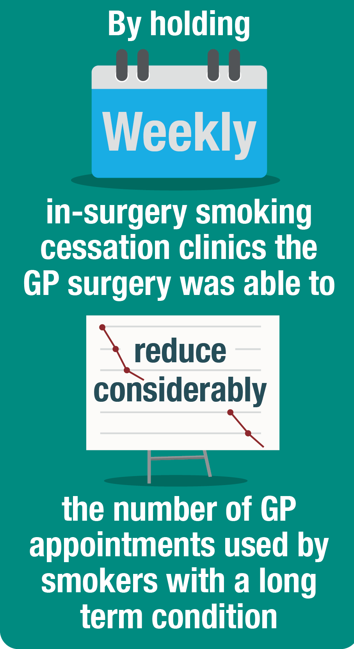
Benefits to practice
Notes:
Increased Footfall slowly at first
Increased Quit Rates
Significantly reduced the number of unplanned admissions
Reduced prescribing spend
Increased appointment capacity
Reduced the number of home visits on a daily basis
Patient wellbeing and general health improvement

Slide 20
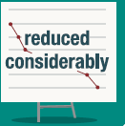
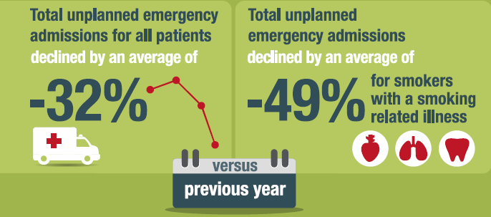
Benefits to practice
By holding frequent in-surgery smoking cessation clinics, the number of unplanned emergency admissions reduced considerably in smokers with smoking related illnesses (asthma, diabetes)
Notes:
Increased Footfall slowly at first
Increased Quit Rates
Significantly reduced the number of unplanned admissions
Reduced prescribing spend
Increased appointment capacity
Reduced the number of home visits on a daily basis
Patient wellbeing and general health improvement

Slide 21
Outcome
Providers were contacted and invited to practice manager meetings
Clinics have been set up across Sandwell
All have much more robust referral systems
Internal and external providers are being efficient

Slide 22
Now using the FOCUSED tool…
The FOCUSED tool was introduced to highlight the key points of the service
Results were also highlighted to show the benefits and
rewards of engaging smokers in the programme
Important data is shown in an easy to understand
way which captures the successes

Slide 23
Thank you
If you would like to arrange an appointment with a J&J representative to see how the FOCUSED cost model can benefit you and your patients, please contact focused@cellohealth.com

Slide 24
References
ASH fact sheet: Smoking statistics. January 2015
Smoking in England. Latest Statistics. Top-line findings from the STS (STS140721) http://www.smokinginengland.info/latest-statistics/ Accessed May 2015
Data on file: Emma Croghan, Director Public Health and Lifestyle Services, North 51 Ltd. Data collated through services provided through North 51 Ltd. and covers the year April 1st 2014 to March 31st 2015. Data supplied to J&J Ltd. June 2015

