Slide 1
Smokefree Mental Health Trusts - Tackling the burden of smoking in mental health settings
UKNSCC 2015, Manchester
Martyn Willmore – Fresh

Slide 2
Overview
Acknowledgements:
North East Mental Health Strategic Clinical Network
Public Health England NE Centre
Dr Jo Darke, PH Registrar
Northumberland, Tyne & Wear MH Trust
Tees, Esk & Wear Valley MH Trust
Lancashire Care Foundation Trust
Cheshire & Wirral Partnership FT
Devon Partnership NHS Trust
Why this matters
NICE Guidance
Working together
Making progress
Next steps & summary

Slide 3
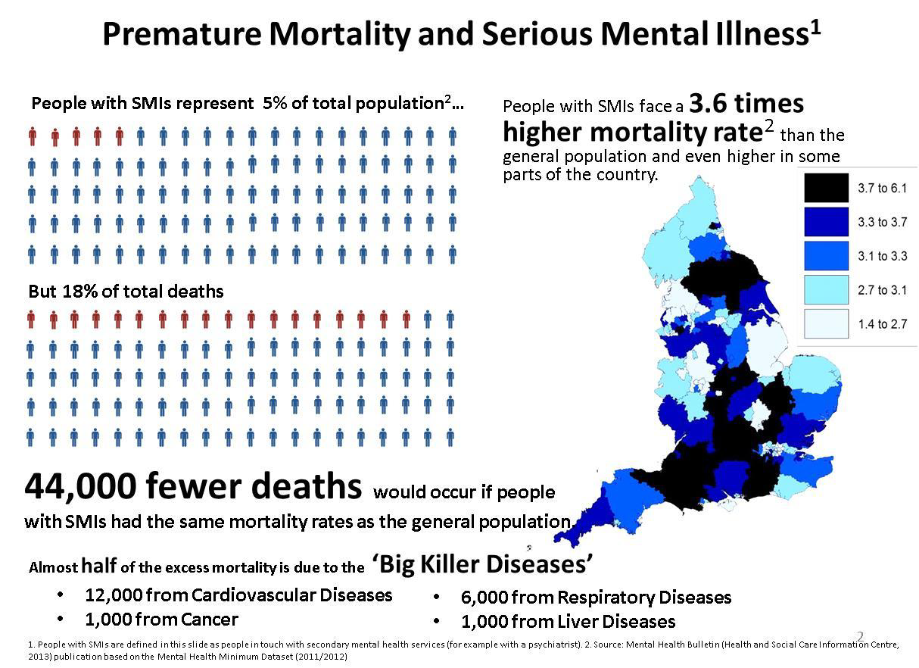
Mental Health & Inequalities

Slide 4
Smoking rates at NTW
Speciality (inpatients) | Proportion of smokers (%)
Adult mental illness | 65.8
CAMHS | 14.3
Forensic psychiatry | 51.5
Learning disability | 32.5
Old age psychiatry | 12.8
Rehabilitation | 17.9
Total | 46.5
Of the around 65,000 patients who access NTW services annually, this would equate to around 30,000 being smokers

Slide 5
Why this matters
Being compliant with NICE guidance
Tackling health inequalities
Huge captive audience, receptive to health advice
NHS Five Year Forward View – prevention agenda
What chance 5% prevalence by 2025 if we can`t make progress in this area?

Slide 6
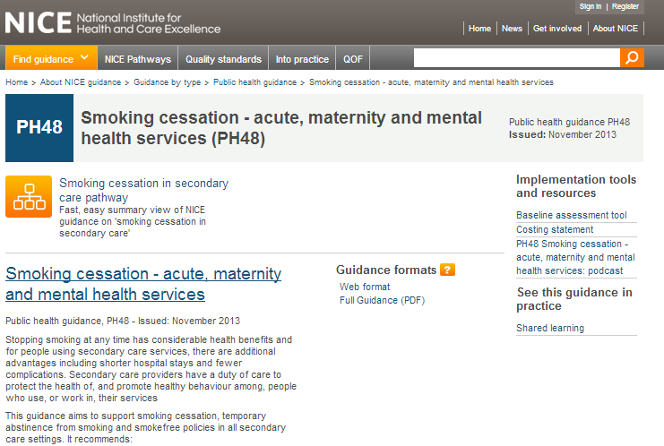
NICE Guidance PH48 (Nov 2013)
ff

Slide 7
Working together
North East Strategic Clinical Network – focus on parity of esteem between mental and physical health
SCN identified smoking as their number one preventable mortality priority
Established steering group in July 2014. Broad membership
Offer of support to both Trusts to help map current practice against 16 NICE recommendations

Slide 8
Mental Health Trust Mapping (i)
Key issues emerging from this work:
Provision of information about smoking to service users, visitors, carers, family members
Need for systematic identification of smokers on admission
Changes to IT systems/documentation to support routine offer of support/referral to smokers
Staff training requirements (e.g. VBA training)
Provision of support and NRT to abstain during stay (nicotine management). VBA+

Slide 9
Mental Health Trust Mapping (ii)
Role of in-house support for those that want structured support to quit (Russell Standard). Links to community
Smokefree policies. Senior staff/board commitment. Enforcement of policy
Attitude to electronic cigarettes, and access to NRT
Time spent by staff facilitating smoking
Alternative staff/patient interaction time and activities
Staff smoking on-site. Key role of staff as role models
Role of Communications is pivotal

Slide 10
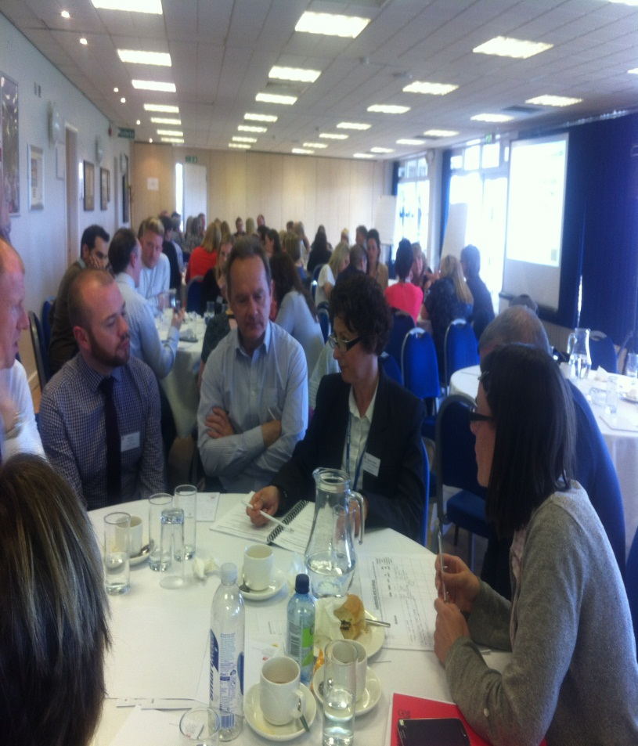
Making progress
On No Smoking Day 2015, we presented findings from NTW mapping exercise to around 60 staff
On 30th April, we held an event for 130 Trust staff and key partners to learn lessons from other smokefree Trusts
We used these events to begin local action planning
Both MH Trusts have now recruited dedicated staff to lead this agenda

Slide 11
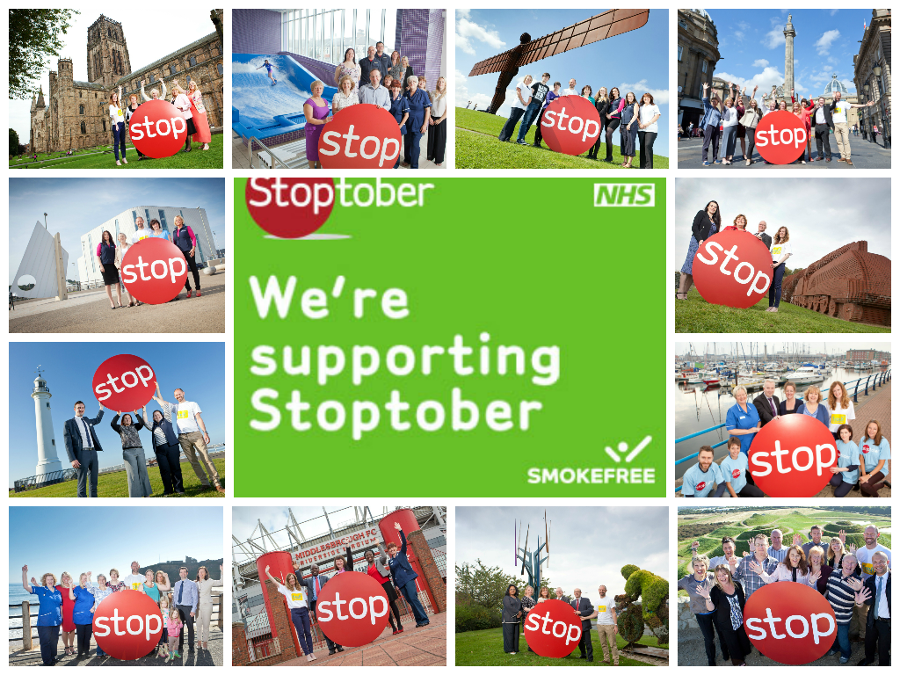
Making progress
We used Stoptober 2014 as a way to engage with MH Trust staff through Occupational Health Teams
Working to secure funds to support training of MH Trust staff
Planning events for Summer 2015 with Service Users, to consult and learn
Sharing draft policies around smokefree and electronic cigarettes

Slide 12
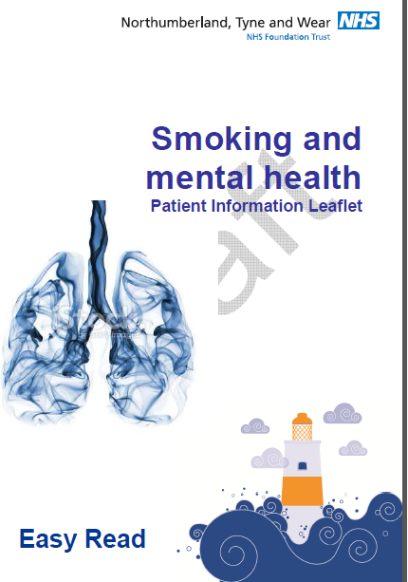
Making progress
Working with local groups to develop leaflets/resources to inform patients about smokefree pre-admission
Developing communications plans for staff, service users, visitors around SF site
Also generating PR to raise public awareness of links between smoking and mental health, and stress
Both Trusts now working towards being smokefree by No Smoking Day 2016

Slide 13
Lessons Learnt & Summary
NICE guidance provided a real opportunity to engage with our MH Trusts around smoking
Crucial importance of clinical champions to drive this agenda locally
Strategic buy-in and leadership around a shared vision
Being clear on what that vision is (i.e. not “just” smokefree)
Roles and responsibilities of all partners
Having realistic timescales, and engaging staff and service users to win “hearts and minds”

Slide 14
Contact details….
info@freshne.com
martyn.willmore@freshne.com
0191 333 7140
www.freshne.com
https://twitter.com/freshsmokefree

