Slide 1



Engaging With GP Practices: Breaking New Ground
Zaheera Chatra
Stop Smoking Specialist
11th June 2015

Slide 2

“Happiness lies in the joy of achievement and the thrill of creative comfort”- Franklin D. Roosevelt

Slide 3
The Rationale for Change
Referral process
Creating a new way
The importance of change for:
  Stop Smoking Service
  GP Practices
Forming stronger partnerships

Slide 4

First Steps
Being a salesperson
Prioritising smoking cessation- Win Win
CCG Commissioning Strategy
High spend with poor outcomes
GP prescribing- NRT, Champix, Zyban
GP referral rates
Protected learning time

Slide 5
The Referral Process
It needed to be:
  Simple
  Easy to use
  No form filling
  Best use of clinicians’ time
Prioritised and part of CCG templates
Set up NHS.net email account
Used by all staff

Slide 6
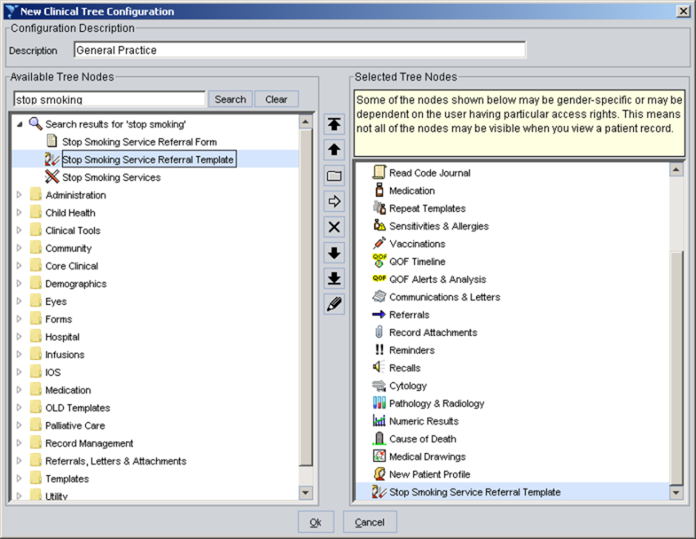
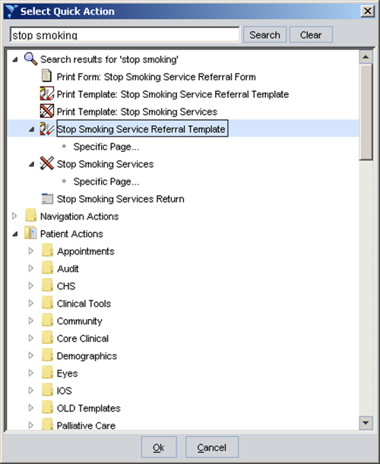
The System

Slide 7
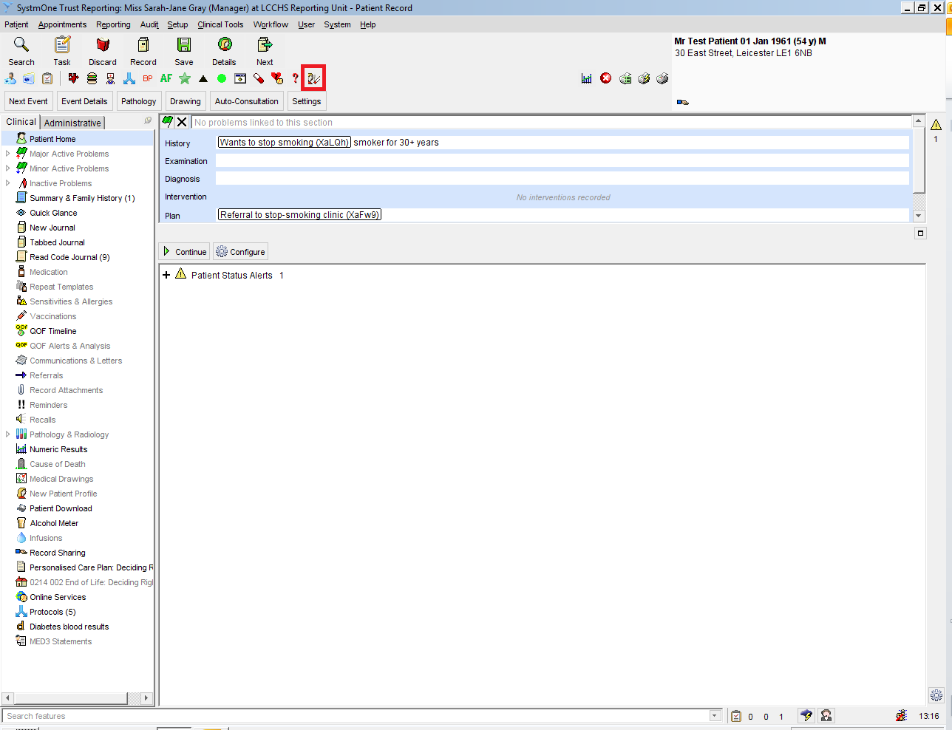
Consultation Template

Slide 8
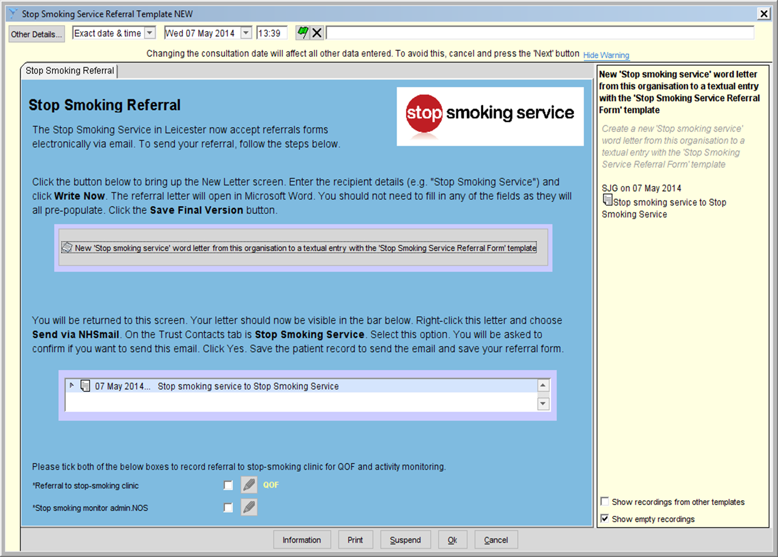

Slide 9
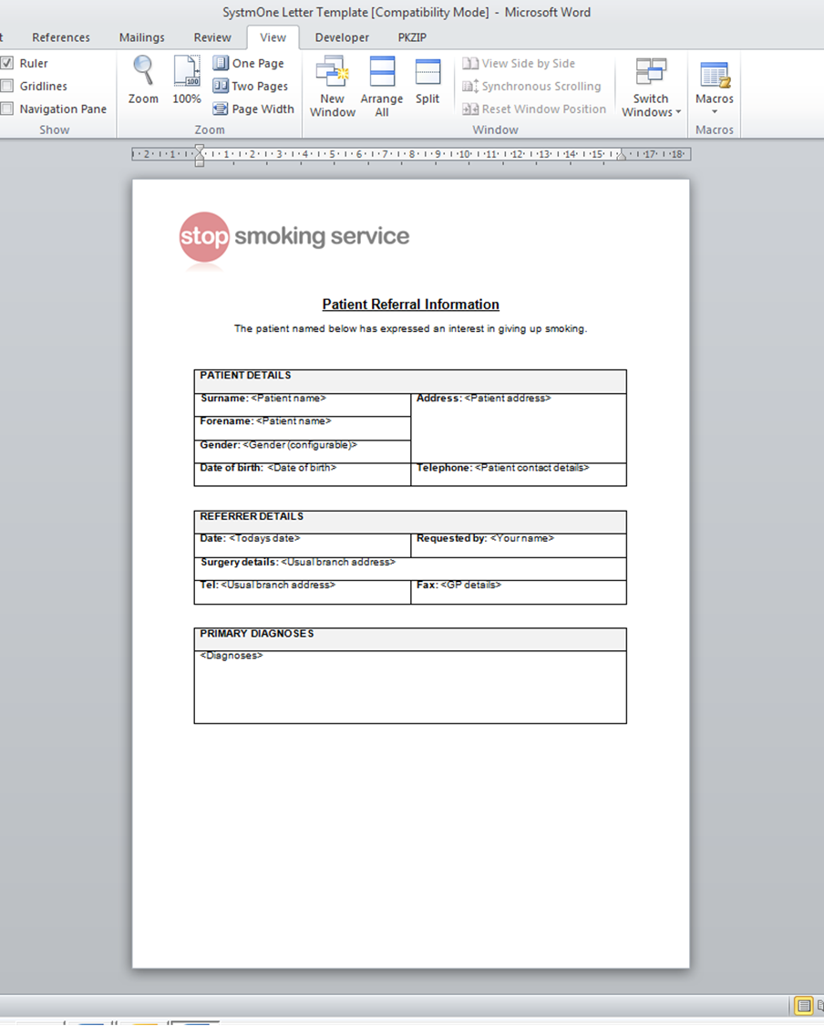
Captured Information

Slide 10
SSS Follow Up
Email account checked daily
Referral info recorded on Quit Manager
Follow up by phone and or letter
Confirm interest
Book client into clinic

Slide 11

Further Support
Training- Brief Opportunistic Training
Encouraged to complete NCSCT VBA
SystmOne support
First point of contact

Slide 12
GP Referral Data

Slide 13
Total SQD vs Total Quit

Slide 14
Total Set a Quit Date | Total 4 Week Quit | Total Not Quit
216 | 120 | 96

Slide 15

The Pros…
Free- no cost
More referrals = more quits
Tracked referrals
Audited
Creates healthy competition
Improved communication
GPs informed of patient outcomes
Smoking status recorded

Slide 16
….The Cons
Poor quality referrals
Incorrect patient contact details
“Over” referral

Slide 17
Testimonials
“I have used the STOP referral template. I found it quick, easy and fluid to use. Many thanks.”
Dr Kidy-General Practitioner (GP)
Sam Cockbill, Medical Secretary
“Referral pathway very quick and easy to use. Isn’t too much trouble to ask patients at reception if they want to be referred as takes seconds to do so and does not hold things up.”

Slide 18
Helena Musker, Practice Nurse
“I am a Practice Nurse RGN. I have found the in-house service which is provided by the stop smoking service a great addition to patient care when promoting healthy lifestyle.
The easy referral template has contributed to a fast and efficient way of introducing patients to a good service. Long may it continue as well as being able to work with great bunch of professional people.”

Slide 19
Tereza Biddle, Patient
“I went in on the Tuesday and was asked by my GP if I was interested in stopping smoking. By Thursday I had a call from the stop smoking service and booked into a clinic. I found the process really quick and easy- Thank you!”

Slide 20
Thank you
zaheera.chatra@leicester.gov.uk
07827 881 443
0116 454 4000

