Slide 1
Smoking Amongst Surgical Patients
Benjamin Bussmann
Fy-1
Whipps Cross Hospital

Slide 2
About Whipps Cross
One of 6 hospitals run by the Barts Health NHS trust
Serves population of 350000 people
642 beds
142 surgical beds
~16000 operations per year
Orthopaedic, vascular, ENT, general surgery, colorectal surgery, urology, trauma and ophthalmological surgery.

Slide 3
Overview
Evidence behind smoking cessation in surgery
Nice Guidance on smoking cessation
Audit methods and results
Implementation

Slide 4
Prospective study in general surgical patients
2989 patients
Results: Smokers had:
  increased in-hospital mortality
  Higher rate of ITU admissions
  Higher rate of LRTI
Emphasises need for smoking cessation programs

Slide 5
Randomised control trial
120 patients for elective knee or hip replacement
  Intervention: counselling, nicotine replacement, at least 50% smoking reduction
Results:
  Smoking cessation interventions reduce postoperative morbidity
  18% vs 52% complication rate
  Biggest effect on wound healing, cardiovascular complications and need for secondary surgery

Slide 6
S
It is safe to stop smoking within 8 weeks prior to surgery

Slide 7
Aim
Find out:
  What is NICE guidance on smoking cessation?
  How well is this issue addressed amongst surgical patients at Whipps Cross?

Slide 8
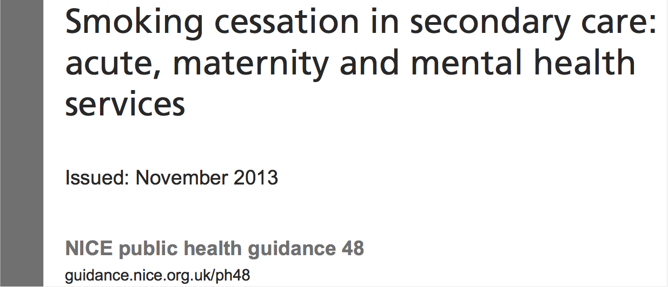
Nice Guidance

Slide 9
PH 48
“This guidance aims to support smoking cessation, temporary abstinence from smoking and smoke-free policies in all secondary care settings”
Aimed at all levels of health care providers
  Doctors (GP and Hospital doctors)
  Nurses (inc. Midwives, Community, Hospital, Pre-assessment)
  Other health care professionals (councilors, health visitors, pharmacists)
  Managers
  Commissioners

Slide 10
PH 48 Recommendations
Provide information for planned or anticipated use of secondary care
Identify people who smoke and offer help to stop
Provide intensive support for people using acute and mental health services
Provide intensive support for people using maternity services
Provide information and advice for carers, family, other household members and hospital visitors
Advise on and provide stop smoking pharmacotherapies
Adjust drug dosages for people who have stopped smoking
Make stop smoking pharmacotherapies available in hospital
Put referral systems in place for people who smoke
Provide leadership on stop smoking support
Develop smokefree policies
Communicate the smokefree policy
Support staff to stop smoking
Provide stop smoking training for frontline staff
Ensure local tobacco control strategies include secondary care
Commission smokefree secondary care services

Slide 11
Methods
Cohort
  All surgical in-patients on surgical wards on 26/2/15 (excluding ophthalmology patients)
  As defined by the handover list
Data collection
  Patient Survey
  Drug charts
  Patients notes

Slide 12
Results
61 patients
Average age of 62.3 years old

Slide 13
Results

Slide 14
Recommendation 1
Provide information for planned or anticipated use of secondary care
  Provide everyone with information and advice before their appointment, procedure or hospital stay.
  Before a planned or likely admission, work with the person to include the management of smoking into their personal care plan.

Slide 15
Recommendation 1

Slide 16
Recommendation 2
Identify people who smoke
  During the first face-to-face contact, ask everyone if they smoke or have recently stopped smoking.
  Record smoking status and the date they stopped.
  If a person is unable to or does not want to talk about smoking, note this in their records and ask about their smoking status at the first available opportunity.

Slide 17
Recommendation 2

Slide 18
Recommendation 3
Provide intensive support for people using acute and mental health services
  Discuss current and past smoking behavior and develop a personal stop smoking plan.
  Provide information about the different types of stop smoking pharmacotherapies and how to use them.
  Offer and arrange or supply prescriptions of stop smoking pharmacotherapies
  Provide information about the types of intensive behavioral support available.

Slide 19
Recommendation 3

Slide 20
Recommendation 6
Advise on and provide stop smoking pharmacotherapies
  Advise people who smoke about licensed nicotine-containing products and other stop smoking pharmacotherapies.
  Encourage people who do not want (or do not feel able) to stop smoking completely to use licensed nicotine-containing products to help reduce cravings to smoke during their stay or visit.
  If stop smoking pharmacotherapy is accepted, ensure that it is provided immediately.

Slide 21
Recommendation 6

Slide 22
Recommendation 8 & 9
Make stop smoking pharmacotherapies available in hospital
  Pharmacotherapies are available
Put referral systems in place for people who smoke
  Very simple and quick referral system available on the intranet

Slide 23
Conclusions
Very good at identifying Smokers
  Due to preadmission and clerking Proformas
Very Poor at encouraging smoking cessation and providing nicotine replacement
    Despite adequate pharmacotherapy available
    Despite existing referral pathways

Slide 24
Implementations
Act in preoperative assessment clinic
  All elective surgery patients are seen by a junior surgical doctor prior to their elective surgery.
  Ideal patient-doctor encounter to address smoking status for elective surgery patients
Act on ward rounds
  All in-patients are seen daily on ward rounds

Slide 25
Implementations
Opt out referral system in preoperative assessment clinic.
  Opt-out approach insured all patients are included

Slide 26
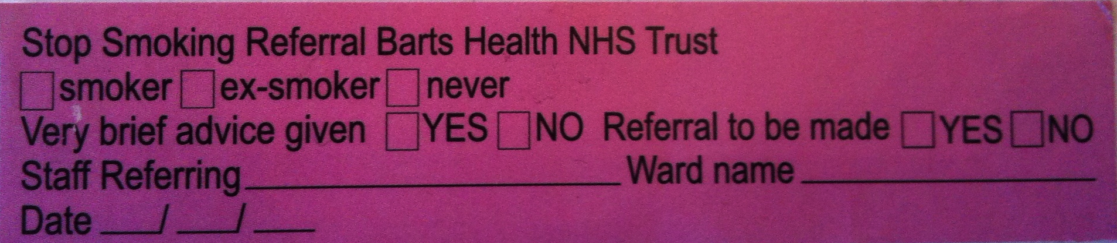
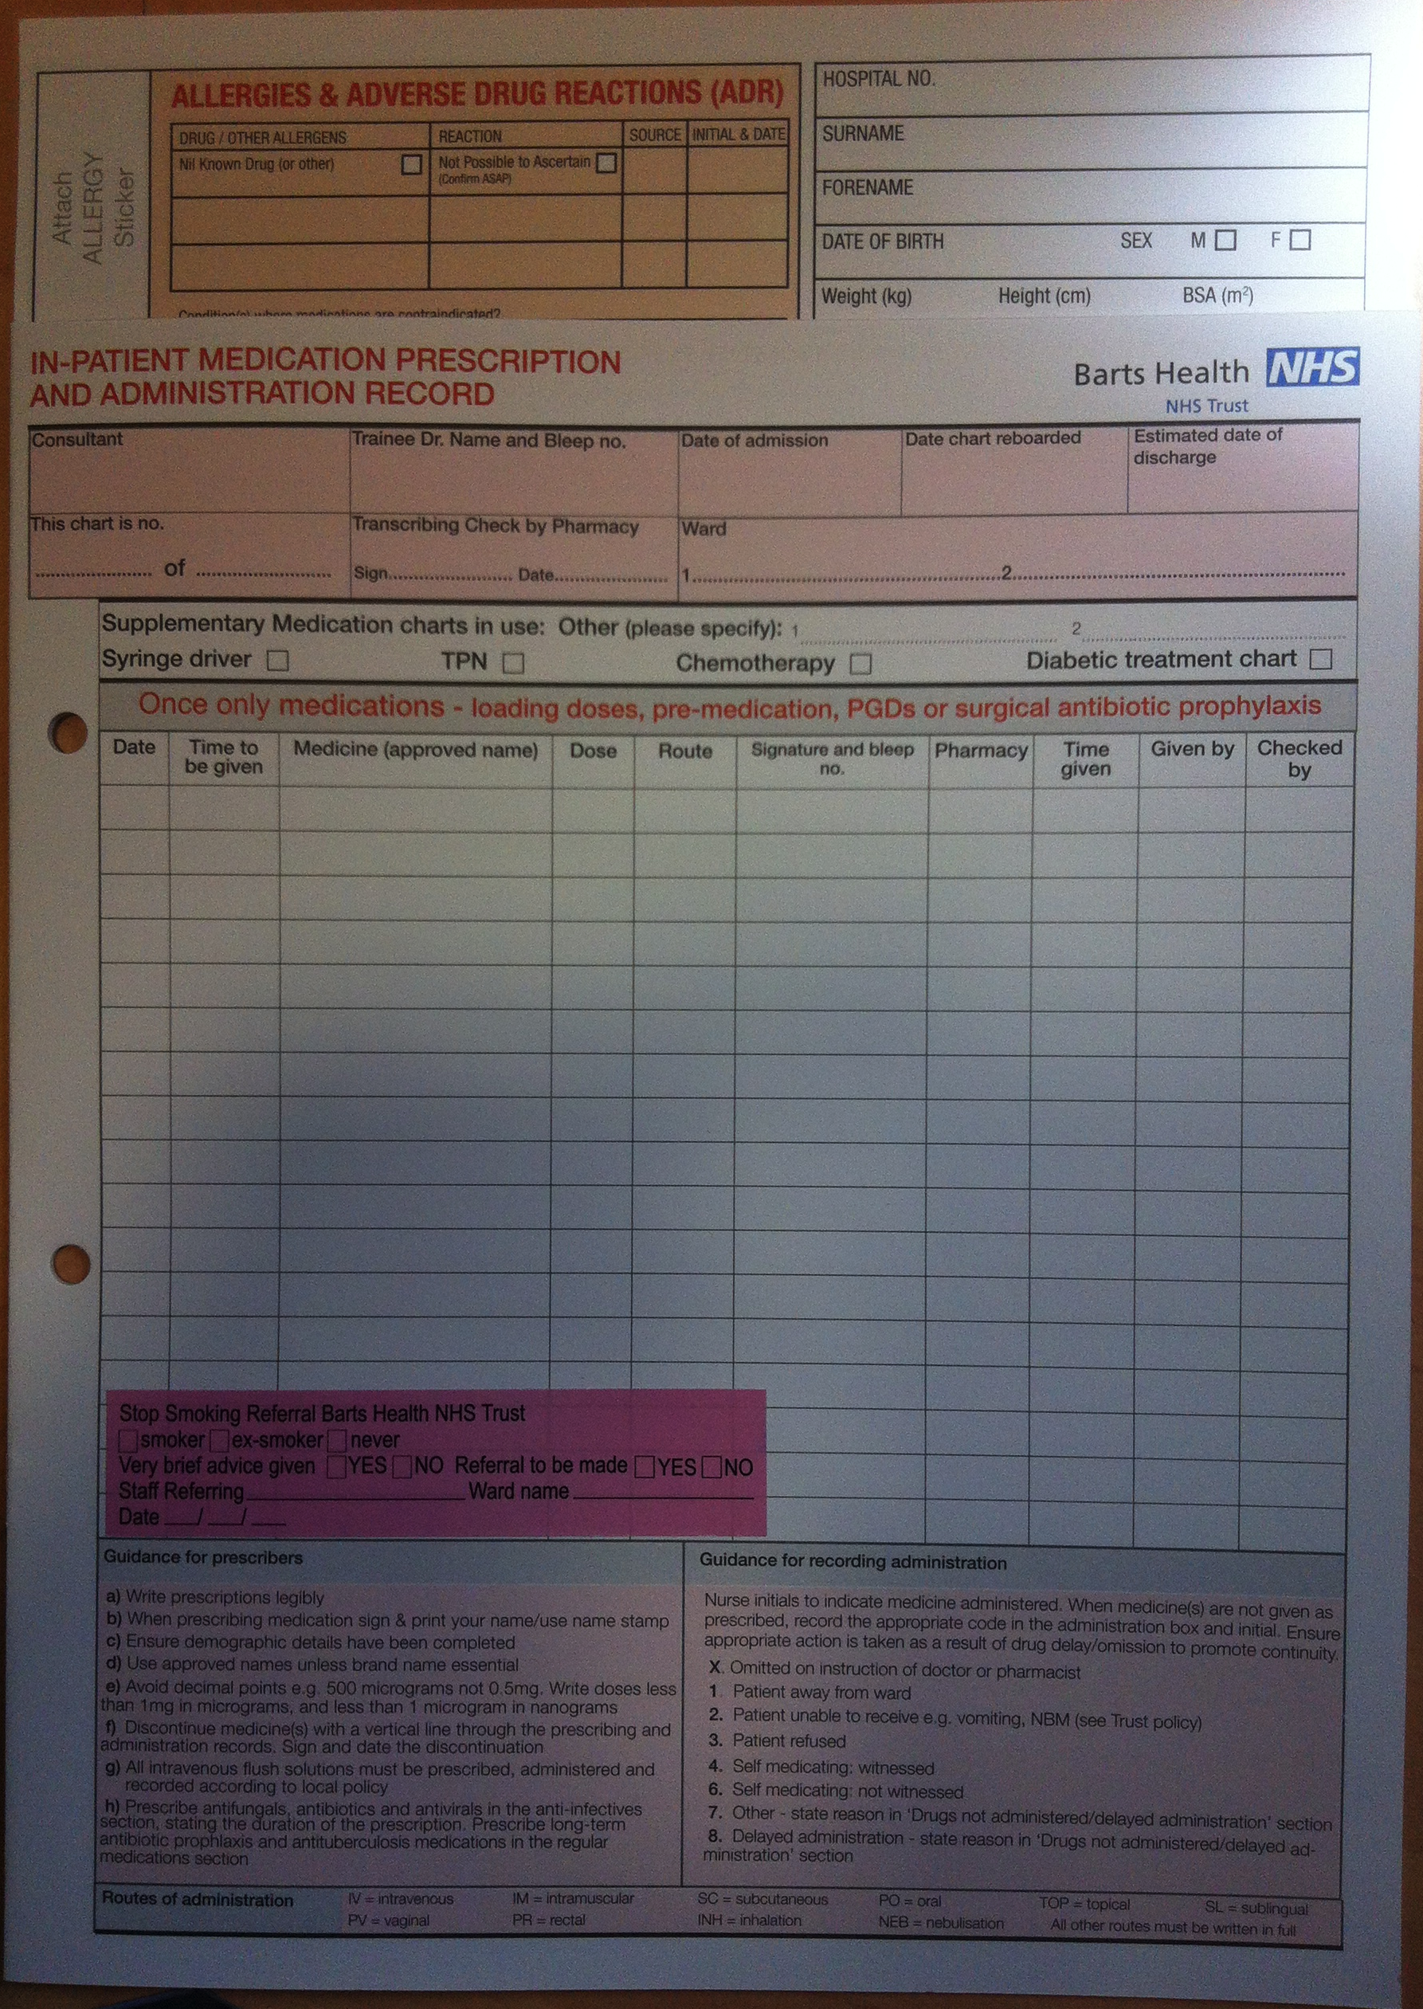
Implementations
Smoking cessation stickers on the front of all drug charts
  Drug charts are reviewed daily as part of ward rounds
  Prompts prescription of nicotine replacement therapy and referral to smoking cessation services.

Slide 27
Thank you
Any questions?

Slide 28
References
Whipps Cross University Hospital Quality Report 17/03/2015
National Institute for Clinical Excellence. "Smoking cessation in secondary care: acute, maternity and mental health services." NICE: http://www. nice. org. uk/nicemedia/live/13017/63459/63459. pdf (2013).
Møller AM, Villebro N, Pedersen T, Tønnesen H. Effect of preoperative smoking intervention on postoperative complications: a randomised clinical trial. Lancet. 2002;359(9301):114-117.
Delgado-Rodriguez M, Medina-Cuadros M, Martinez-Gallego G, Gomez-Ortega A et al. A prospective study of tobacco smoking as a predictor of complications in general surgery. Infection control and hospital, 2003, 24. 1: 37-43
Myers, Katie, et al. "Stopping smoking shortly before surgery and postoperative complications: a systematic review and meta-analysis." Archives of internal medicine 171.11 (2011): 983-989.

